Slide 1

Anatomy of a URL:
Finding Broken Links
This Photo by Unknown Author is licensed under CC BY-SA-NC
Dr. Steve Broskoske
TED 121 Educational Technology
Misericordia University

Slide 2
Anatomy of a URL
What is a URL?
  Stands for uniform resource locator.
  Refers to the Web address of a page on the Web.
What language is used to create Web pages?
  HTML (hypertext mark-up language).

Slide 3
Anatomy of a URL
http://www.servername.domain.countrycode/foldername/filename.html
http://
Hypertext transfer protocol: Tells the Web browser that you are attempting to open a Web document composed in HTML (hypertext mark-up language).

Slide 4
Anatomy of a URL
http://www.servername.domain.countrycode/foldername/filename.html
http://www
Tells browser you are seeking to load information from the World Wide Web.

Slide 5
Anatomy of a URL
http://www.servername.domain.countrycode/foldername/filename.html
http://www.misericordia
Server name: The name of the computer where the Web page is stored.

Slide 6
Anatomy of a URL
http://www.servername.domain.countrycode/foldername/filename.html
http://www.misericordia.edu
.com
.net
.edu
.gov
.org
.mil
Domain name: 3-letter codes that differentiate different types of Web pages.

Slide 7
Anatomy of a URL
http://www.servername.domain.countrycode/foldername/filename.html
http://www.misericordia.edu/users
Folder name: Folder on the server in which files are stored.

Slide 8
Anatomy of a URL
http://www.servername.domain.countrycode/foldername/filename.html
http://www.misericordia.edu/users/module2.html
File name: Name of the Web page file, composed in HTML

Slide 9
Anatomy of a URL
http://www.servername.domain.countrycode/foldername/filename.html
http://www.misericordia.edu/users/
index.html
If you do not type
an HTML file name,
index.html is
opened.
Special case: If the HTML file is given the reserved name index.html, you do not have to type it to view it.

Slide 10


How to Find a Lost Web Page
Backspace
http://www.misericordia.edu/users/module9/quiz
Backspace through a URL by backspacing to the last “/” or “.” and hit enter.
Remember you can click “cached” in Google if a page cannot be found.

Slide 11
Detecting “Fake” Items

Slide 12
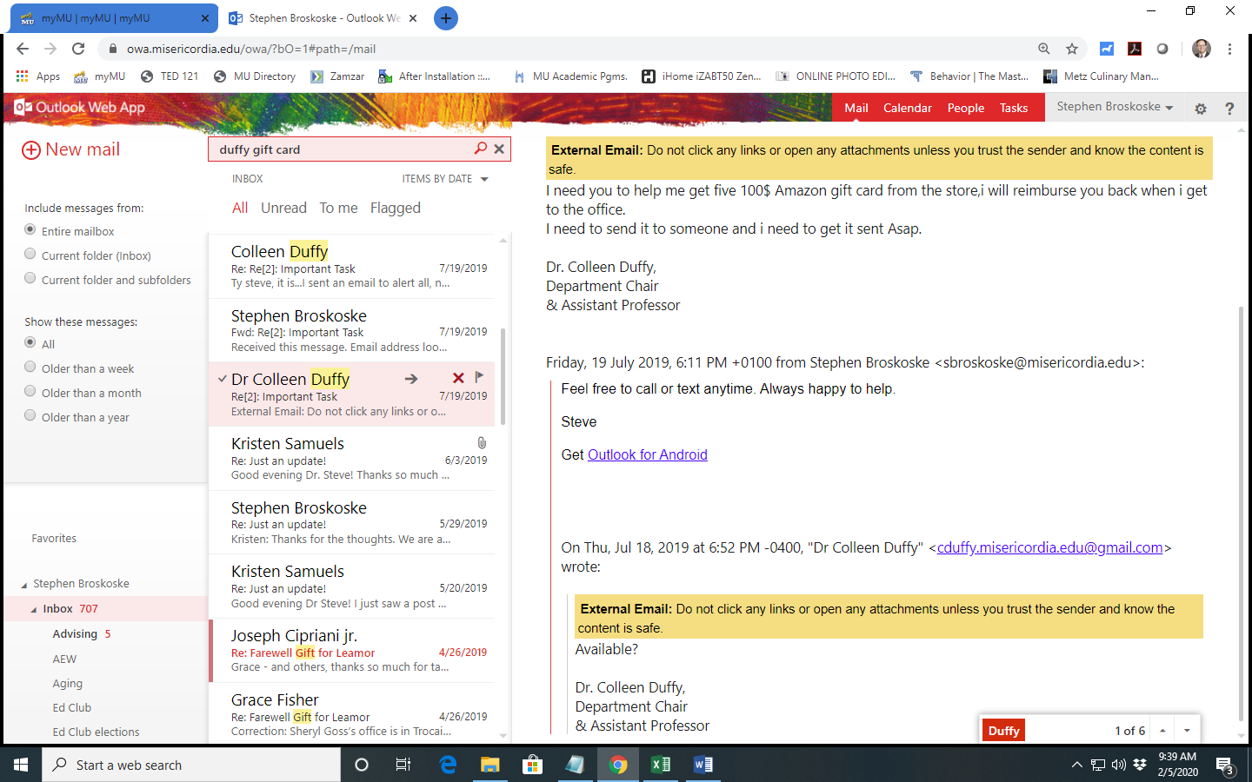
Can You Spot a Fake?

Slide 14
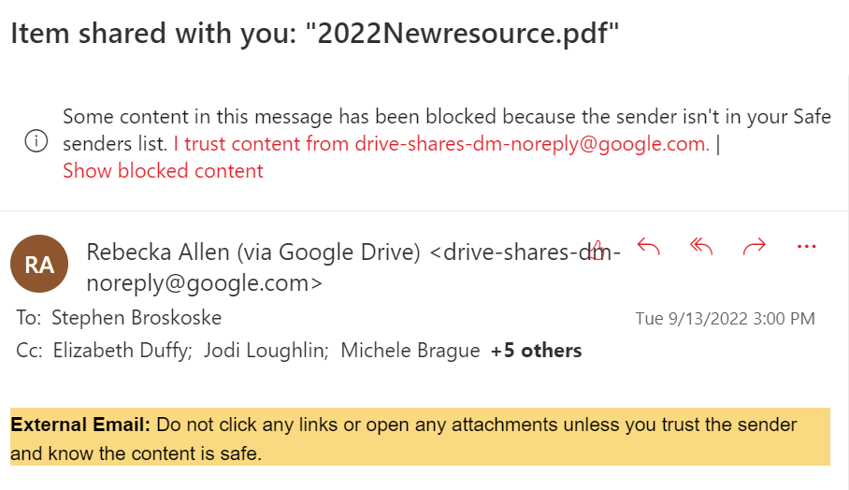
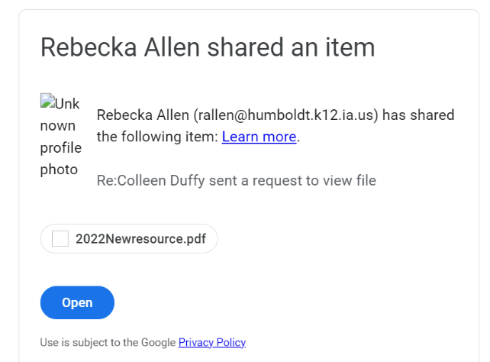

Slide 15
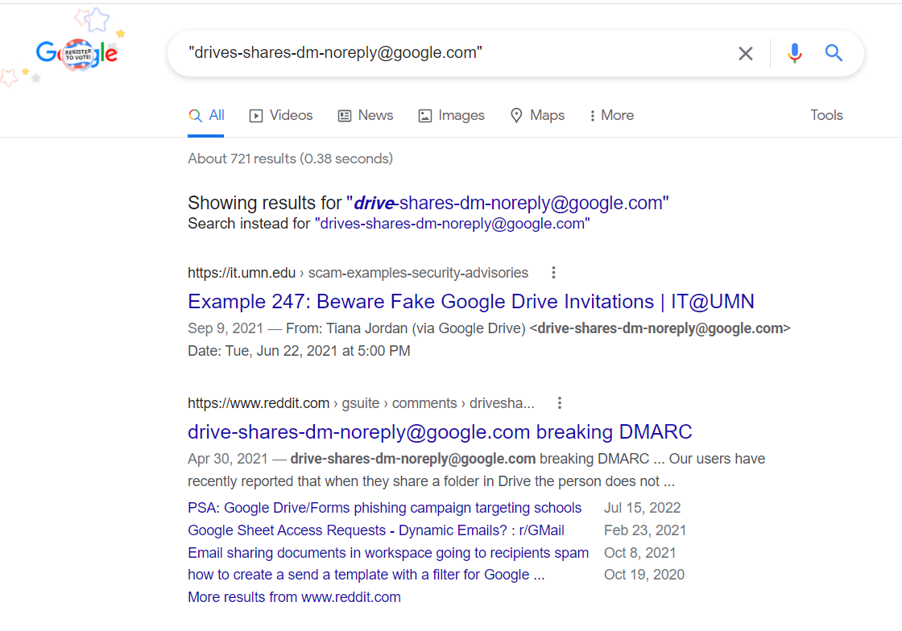

Slide 16
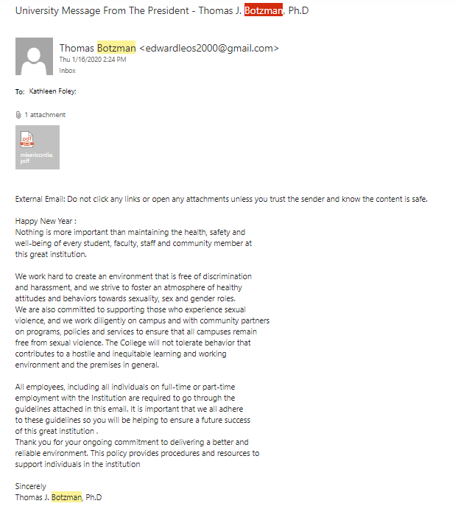

Slide 17
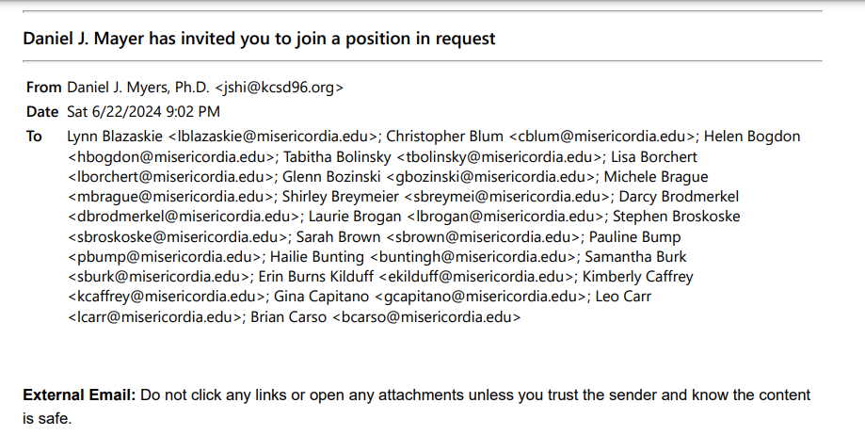
Rest of email on next slide.

Slide 18
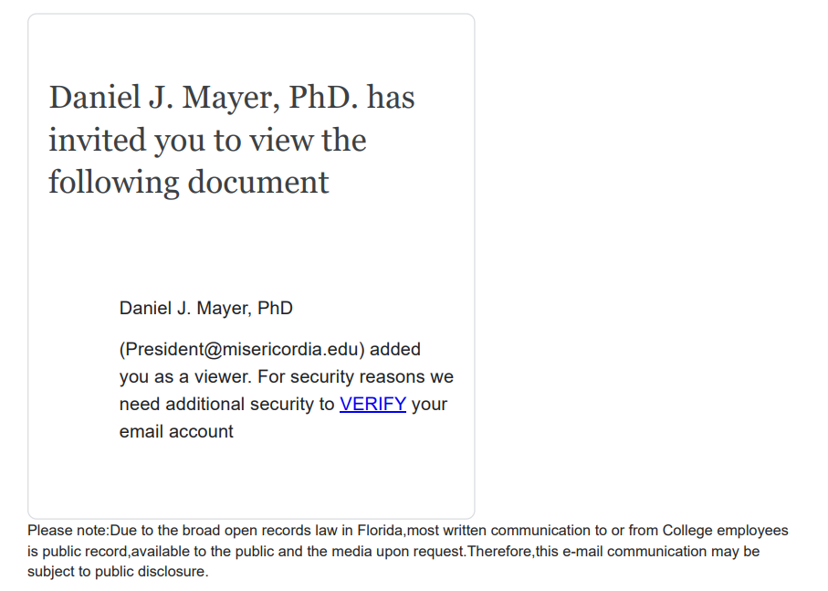

Slide 19
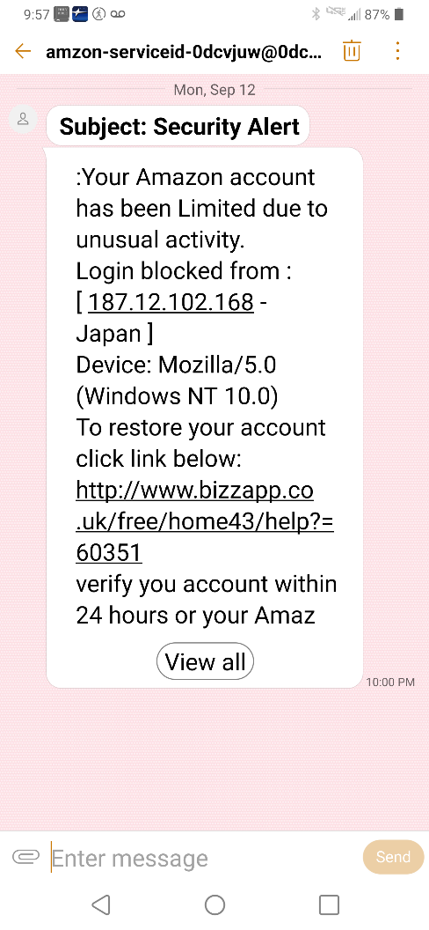
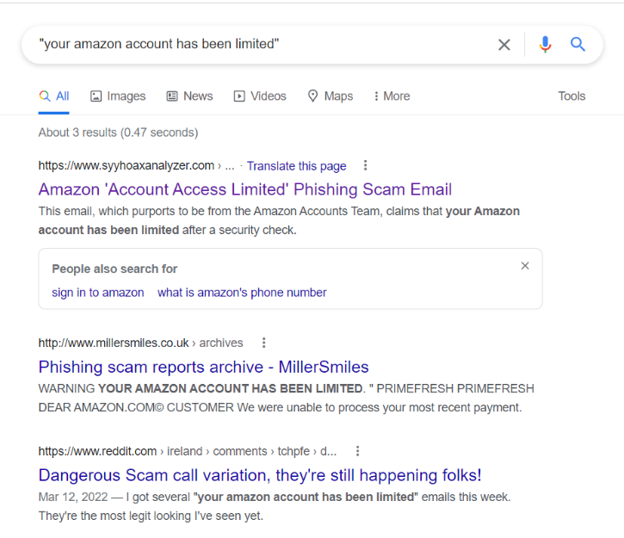
Search for a phrase, URL, or phone number to see if it’s real.
Read about
Amazon Phishing Scam

