Slide 1



Interactive Tools that
Support Assessment
Part 3
Dr. Steve Broskoske
Misericordia University

Slide 2
Tools Outline
What is active learning?
Using video in the classroom
Games
Creating/finding teaching resources

Slide 3
Active Learning
Active learning can be defined as “students doing things and thinking about what they are doing” (Bonwell and Eison, 1991).
There is a growing body of literature that suggests that students profit from “pedagogies of engagement” (Smith, Sheppard, Johnson, & Johnson, 2005).

Slide 4
Active Learning
Active learning occurs when students “are interacting with teachers, classmates, and environments or undertaking projects rather than passively taking in whatever a teacher tells them” (PCAST, 2010, p. 5).
Active learning increases student engagement and fosters and supports acquisition of these skills.

Slide 5
Active Learning
Teaching in our modern society involves more than presenting factual information through direct instructional techniques.
Careers that today’s students will seek after they graduate high school or college require the development of skills such as critical thinking, collaboration, and problem-solving (DeLoatch, 2015).

Slide 6
Active Learning
Evidence strongly indicates that the most effective pedagogy in STEM education is cooperative, collaborative, active, and inquiry-based learning methods, because these approaches increase learning and retention of information, and because they support higher order thinking skills (PCAST, 2010).

Slide 7
Using Video in the Classroom

Slide 8
Instructional Video
Khan Academy
WatchKnowLearn
TED Talks
NeoK12
videolectures.net
PBS Learning Media
Listing of Educational Video Sites
(RefSeek)

Slide 9
Using Video Interaction Tools
Increasingly, teachers are using video to teach in their classrooms.
If you assign video for an assignment:
  How can you determine if students actually watched the video?
  How can you increase learning from video?

Slide 10
Using Video Interaction Tools
Research (Vural, 2013) has suggested that a question-embedded interactive video environment:
  Promotes student learning from video.
  Improves the amount of interaction of the student.
  Improves the amount of time spent with the learning materials.
  Can lead to better learning outcomes.
  Can lead to higher learner achievement.
Notes:
https://files.eric.ed.gov/fulltext/EJ1017292.pdf

Slide 11
Purpose of Interaction Tools
Turn a video from a passive to an interactive experience.
More deeply engage learners in a flipped classroom.
Increase understanding of content.
Assess student comprehension of video content.
Increase accountability of students.

Slide 12


Creating Interactive Video
Two apps can help you hold students accountable while increasing learning from video.

Slide 13
Make Videos Interactive
Allows a teacher to:
  Select a video (YouTube, Khan Academy, your own).
  Crop the video (only use portion desired).
  Record your voice over a video.
  Embed quiz questions.
  View results.
PlayPosit
EDpuzzle

Slide 14
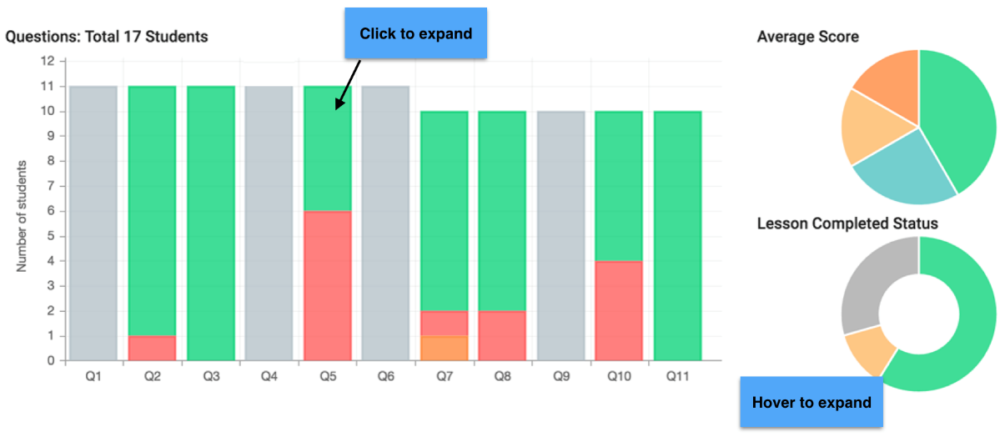
Grading and Analytics
Online video tools allow you to view student grades and analytics for the class.

Slide 15
Overview of Using PlayPosit
Select design to create a video bulb.
Enter a YouTube video URL and lesson details to get started.
Crop video if needed.
Add questions sporadically throughout video.
Assign video to class or share URL.

Slide 16
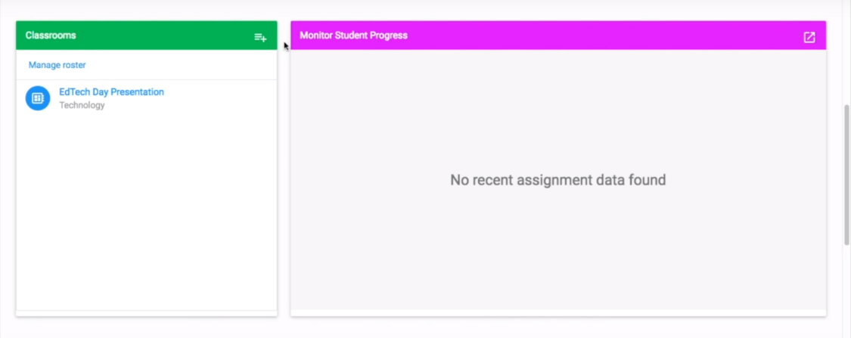
Create a Class Folder
You can create a class (a folder for each course) to help you organize videos.

Slide 17
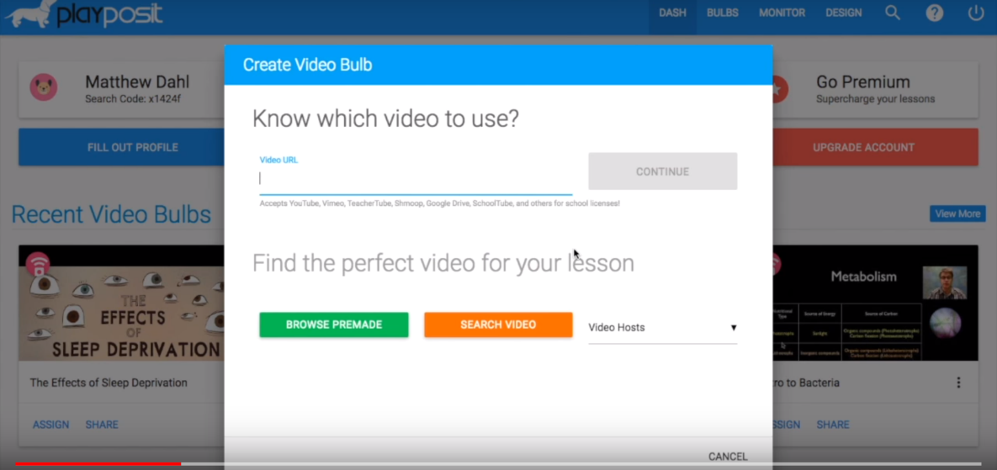
Select a Video
Click “design” to begin.
Add a URL for a YouTube video (could be a video that you created).

Slide 18
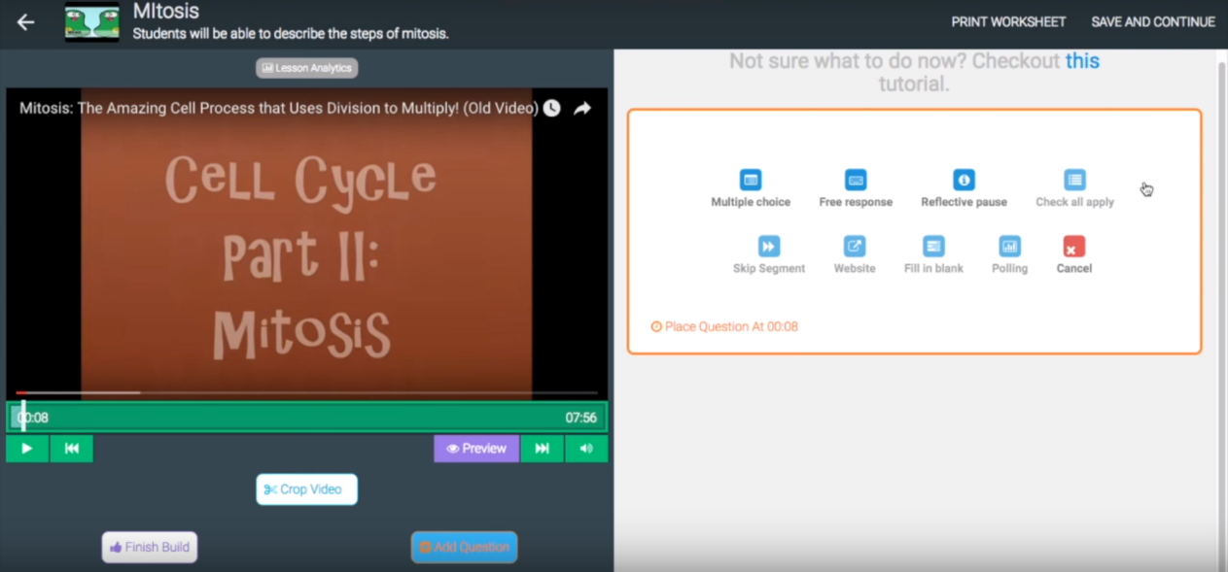
Crop and Add Questions
Choose from 3 question types for free version, add the rest if you go Pro.
Crop a video.
Add a question.

Slide 19
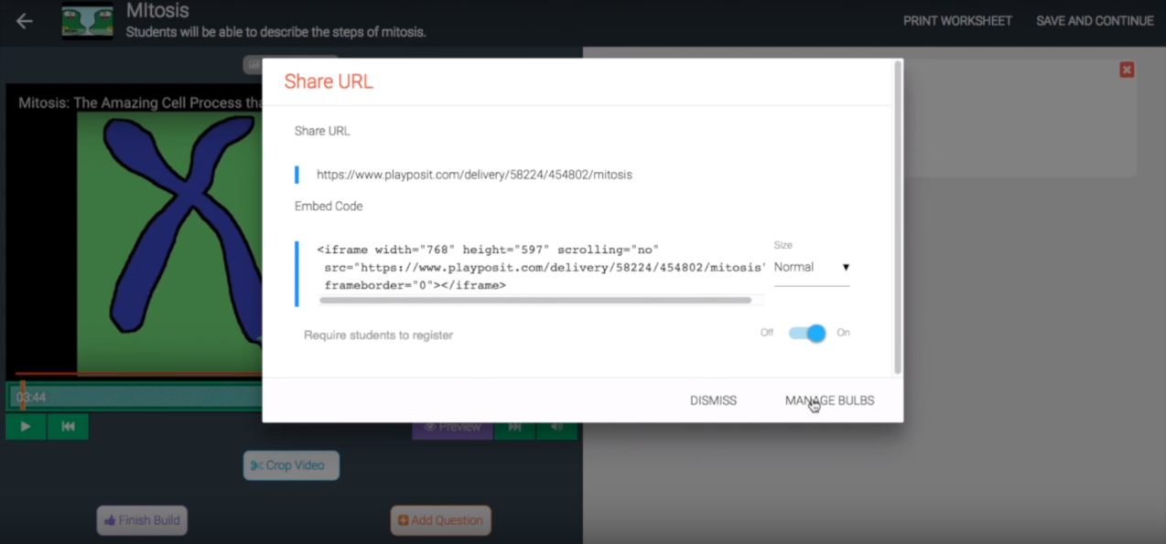
Assign Video to Students
Either assign the video to a class OR copy the Share URL and send to students.

Slide 20
Games

Slide 21
Games Are Effective
Use of academic games, such as adaptations of Family Feud, $100,000 Pyramid, Jeopardy, and Millionaire, is associated with a gain of 20-percentile points in student achievement.
(Marzano, 2010)

Slide 22

Games Are Effective
Game show review games are very effective because students already understand and may be interested in the game.

Slide 23
Jeopardy Game:
Jeopardy Labs
Jeopardy Labs (Web page)
  Create a jeopardy-type game online.
  Uses:
    Great for review.
    Great way to engage students in class discussion.
jeopardylabs.com

Slide 24
Jeopardy Game:
FlipQuiz
FlipQuiz (Web page)
  Create a Jeopardy-type review game.
  Pro version: Adds buzzer mode along with many ways for students to review content.
playfactile.com/flipquiz

Slide 25
Using Online Resources to
Create a Review Game
Play a review game based on a TV gameshow using one of the following free PP templates.
  Jeopardy
  Family Feud
  Wheel of Fortune
  Deal or No Deal
  The Price Is Right
  Millionaire
  Cash Cab
thebalance.com/
free-powerpoint-games-for-teachers-1358169

Slide 26

Play Online
Drill & Practice Games
Academic Skill Building Games (Website)
  Make learning fun by leading your students to engage in drill and practice through various games and fun activities.
Arcademics.com

Slide 27
Create Your Own Games
This free tool by WISC-Online will allow a teacher to create his/her own online game.
Many game types are available:
  Baseball, beekeeper, bingo, build your knowledge, chakalakala, crosswords, fashcards, hangmoon, have U heard, Jeopardy, matching, memory match, rapid fire, sequence, slithery snake, spin to win, squid hunter, tic-tac-toe, timeout, triviatron.
Play a Game
Build a Game
Notes:
https://www.wisc-online.com/

Slide 28
Creating/Accessing
Teaching Resources

Slide 29
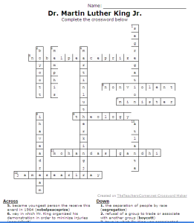
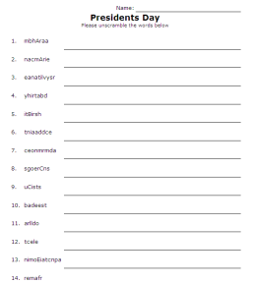
The Teachers Corner
Create crosswords
(worksheets.theteacherscorner.net/make-your-own/crossword)
Create word scramble
(worksheets.theteacherscorner.net/make-your-own/word-scramble)
The Teachers Corner

Slide 30
Education World
Use the math generator to create math worksheets OR access online educational games in many content areas (K-12).
Math Worksheet Generator
Online Educational Games
Notes:
https://www.education.com/worksheet-generator/math/
Online educational games
https://www.education.com/games/

Slide 31
Create Bingo Cards
Bingo Baker
Create bingo cards for educational use.
Base cards on content (like vocabulary words or math problems) or base them on holidays.
Bingo Baker

Slide 32
Create Word Clouds
WordCouds.com/ (Website)
  Spice up handouts and teaching materials.
  Use in teaching:
    What did you learn today?
    After reading a story:
      Tell the main point.
      Who is the most important character?
    Paste in the text of a document to determine most commonly used words.
wordclouds.com
Notes:
https://www.wordclouds.com/

Slide 33
Online Learning Resources
IXL.com
Online teaching/learning resources.
Free and pro membership.
Ties content to textbooks and PA standards.
ixl.com

Slide 34
Conclusion
Assessment used to consist of written homework, term papers, and written tests.
Thanks to technology, we can provide many ways for our students to demonstrate their learning, and aid in teacher assessment of student learning.

