Slide 1



Interactive Tools that
Support Assessment
Part 2
Dr. Steve Broskoske
Misericordia University

Slide 2
Tools Outline
“Creative” Alternatives to Writing Assignments
  Create trading cards (ReadWriteThink.org)
  Create post cards (ReadWriteThink.org)
  Create a comic strip (Lywi.com)
  Become an author
    Early childhood (Storybird.com)
    ML and SecEd (StoryJumper.com)
Teaching tool collections:
  SuperTeacherTools.us
  4Teachers.org
Locating Content Apps:
  Common Sense Education

Slide 3

Interactive Tool Exploration
In small groups, let’s explore some tools you can use with students in the classroom to promote an active classroom.
Google Doc on Blackboard.

Slide 4
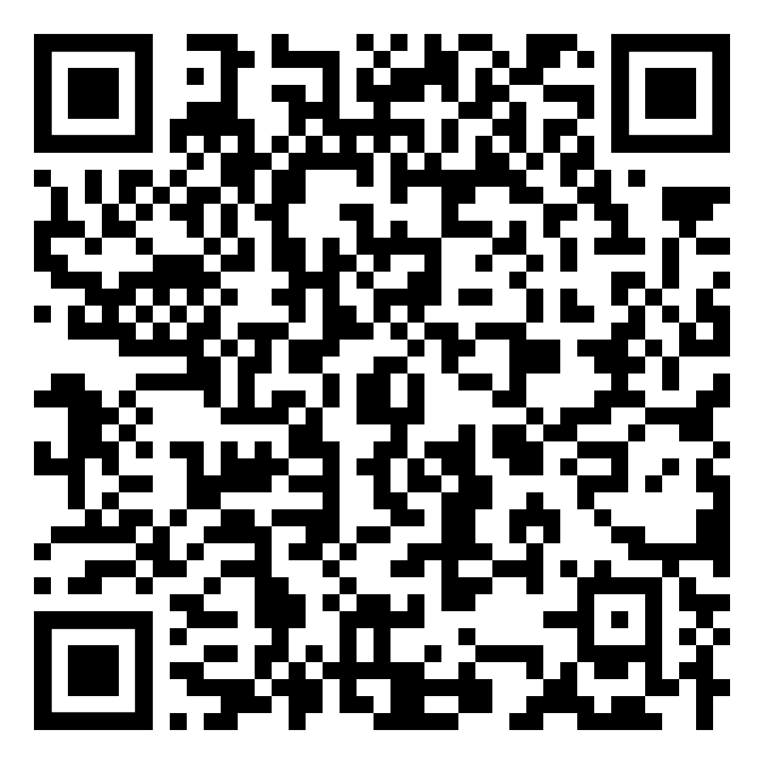
Shared Document
Notes:
https://docs.google.com/document/d/1F3lMF_Z91P8hfZ8til4_ebEUPaffJ2AAbinyyHRMCt8/edit?usp=sharing

Slide 5
“Creative” Alternatives to Writing Assignments
Select and explore at least
one of the following tools.

Slide 6
Create Trading Cards
Trading Card Creator: Students research facts on a real or fictional person, place, object, event, or abstract concept. They then create a trading card that describes the person or concept.
Trading Card Creator
at ReadWriteThink.org

Slide 7
Create Post Cards
PostCard Creator: Students research a famous place and create a postcard that describes the place.
  Students can illustrate the front of their postcards by drawing a picture, creating a collage of images, or through clipart.
Postcard Creator
at ReadWriteThink.org

Slide 8
Create a Comic Strip
Lywi (Website)
Allow your students to create cartoons/comic strips online.
Easy way to express ideas without requiring a talent to draw.
Lywi.com

Slide 9

Become an Author
Storybird.com (Website)
  Focuses on visual storytelling.
  Library of 10,000+ images inspires young writers to create picture books, comics, longform chapter books, poetry, and flash fiction.
  Writing curriculum offers 600+ lessons, quizzes, and writing prompts created by experienced educators and expert authors, aligned with Common Core educational standards.
Story Bird

Slide 10
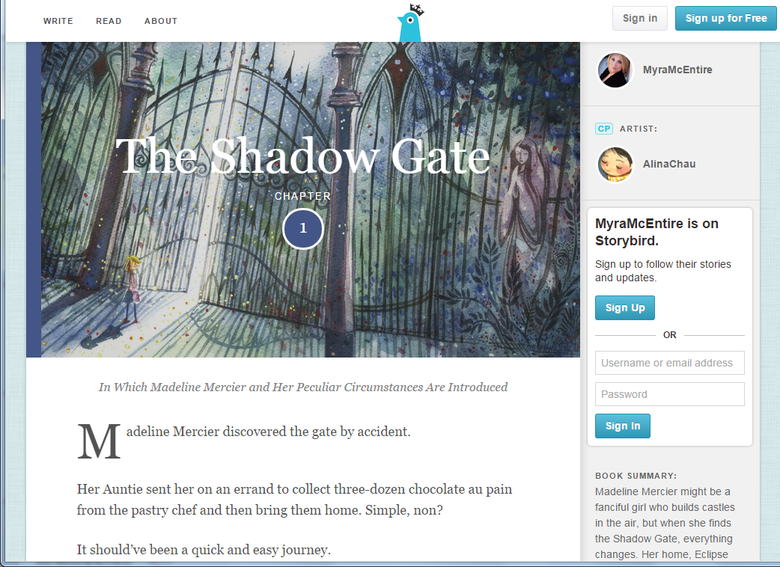

Slide 11
Become an Author
StoryJumper.com (Website)
  Students write, design characters, and add their voice to their book. Grades 1-8.
  Print options:
    Free: Online ebook.
    $2.99: PDF eBook OR audio book.
    $7.99: Video book.
    $14.99: Paperback book.
    $27.99: Hardcover book.
StoryJumper

Slide 12
Educational Games

Slide 13

Play Online
Drill & Practice Games
Academic Skill Building Games (Website)
  Make learning fun by leading your students to engage in drill and practice through various games and fun activities.
Arcademics.com
Notes:
https://www.arcademics.com/

Slide 14
Create Your Own Games
This free tool by WISC-Online will allow a teacher to create his/her own online game.
Many game types are available:
  Baseball, beekeeper, bingo, build your knowledge, chakalakala, crosswords, fashcards, hangmoon, have U heard, Jeopardy, matching, memory match, rapid fire, sequence, slithery snake, spin to win, squid hunter, tic-tac-toe, timeout, triviatron.
Play a Game
Build a Game
Notes:
https://www.wisc-online.com/
https://www.wisc-online.com/gamebuilder#google_vignette

Slide 15
Teaching Tool Collections

Slide 16

Super Teacher Tools
Games: hundreds of academic games covering many subject areas.
Classroom tools: random name generator, group generator, seating chart maker.
Gadgets: QR code generator, timers.
superteachertools.us

Slide 17
4Teacher Tools
Funded Web site that provides free tools to K-12 teachers and students.
Tools:
  Teaching tools and resources.
  Tools to help organize the classroom.
  Assessment tools.
  Tools to assist students.
4teachers.org

Slide 18
Locating New Content Apps

Slide 19

Source of Content Apps
Common Sense Education (Click on Ed Tech Ratings and Reviews.)
  Provides ratings and reviews of apps, games, and websites, designed to help teachers find and use the best digital tools for their classrooms.
  Like the TripAdvisor of educational content apps.
commonsense.org/education

Slide 20
Conclusion
Assessment used to consist of written homework, term papers, and written tests.
Thanks to technology, we can provide many ways for our students to demonstrate their learning, and aid in teacher assessment of student learning.

