Slide 1

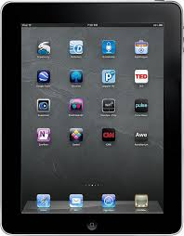

Interactive Tools that
Support Assessment
Dr. Steve Broskoske
Misericordia University

Slide 2

Introduction
Assessment: Process of gathering information about students in order to make decisions about their education.
Due to evolving technology, teachers now have many ways to:
  Have students demonstrate their learning.
  Assess student progress in learning.

Slide 3
Introduction
Students all learn in different ways. Students should be able to demonstrate what they have learned in different ways.
Verbal-Linguistic | Word Smart | With Words
Logical-Mathematical | Logic Smart | With Reasoning
Visual-Spatial | Picture Smart | With Pictures
Musical-Rhythmic | Music Smart | With Sounds
Interpersonal | People Smart | With Others
Intrapersonal | Self Smart | Within Oneself
Bodily-Kinesthetic | Body Smart | With Movement
Naturalist | Nature Smart | With Nature

Slide 4
Tools Outline
Sharing links with students
  Symbaloo
  QR codes (QR Code Monkey)
Creating/accessing teaching resources
  The Teacher’s Corner
  Resources at Education.com
  Bingo Baker
  Word Clouds.com
Simulated social media learning tools
  Twister
  Fakebook
  Texting (SMS) generator
Create a rubric (Rubistar)

Slide 5
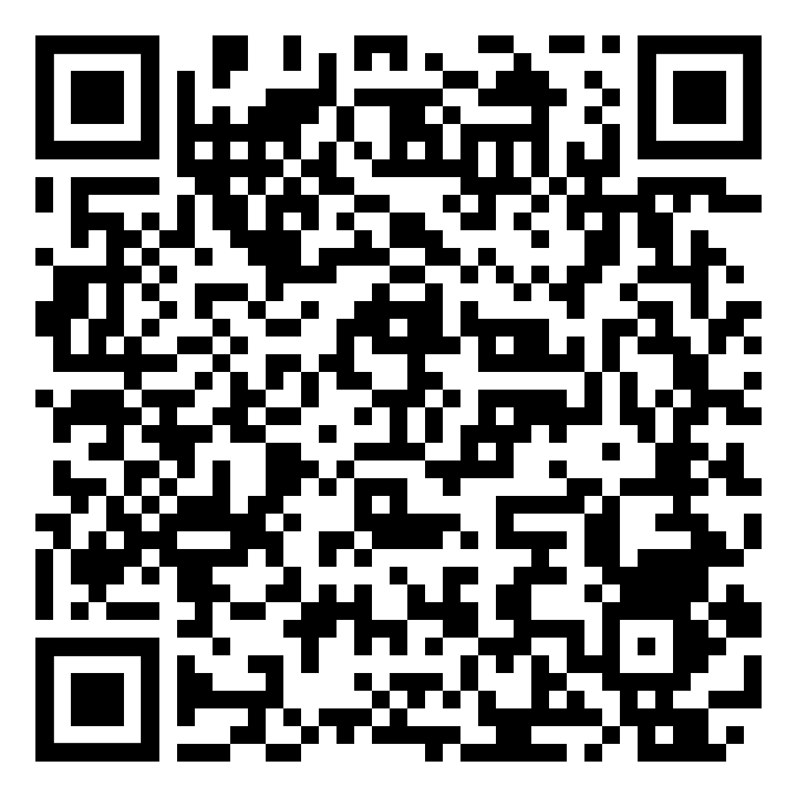
Interactive Links
Notes:
https://docs.google.com/document/d/1CqzWz5GhRykG7WV0hBIwD_-dKRBGNCT0aA-cGZAhid4/edit?usp=sharing

Slide 6
Sharing Links with Students

Slide 7
Provide Convenient Links:
Symbaloo
Symbaloo.com (Website)
  You can create a page of icons which are links to Web sites that you use in your class.
  You can give your students an assignment to create a Symbaloo of links as part of your class.
Teacher Links
Dr. Steve’s Symbaloo
Notes:
https://www.symbaloo.com/shared/AAAABVUKBb4AA41_zxijRA==

Slide 8
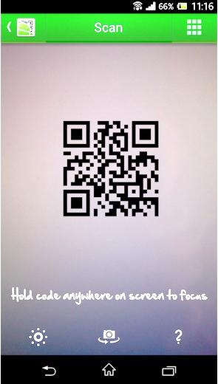
Using QR Codes in the Classroom
Most devices come equipped with their own QR code scanner.
If needed, download a QR code scanner from your appropriate app store.

Slide 9
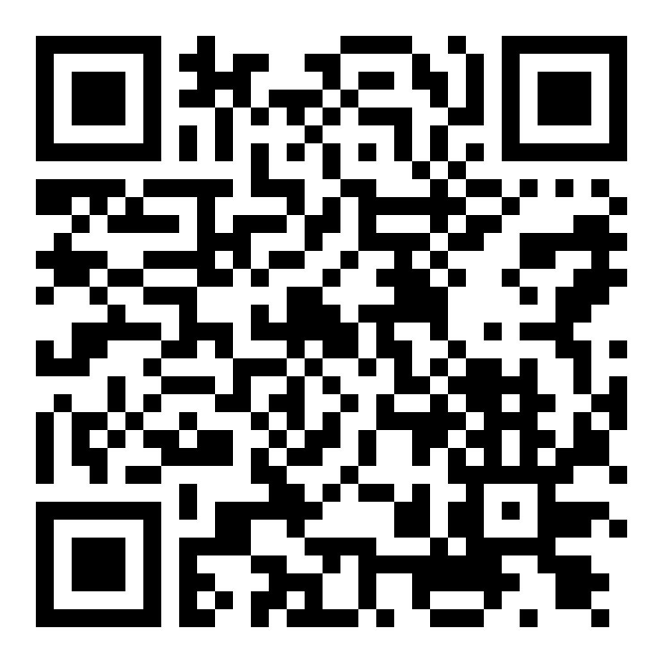
Using QR Codes in the Classroom
In addition to sharing URLs with students, QR codes can also be used to share:
  Text:
    Ask a question.
    Present some information.
    Give clues in a game or
    scavenger hunt.
  YouTube video.
  Location on a map.
Notes:
Gutenberg question

Slide 10
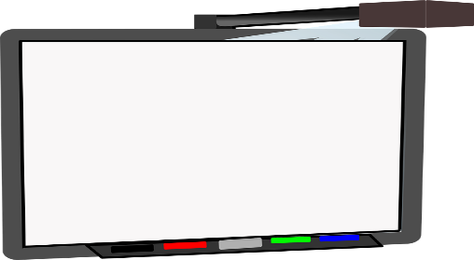
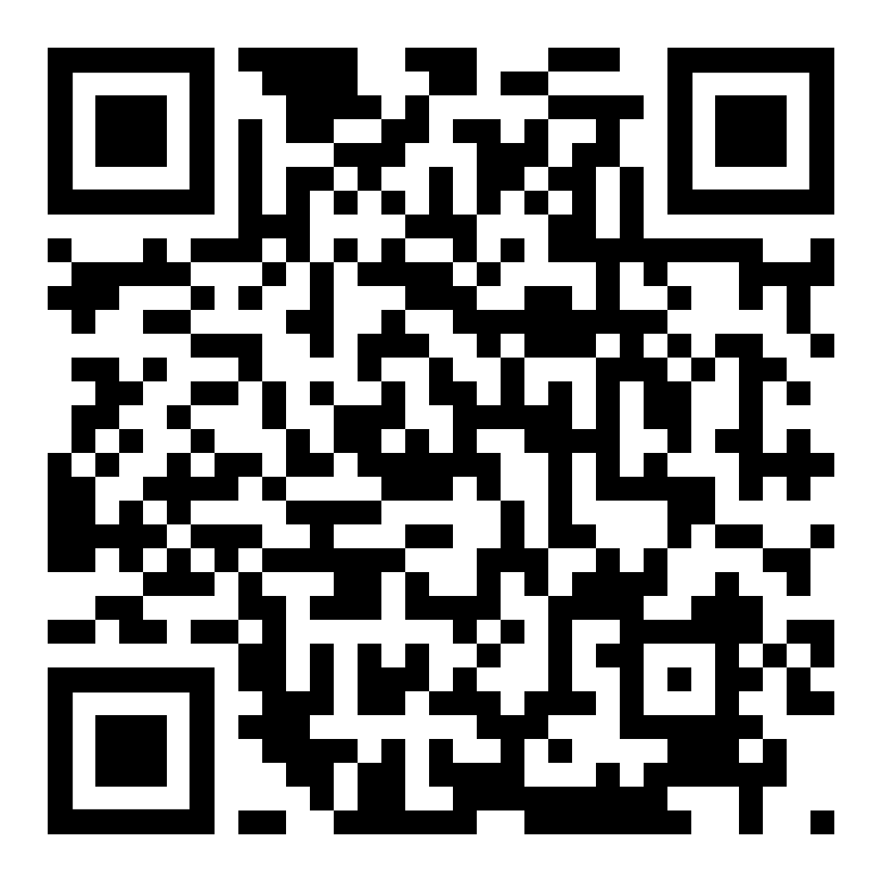
Using QR Codes in the Classroom
You can present them in many ways:
  Display on as part of a projected presentation.
  Print and hang up around a classroom.
  Place a number of QR codes on a printed handout.
Notes:
TED 121 Web page

Slide 11
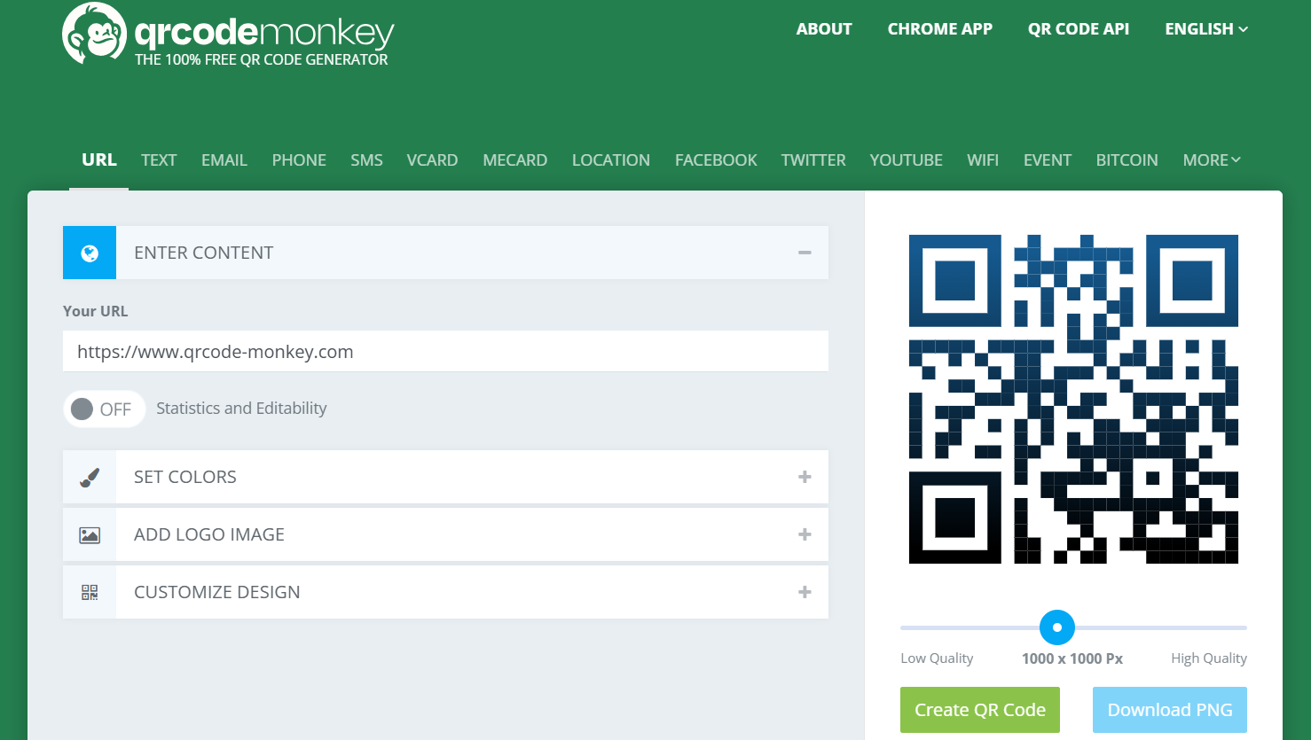
Explore QR Code Monkey
www.qrcode-monkey.com
Notes:
Gutenberg question

Slide 12
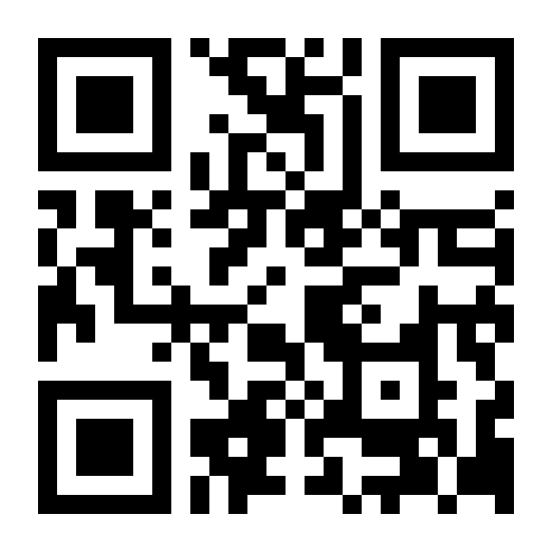
QR Code Monkey

Slide 13
Creating/Accessing
Teaching Resources

Slide 14
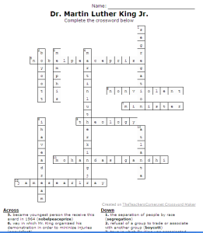
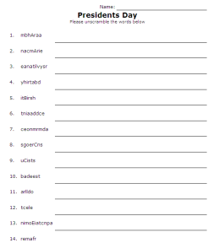
The Teachers Corner
Create crosswords
(worksheets.theteacherscorner.net/make-your-own/crossword)
Create word scramble
(worksheets.theteacherscorner.net/make-your-own/word-scramble)
The Teachers Corner

Slide 15
Resources at Education.com
Use the math generator to create math worksheets OR access online educational games in many content areas (K-8).
Math Worksheet Generator
Online Educational Games
Notes:
https://www.education.com/worksheet-generator/math/
Online educational games
https://www.education.com/games/

Slide 16
Create Bingo Cards
Bingo Baker
Create bingo cards for educational use.
Base cards on content (like vocabulary words or math problems) or base them on holidays.
Bingo Baker

Slide 17
Create Word Clouds
WordCouds.com/ (Website)
  Spice up handouts and teaching materials.
  Use in teaching:
    What did you learn today?
    After reading a story:
      Tell the main point.
      Who is the most important character?
    Paste in the text of a document to determine most commonly used words.
wordclouds.com
Notes:
https://www.wordclouds.com/

Slide 18
Simulated Social Media Learning Tools

Slide 19
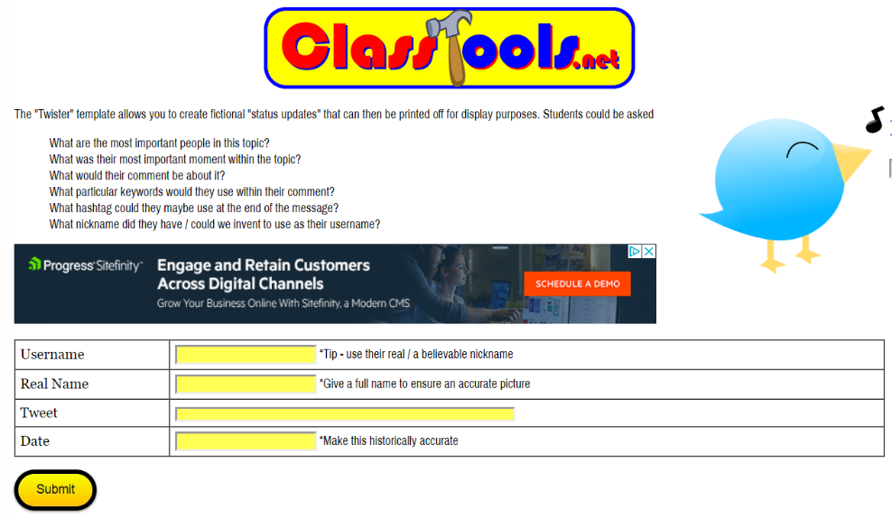
Twister
Social Media Simulated Tools
Use Twister to allow students to create fictional “status updates” that can then be printed off.
Create tweets for fictional, literary, or historical characters.
classtools.net/
twister/
Notes:
https://www.classtools.net/twister/

Slide 20
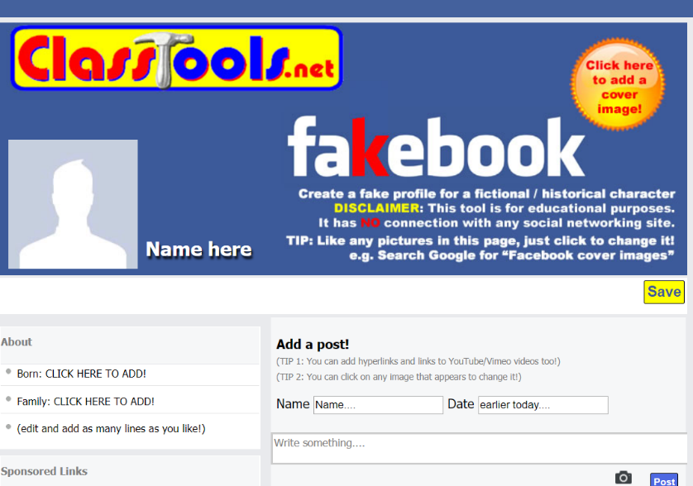
Fakebook
Social Media Simulated Tools
Create a fake profile for a fictional, literary, or historical characters.
classtools.net/
FB/home-page
Notes:
https://www.classtools.net/FB/home-page#google_vignette

Slide 21
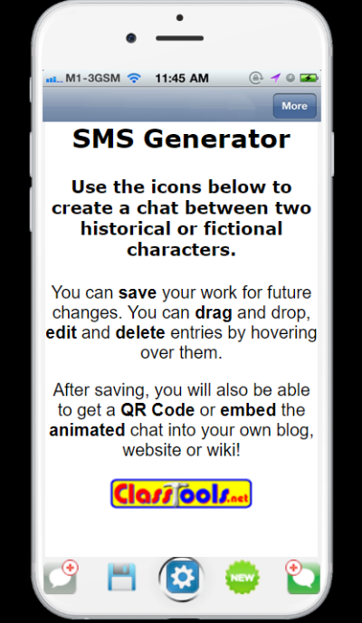
Texting (SMS) Generator
Social Media Simulated Tools
Create a simulated text message discussion between 2 characters (fictional, literary, or historical characters).
classtools.net/SMS
Person 1’s text.
Person 2’s text.
Notes:
https://www.classtools.net/SMS/

Slide 22
Try It: Social Media Tools
Try It!
Either individually or in a group of 2, try one of the following:
  Select Fakebook.
    Choose an historical or famous person and create a Fakebook page.
  Select SMS Generator (texting).
    Choose 2 famous people and generate a conversation between them.

Slide 23
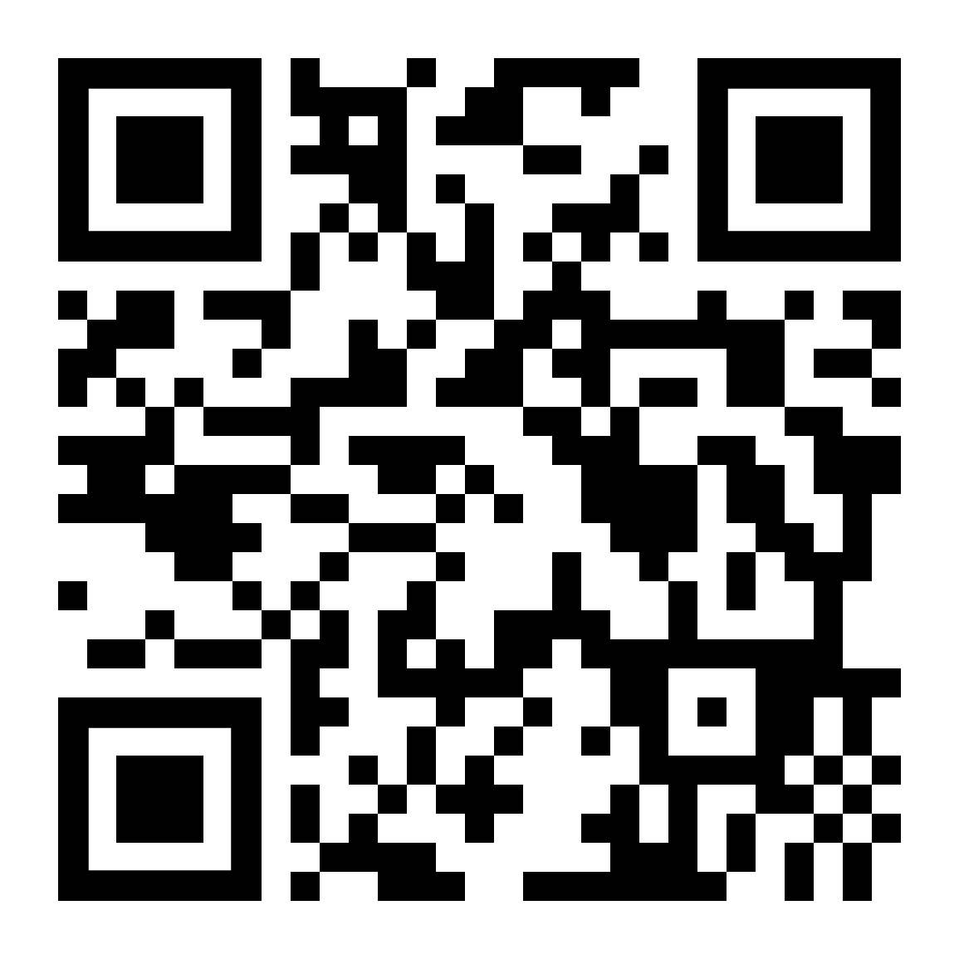
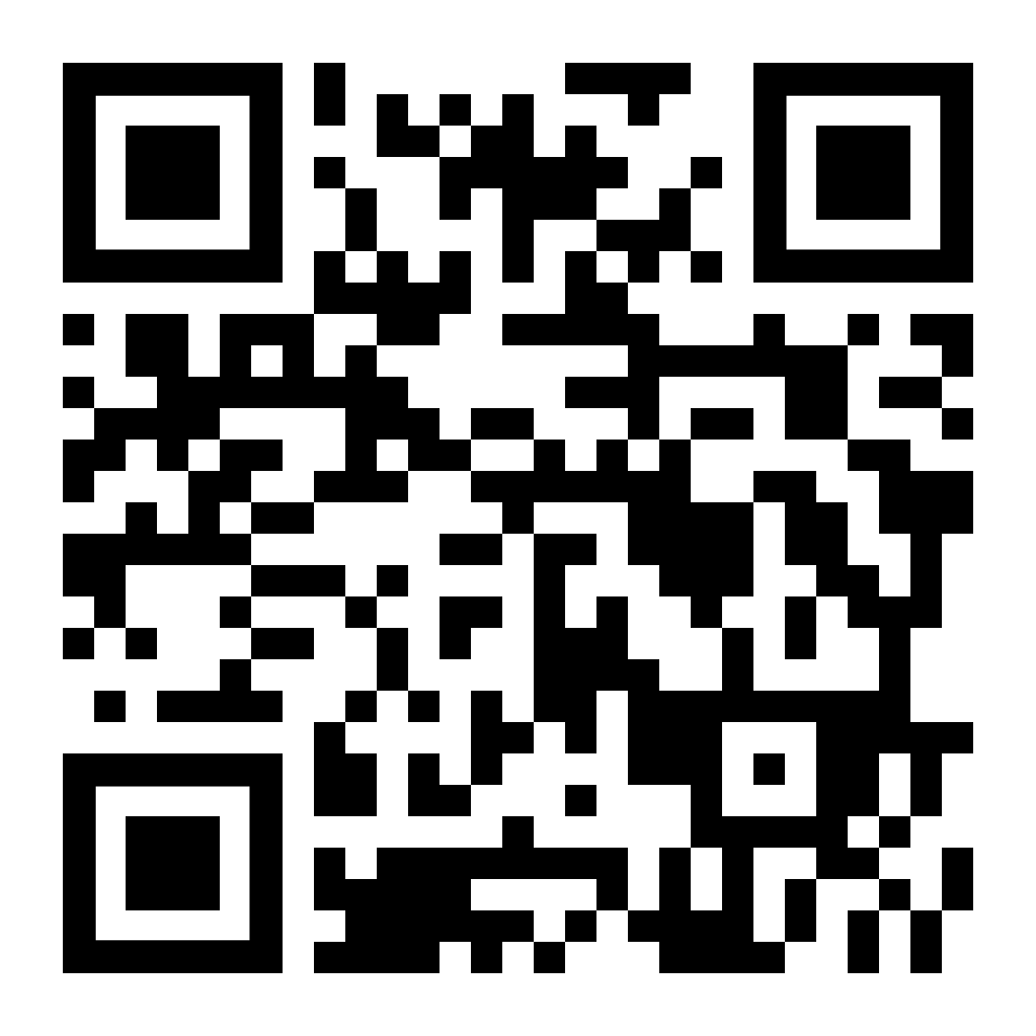
Try It: Social Media Tools
Try It!
SMS Generator
Fakebook
classtools.net/FB/home-page
classtools.net/FB/home-page

Slide 24
Creating and Using Rubrics
(Brief Introduction)

Slide 25
Using Rubistar to
Create a Rubric
The use of rubrics is one of the best ways to help students succeed at tasks and master content.
  Powerful: Transfer responsibility for learning to students by creating a process that focuses on students’ motivation and self-evaluation.
  Clearly identifies what a student needs to do:
    Define required components of a task.
    Define performance standards they should meet.
    List point values that will be used to evaluate performance.
You will learn much more about rubrics in SPE 211 Educational Assessment and other courses.

Slide 26
Using Rubistar to
Create a Rubric
Teachers can make rubrics online for free at Rubistar: http://rubistar.4teachers.org/index.php
  If you create a user name and password, you can save and edit rubrics.
  You can search through existing rubrics made by other teachers.
Rubistar
Notes:
http://rubistar.4teachers.org/index.php

Slide 27
Assignment
Assessment Activity and Rubric
  In Module 5 we are considering a number of ways that a teacher could use technology to have students demonstrate their understanding and competency with content. In pairs (or individually), do the following:
  Create and describe an activity that uses technology to assess student acquisition of content. Describe it in a brief Word document. (Upload the document to Blackboard.)
  Use the Rubistar tool to create a rubric to grade the assignment (upload the rubric to Blackboard).

Slide 28
Conclusion
Assessment used to consist of written homework, term papers, and written tests.
Thanks to technology, we can provide many ways for our students to demonstrate their learning, and aid in teacher assessment of student learning.

