Slide 1

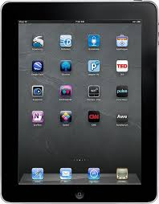

Interactive Tools that
Support Assessment
Dr. Steve Broskoske
Misericordia University

Slide 2

Introduction
Assessment: Process of gathering information about students in order to make decisions about their education.
Due to evolving technology, teachers now have many ways to:
  Have students demonstrate their learning.
  Assess student progress in learning.

Slide 3
Introduction
Students all learn in different ways. Students should be able to demonstrate what they have learned in different ways.
Verbal-Linguistic | Word Smart | With Words
Logical-Mathematical | Logic Smart | With Reasoning
Visual-Spatial | Picture Smart | With Pictures
Musical-Rhythmic | Music Smart | With Sounds
Interpersonal | People Smart | With Others
Intrapersonal | Self Smart | Within Oneself
Bodily-Kinesthetic | Body Smart | With Movement
Naturalist | Nature Smart | With Nature

Slide 4
Tools Outline
Sharing links with students:
  Symbaloo
  QR codes (QR Code Monkey)
Simulated social media learning tools
  Twister
  Fakebook
  Texting (SMS) generator
Create a rubric (Rubistar)

Slide 5
Sharing Links with Students

Slide 6
Provide Convenient Links:
Symbaloo
Symbaloo.com (Website)
  You can create a page of icons which are links to Web sites that you use in your class.
  You can give your students an assignment to create a Symbaloo of links as part of your class.
Teacher Links
Dr. Steve’s Symbaloo
Notes:
https://www.symbaloo.com/shared/AAAABVUKBb4AA41_zxijRA==

Slide 7
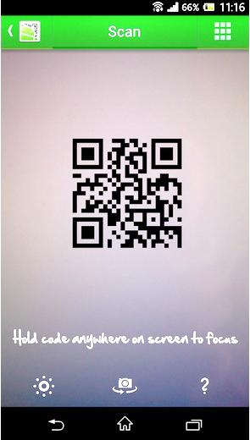
Using QR Codes and Scanners
Some devices come equipped with their own QR code scanner.
If needed, download a QR code scanner from your appropriate app store.

Slide 8
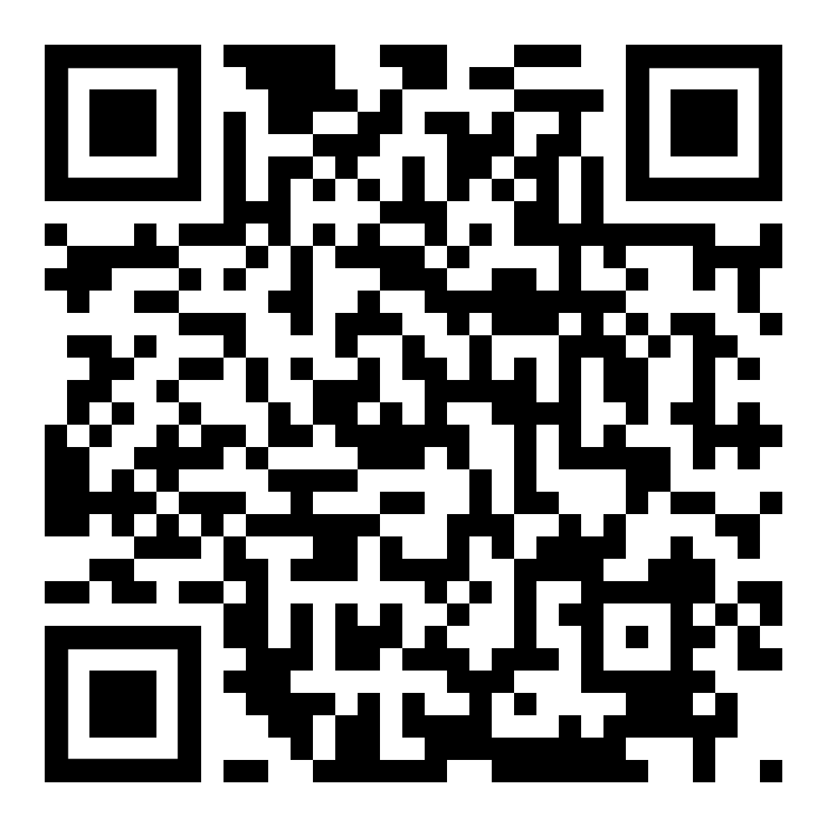
URL
Notes:
TED 121 Web page

Slide 9
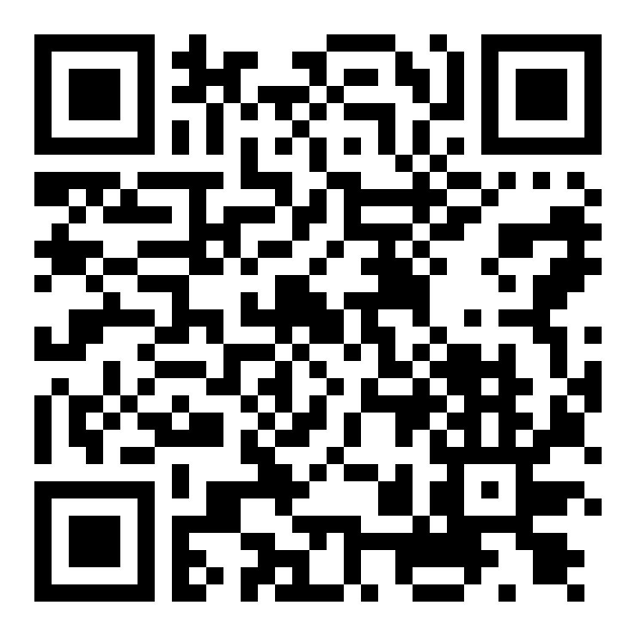
Question
Notes:
Gutenberg question

Slide 10
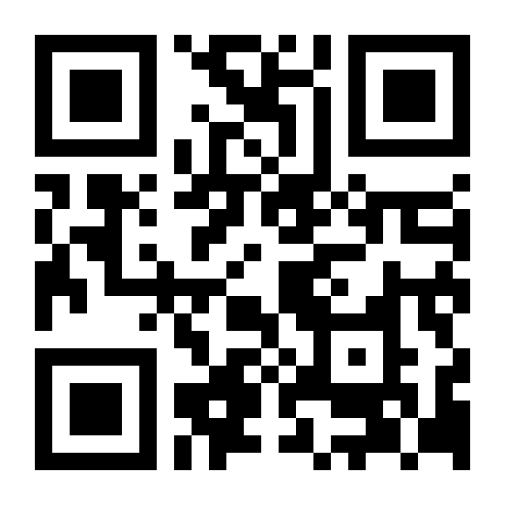
QR Code Monkey

Slide 11
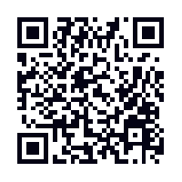
Create a QR Code
Create QR codes for students to provide:
  Web page URL.
  Video at YouTube.
  Question/text.
  Location on Google Maps.
  Scavenger hunt activity.
www.qrcode-monkey.com
Notes:
http://www.qrcode-monkey.com/

Slide 12
Simulated Social Media Learning Tools

Slide 13
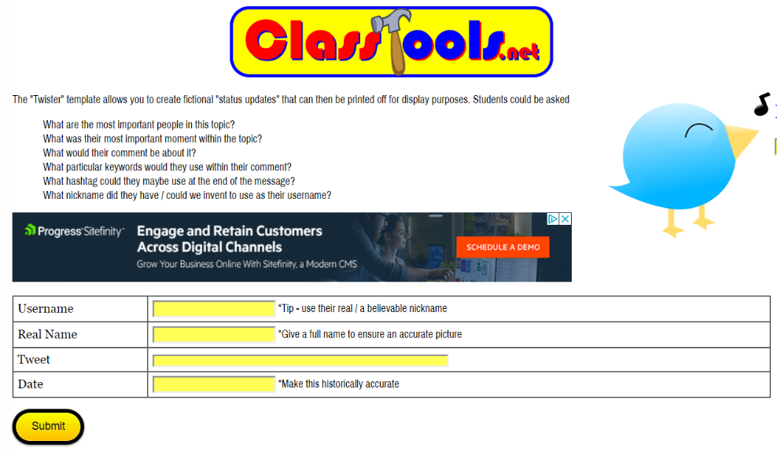
Twister
Social Media Simulated Tools
Use Twister to allow students to create fictional “status updates” that can then be printed off.
Create tweets for fictional, literary, or historical characters.
classtools.net/
twister/
Notes:
https://www.classtools.net/twister/

Slide 14
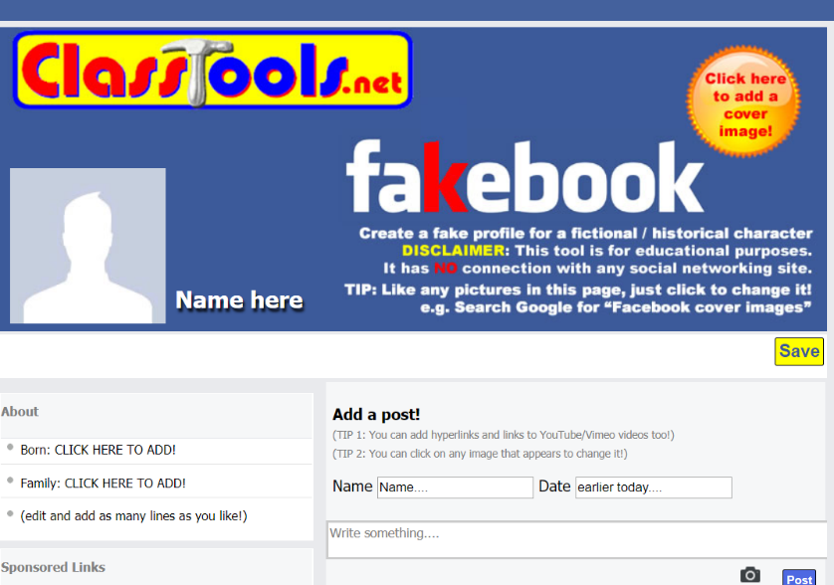
Fakebook
Social Media Simulated Tools
Create a fake profile for a fictional, literary, or historical characters.
classtools.net/
FB/home-page
Notes:
https://www.classtools.net/FB/home-page#google_vignette

Slide 15
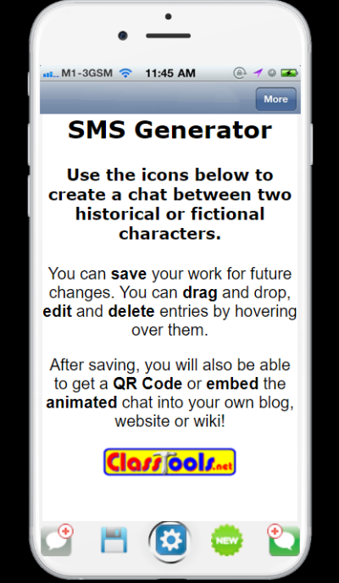
Texting (SMS) Generator
Social Media Simulated Tools
Create a simulated text message discussion between 2 characters (fictional, literary, or historical characters).
classtools.net/SMS
Person 1’s text.
Person 2’s text.
Notes:
https://www.classtools.net/SMS/

Slide 16
Try It: Social Media Tools
Try It!
Either individually or in a group of 2, try one of the following:
  Select Fakebook.
    Choose an historical or famous person and create a Fakebook page.
  Select SMS Generator (texting).
    Choose 2 famous people and generate a conversation between them.

Slide 17
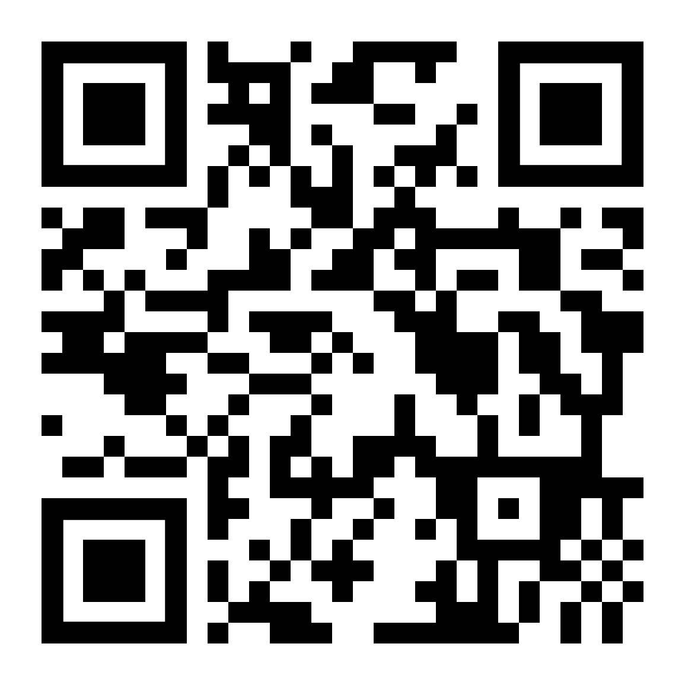
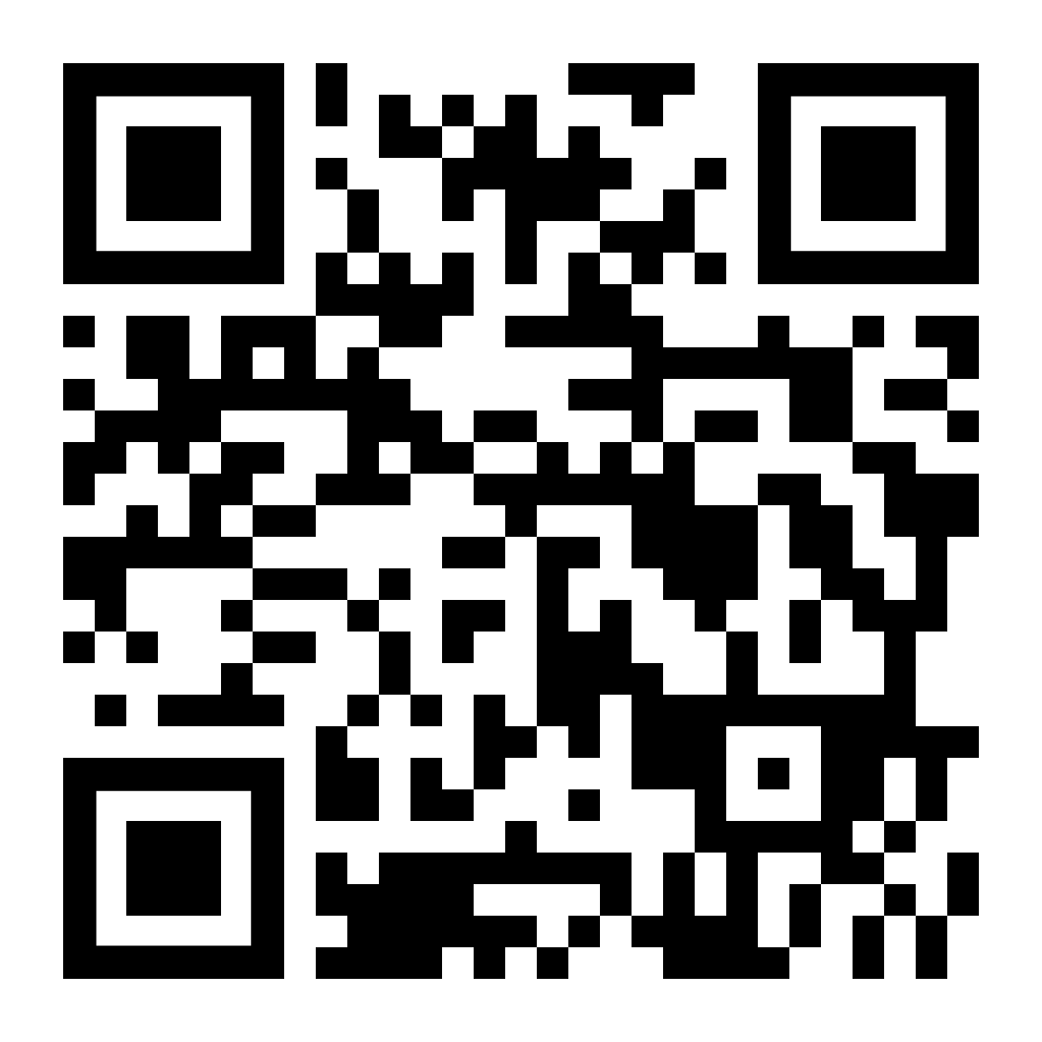
Try It: Social Media Tools
Try It!
SMS Generator
Fakebook
classtools.net/FB/home-page
classtools.net/FB/home-page

Slide 18
Creating and Using Rubrics
(Brief Introduction)

Slide 19
Using Rubistar to
Create a Rubric
The use of rubrics is one of the best ways to help students succeed at tasks and master content.
  Powerful: Transfer responsibility for learning to students by creating a process that focuses on students’ motivation and self-evaluation.
  Clearly identifies what a student needs to do:
    Define required components of a task.
    Define performance standards they should meet.
    List point values that will be used to evaluate performance.
You will learn much more about rubrics in SPE 211 Educational Assessment and other courses.

Slide 20
Using Rubistar to
Create a Rubric
Teachers can make rubrics online for free at Rubistar: http://rubistar.4teachers.org/index.php
  If you create a user name and password, you can save and edit rubrics.
  You can search through existing rubrics made by other teachers.
Rubistar
Notes:
http://rubistar.4teachers.org/index.php

Slide 21
Assignment
Assessment Activity and Rubric
  In Module 5 we are considering a number of ways that a teacher could use technology to have students demonstrate their understanding and competency with content. In pairs (or individually), do the following:
  Create and describe an activity that uses technology to assess student acquisition of content. Describe it in a brief Word document. (Upload the document to Blackboard.)
  Use the Rubistar tool to create a rubric to grade the assignment (upload the rubric to Blackboard).

Slide 22
Conclusion
Assessment used to consist of written homework, term papers, and written tests.
Thanks to technology, we can provide many ways for our students to demonstrate their learning, and aid in teacher assessment of student learning.

