Slide 1

Adding Multimedia Elements
Hands-on Approach to
Creating Multimedia Elements
by Dr. Steve Broskoske

Slide 2
Multimedia we will cover:
Download sounds.
Animation for teaching.
Screen shots.
Slide transitions.

Slide 3
Downloading Sounds to
Use with Custom Animation
Using a search engine, search for sounds (.wav).
Custom animate a graphic (or other screen element) as usual.
Take the drop-down for the play-listed item, and select “effect options” to add a sound as usual.
Instead of selecting a standard sound, select “other sound.”

Slide 4
Downloading Sounds
You can download sounds by searching on Google. Better yet, navigate to a specialty search engine for sounds.
https://www.findsounds.com/
https://freesound.org/

Slide 5
Sounds in Particular Apps
Search for audio files:
  Search for .mp3, .wav, .m4a files
In online PP app:
  Select insert—audio.
  Play audio on slide when desired.
In Google Slides:
  Select insert—audio.
  Play audio on slide when desired.

Slide 6



Downloading Sounds
TRY IT: Download a sound to accompany the following graphics. Animate the graphics and add a sound that can be played.

Slide 7



Downloading Sounds
TRY IT: Animate one or more of the following graphics. Download an appropriate sound to accompany the graphic.

Slide 8
Using Animation to Teach
TRY IT: Animate the following algebra illustration and add a sound(s) to effectively demonstrate this math topic.
Let a = 6.
x = 10 + a
6
x = 16

Slide 9
Using Animation to Teach
TRY IT: Add sounds to the following animations to effectively demonstrate how to solve this math problem.
5
1
6 4
- 4 6
1
8

Slide 10
Capturing Screen Shots
Every device/platform has a way to capture an screen shot (screen capture). Capture an image of the screen, then insert it into any application as a graphic.
In Windows:
  Press the “print screen” key to capture an image of the entire screen to the clipboard. Then “paste” to insert.
In Mac:
  Press shift + command + control + 3 to send the image straight to the clipboard instead of saving a file. (Don’t use shift to save the screen shot as a file.)

Slide 11
Capturing Screen Shots
TRY IT: Take a screen shot of the previous slide. Paste it below.

Slide 12
Capturing Screen Shots
TRY IT: Take a screen shot of a Web page or a screen in another program/app. Paste it below.

Slide 13
Graphic Editing
Using the Picture Toolbar
TRY IT: Take a screen capture of a menu or dialog in the ribbon of PowerPoint. Double-click the graphic to open the drawing tools format tab. Use the cropping tool to edit the graphic so that only the slide show menu shows. Add callouts as needed to explain information.

Slide 14
Slide Transitions
To create a professional touch, you can create slide transitions as the professionals do on television. Open the animations tab, and select effects from the transition to this slide group.

Slide 15
Slide Transitions
TRY IT: Try creating various slide transitions on different slides throughout this presentation.

Slide 16
Using Action Buttons and Links

Slide 17
Action Buttons/Links
In PowerPoint desktop app:
From the insert tab, select shapes from the illustrations group.
Select action buttons from the bottom of the dialog.
Select button type.
  Suggestion: Use the custom button. You can type a description on it.
Click and drag on the slide to create button.
Specify action settings to make the button work.

Slide 18
Action Buttons/Links
In online PP app:
  Select insert—link.
  Select from entering a URL, a file, or a slide within the presentation.
In Google Slides:
  Select insert—shape.
  Select shape and choose insert—link. Then, type/paste a URL or select a slide within the presentation.

Slide 19
Navigate to Another Slide
You can make action buttons navigate to a particular slide within the current presentation.
  Next slide, previous slide, first slide, last slide, particular slide.

Slide 20
Navigate to Web Site
Navigate to Misericordia’s URL using an action button/shape:

Slide 21
Navigate to Web Site
Navigate to PDE’s URL using an action button/shape:
  https://www.pa.gov/agencies/education

Slide 22
Insert a Video
In Google Slides:
  Select insert—video.
  Select from YouTube OR from Drive.
  Specify how to start the video:
    Play on click: Click anywhere to play.
    Play automatically: Plays immediately.
    Play manual: Have to press play button on video.

Slide 23
Insert a Video
In PowerPoint online:
  Select insert—video.
  Select from YouTube (or other provider) OR from device.
  Specify how to start the video:
    Play on click: Click anywhere to play.
    Play automatically: Plays immediately.
    Play manual: Have to press play button on video.

Slide 24
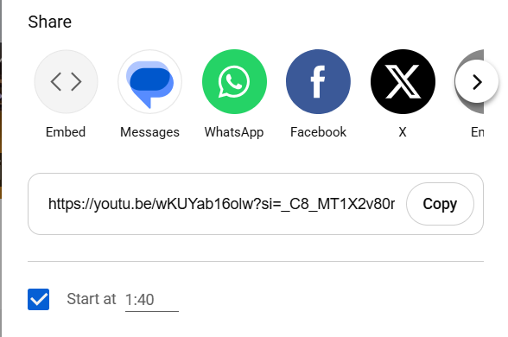
Insert a Video
As a bonus, in PowerPoint online:
  You can navigate directly to
  YouTube.
  Run video to where you
  want to start.
  Click share button.
  Check if you want to start
  video at that point.
  Press copy button and
  paste into PP.

Slide 25
Insert a Video
Create an action button/shape to show a video from YouTube:

Slide 26
Review
Download sounds
  Download .wav or .mp3.
Screen shots
  In Windows: press print screen key and paste.
  In Mac: press shift + command + control + 3.
Slide transitions
  Select effects from the transition to this slide group.
Create action buttons to link to URLs or slides.

