Slide 1

Animating Graphics and Text Boxes
Hands-on Approach to
Animating Elements on a Slide
by Dr. Steve Broskoske

Slide 2
Animate Any Object on a Slide
In PP Desktop app: From the animations tab, select animation pane from the advanced animations group. In both versions:
Click to select an object.
Press add animation.
Specify:
  Entrance, emphasis, and/or exit.
  Effect options (specify direction).

Slide 3
Animate Any Object on a Slide
In Google Slides:
Select graphic to be animated.
Press view—motion.
Press add animation.
Specify:
  Animation type.
  Start condition (on click, after previous, with previous).

Slide 4

Animating a Graphic
Specify entrance, emphasis, and exit as desired. Select on click, with previous, or after previous to specify what will trigger the play-listed items to play.

Slide 5
Animate Text on a Slide
In PP Desktop app: From the animations tab, select animation pane from the advanced animations group.
In both versions:
Select the text box – not the text!
Select animation. Select animation type.
Select effect options and specify by paragraph. (Otherwise, all bullets fly in at once as a unit.)

Slide 6
Animate Text on a Slide
In Google Slides:
Select text box OR text to be animated.
Press view—motion.
Press add animation.
Specify:
  Animation type.
  Start condition (on click, after previous, with previous).
Click by paragraph. (Otherwise, all bullets fly in at once as a unit.)

Slide 7
Animating Text
In PP, select entire text box (not just the text) and specify animation entrance. Notice how all of the bullets get the same action.
Animating text is fun and easy.
Just remember to highlight the text box by clicking on a border of the box.
Then specify the entrance animation.
Then work with the bullets as one whole unit OR as individual play-listed items.

Slide 8
Animating Text
Interactivity.
Such as flying bullets!
This allows the speaker to capture and focus audience attention.
And pace the presentation.

Slide 9



Reordering Animation Order
Animate the graphics. Then, use the reorder below the play list to determine the order of play.

Slide 10

Review: Animation
Animate every element on this screen, even text boxes. Then change the order of animation. Title should enter first.
Butterflies are fun to watch!
Butterflies come in many different colors.
Butterflies live the first half of their lives crawling on the ground before they earn their wings.
Butterflies love to fly around.

Slide 11
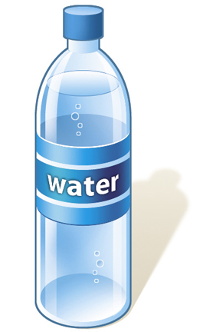

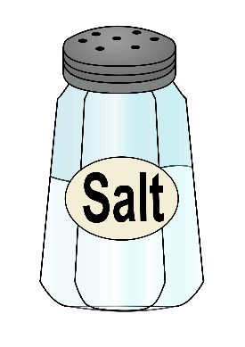
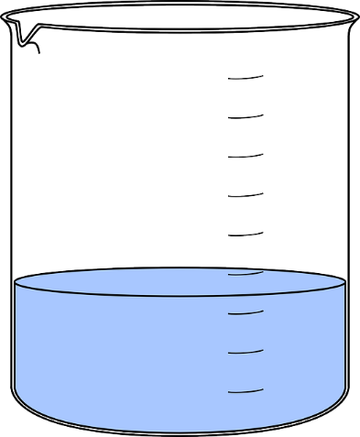
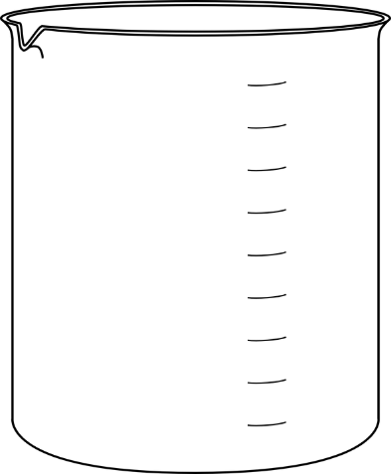
How to Make Saline Solution
Demo
Add 1 cup of water of distilled water into a container.
Add ½ teaspoon of salt.
Ingredients you will need:

Slide 12
How to Make Saline Solution
Try It!
Add 1 cup of water of distilled water into a container.
Add ½ teaspoon of salt.
Ingredients you will need:

Slide 13
Creating and Animating
Callouts

Slide 14
Animate Text on a Slide
In Google Slides:
Select insert—shape.
Select: shape, arrow, or callout.
In PP online:
Select insert—illustration—shapes.
Select: shapes, arrows, callouts, and much more.

Slide 15
Creating Callouts
Insert a callout to call attention to some content on a slide. Then, animate the callout to make the content more memorable.
Point to this.
Point to this.
Point to this.

Slide 16
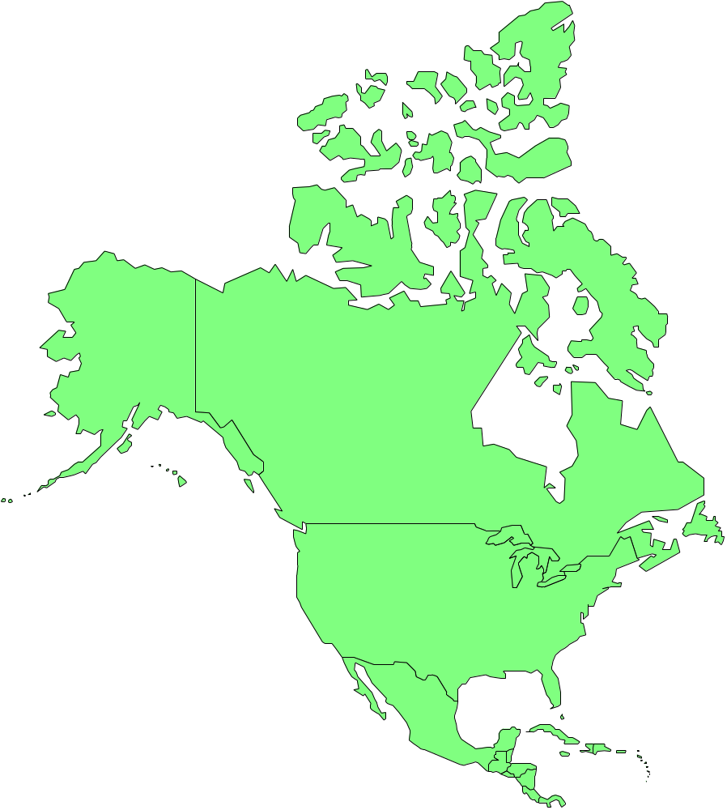
Creating Callouts

Slide 17
Using Drawing Tools as Callouts
Use rectangles and ovals to call attention to words on the slide.
Insert a rectangle shape to highlight a word.
Change color of the shape as desired.
Animate the shape to fade in or appear.
After animating, select send to back.
The young man walked down the street.

Slide 18
Using Drawing Tools as Callouts
Additionally, add block arrows as callouts to provide additional information to various words below.
The eager student entered the classroom early.

Slide 19

Reminder: Ensure Text is Readable (UDL)
Correct this slide.
Animating text is fun and easy.
Just remember to highlight the text box by clicking on a border of the box.
Then specify the entrance animation.
Then work with the bullets as one whole unit OR as individual play-listed items.

Slide 20
Review
Animate an object by specifying entrance, emphasis, and exit, or custom path.
Change animation order by using re-order buttons.
Create call-outs to point to items on a slide by using drawing tools.

