Slide 1

Using Action Buttons and Action Settings
Hands-on Approach to Learning
How to Use Action Buttons
by Dr. Steve Broskoske

Slide 2

What can action buttons do?
Navigate to a particular URL (Web address).
Navigate to a particular slide in current or other PowerPoint presentation.
Open a data file (document, spreadsheet, database).
Run a program.
Play a sound.

Slide 3
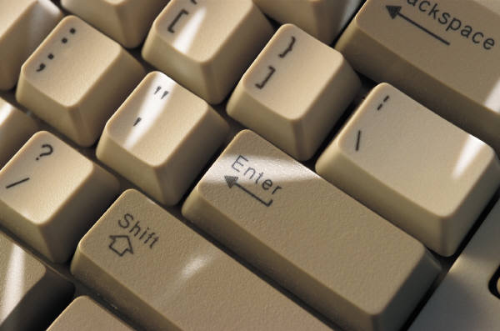
With action buttons you can…
Incorporate other technologies (other programs, Web sites, movies).
Open Word to use as a whiteboard.
Incorporate interactivity: prepare for use with SmartBoard.
Build in flexibility (vs. linear presentation).

Slide 4
Create an action button
From the insert tab, select shapes from the illustrations group.
Select action buttons from the bottom of the dialog.
Select button type.
  Suggestion: Use the custom button. You can type a description on it.
Click and drag on the slide to create button.
Specify action settings to make the button work.

Slide 5
Navigate to Another Slide
You can make action buttons navigate to a particular slide within the current presentation.
  Next slide, previous slide, first slide, last slide, particular slide, last slide viewed.

Slide 6
Navigate to Another Slide
Review with students: You can create an action button to navigate to a particular slide to allow students to review a previous topic. Then, place a “return” button so you can quickly return.

Slide 7
Navigate to Web Site
You can navigate to a particular URL.

Slide 8
Change settings after-the-fact
You can change the action settings of a button “after-the-fact.” Select insert—action OR right-click the button (not text) and select edit hyperlink.
Misericordia Home Page
Careful: When changing button settings “after-the-fact,” make the button hot, not the text on the button!

Slide 9
Caution
Caution
Careful: When changing button settings “after-the-fact,” make the button hot, not the text on the button!
Text is hot, not the button.
Experiment with
this button.
Button navigates to previous slide.

Slide 10
Open a Word Document
You can make an action button open a Word document or any other data file located on the PC.
Open a Word Document
Take the document with you: Make a folder and place documents and other resources in it before linking to them. Otherwise you will link to “my documents” on your hard drive, and you will not have those resources with you.

Slide 11
Open Another PowerPoint File
If you open another PP presentation, you can specify which slide to open to start.
Open another PowerPoint file

Slide 12
Link to a Video
Navigate YouTube or TeacherTube (or other video site).
Find a video and copy its URL.
Create an action button and paste in the URL.

Slide 13
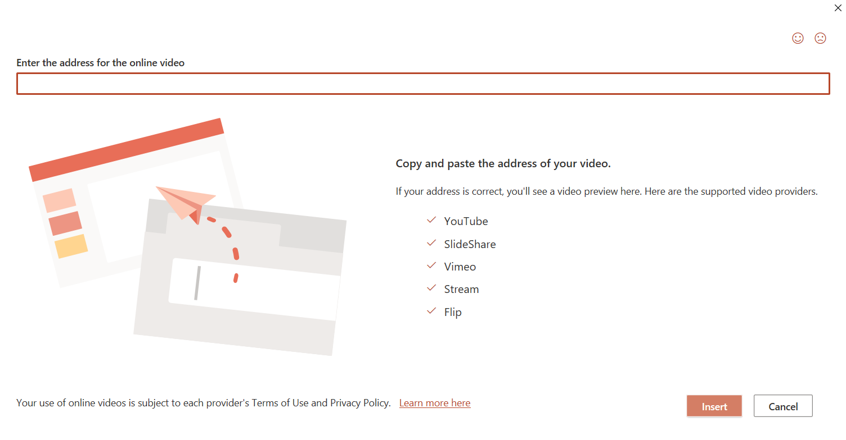
Embed a Video
Latest – embedding a video on a slide.
Select insert—video.

Slide 14
Embed a Video

Slide 15
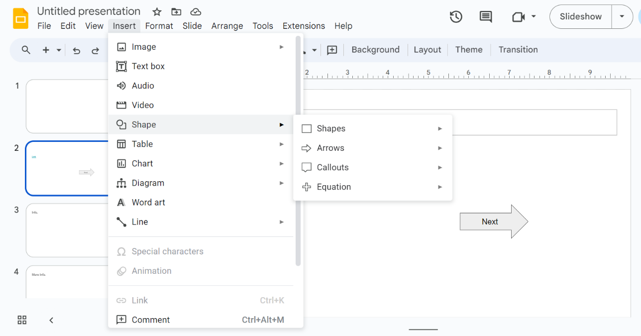
Google Slides: Embed a Video

Slide 16
Play a Sound
You can make an action button play a sound.
Hear a sound played.

Slide 17
Sound Effects
You can prepare sound effects into your presentations to keep your class lively and to encourage students.
Crickets
Boing
Applause
C
A

Slide 18
“Mouse over” buttons
You can assign an action setting to a button to occur when the student/teacher rolls the mouse over the button. (The button can still have another action setting to occur when the button is pressed.)
Roll over this button with mouse

Slide 19

“Mouse over” objects
Action settings don’t only apply to buttons. They can be applied to graphics or text boxes, too!
Text box mouse over.

Slide 20
“Mouse over” objects
A space object that survives its passage through the earth's atmosphere such that part of it strikes the ground.
Select the correct vocabulary word below:
meteor
meteorite
meteoroid

Slide 21
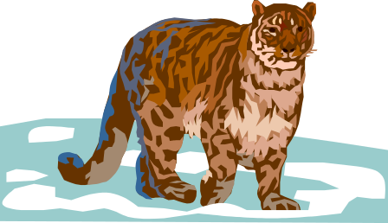


“Mouse over” objects
Pick the farm animal that gives us milk.

Slide 22


Feedback Screen
INCORRECT. These animals do not give us milk to drink. Please try again.
Try Again

Slide 23

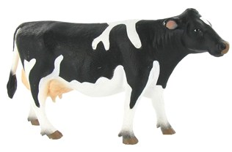
Feedback Screen
CORRECT. A cow provides milk.
Good job!
Continue

Slide 24
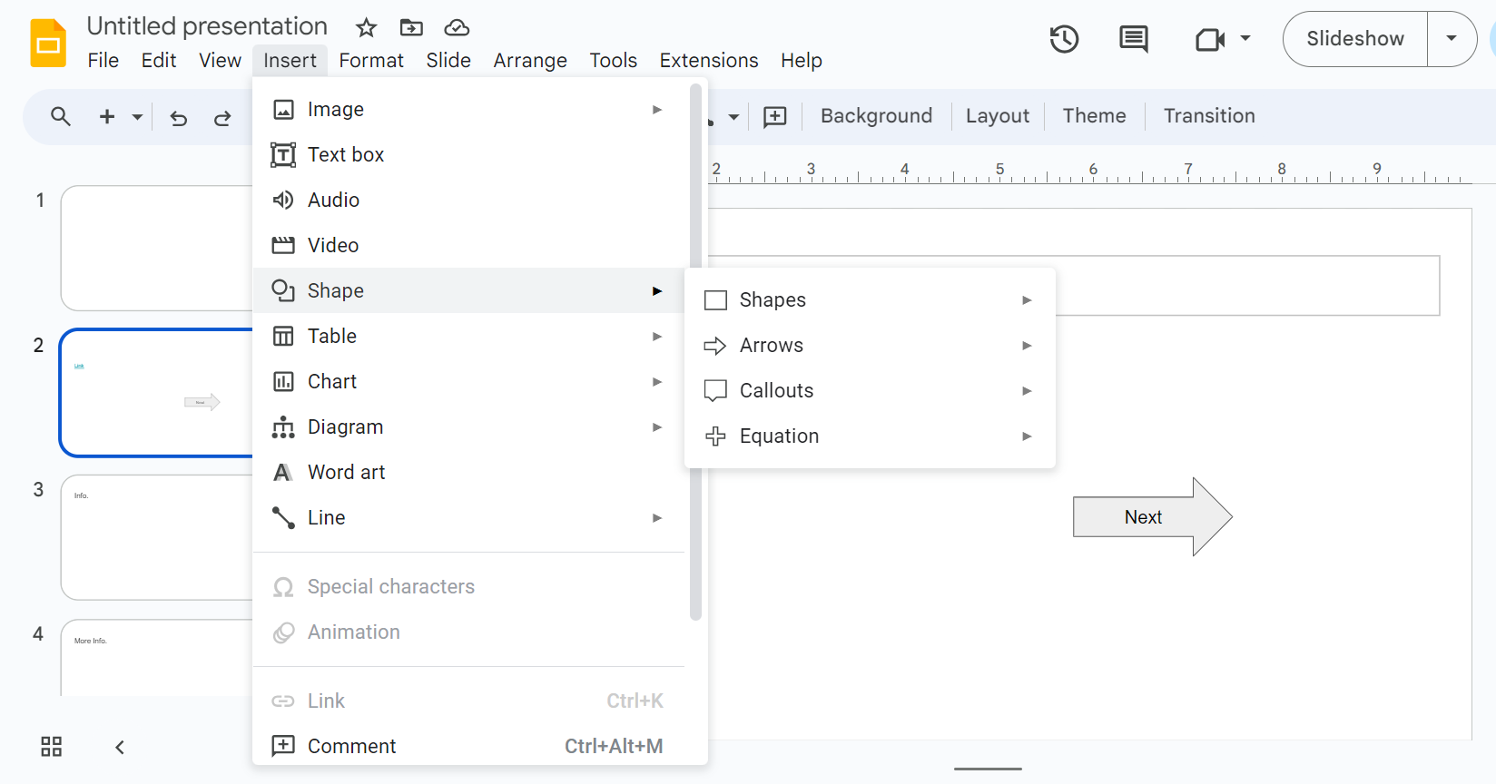
Shapes and Links in Google Slides

Slide 25
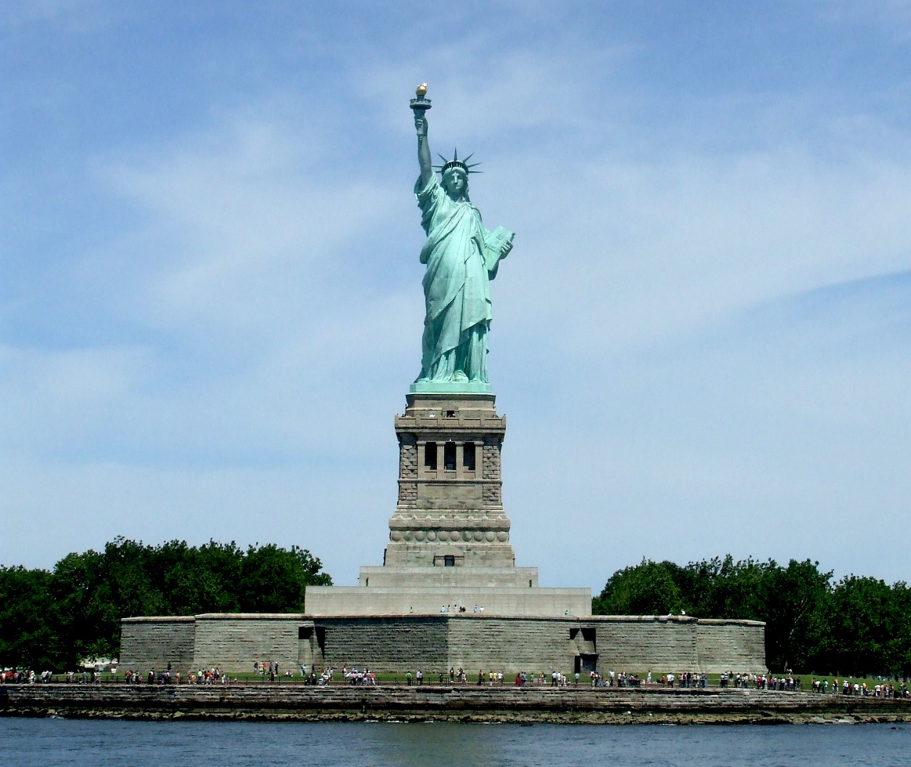
Rollover Graphic/Information
This Photo by Unknown Author is licensed under CC BY-SA

Slide 26
Rollover Graphic/Information
"The Statue of Liberty Enlightening the World" was a gift of friendship from the people of France to the United States and is recognized as a universal symbol of freedom and democracy. The Statue of Liberty was dedicated on October 28, 1886. It was designated as a National Monument in 1924.

Slide 27
Compare: Triggered Animations
Which of the following is the correct chemical formula for water?
HO
H₂O
H₂O₂
Try again!
Correct!
Try again!

Slide 28
Working with
Invisible Action Buttons

Slide 29
Creating invisible action buttons
You can create invisible action buttons to create ultimate interactivity in the classroom. If used with a “SmartBoard,” students can touch the image projected onto the board to interact with the slide show.
Make this button invisible

Slide 30
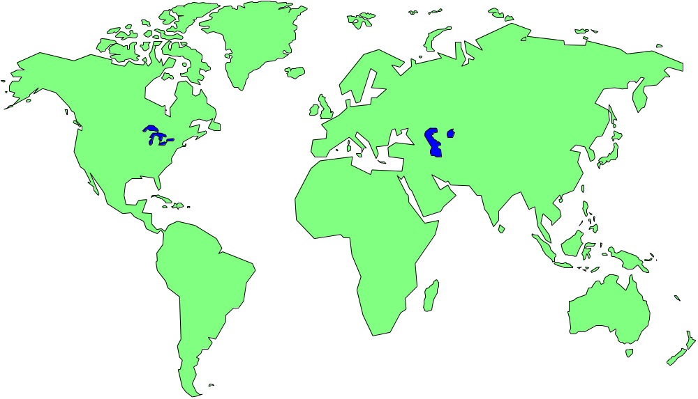
Creating hot spots using invisible buttons
Click a continent to learn more about it:

Slide 31
Learn About North America
Information about North America would appear here.

Slide 32
Learn About South America
Information about South America would appear here.

Slide 33
Learn About Africa
Information about Africa would appear here.

Slide 34

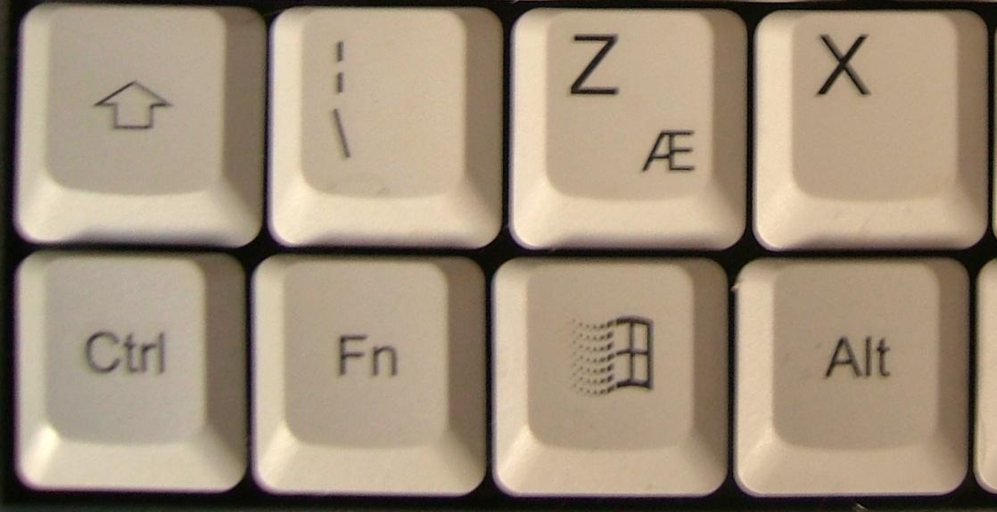

Do we need invisible action buttons here?
Click a PC key below to learn more about its function:

Slide 35
The “Control” Key
The Control key is a modifier key which, when pressed in conjunction with another key, performs a special operation (for example, Ctrl + C ). Similar to the Shift key, the Control key rarely performs any function when pressed by itself.

Slide 36

Creating hot spots using invisible buttons
Click on a hot spot on the microscope graphic to learn more about parts of a microscope.

Slide 37
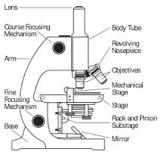
Microscopes
The objective refers to the lenses that can be used to view the slide placed on the stage.

Slide 38
Adding Audio/Video to PowerPoint

Slide 39
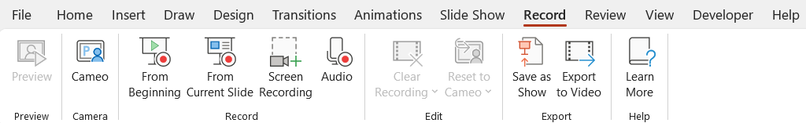
Video Options

Slide 40
Recording Audio on Slides

Slide 41
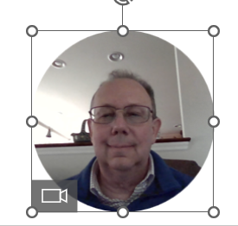
Recording a Video Cameo

Slide 42
Screen Recording

Slide 43
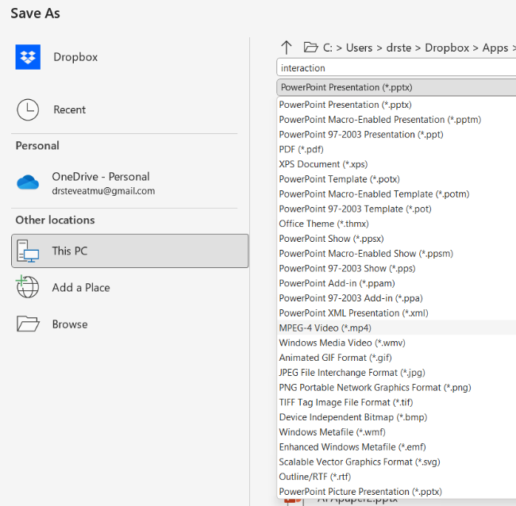
Saving a Video
Select save as an mpeg-4 video.

Slide 44
Review:
Action Buttons
Action buttons:
  Navigate to a particular URL.
  Navigate to a particular slide.
  Open a file or program.
  Play a sound (mouse click OR mouse over).
Invisible action buttons
Apply action settings to other objects (graphics or text boxes).
Add audio or video, and save as a video.

