Slide 1


Downloading Files Using FTP
Dr. Steve Broskoske
Misericordia University

Slide 2
Introduction to FTP
What does FTP mean?
FTP stands for file transfer protocol. FTP refers to the ability to transfer files from a computer on the Internet (including the Cloud) to your device.
Download: Transfer files from a server online or a cloud account to your device.
Upload: Transfer files from your device to a server online or a cloud account.

Slide 3

Downloading Files
How do you tell the difference between a standard link and a download link?
WordDocument.docx (35 Kb)
File name will be displayed in bottom of browser.
An icon may be used.
Link may display filename.
File size may be shown.
http://www.misericordia.edu/users/ted121/resources/APAtemplate.doc

Slide 4
Downloading Files
What does a Web page file look like?
  Filename ends in .html OR .htm
What do other files look like?
index.html
filename.docx
  Word documents
filename.xlsx
  Excel spreadsheets
filename.pptx
  PowerPoint files
filname.mdbx
  Access database files
filename.jpg OR .gif
  graphics/pictures
filename.wav
  sound file

Slide 5
Understanding Digital Storage

Slide 6
Understanding Digital Storage
It is important to understand a little bit about digital storage.
Many e-mail clients, Web sites, and digital communication tools specify limits:
  Amount of storage space allowed.
  Maximum file size allowed to transfer/send/post.
  Maximum file size allowed per attachment in e-mail.

Slide 7
Understanding Digital Storage
A byte (binary digit) of information is roughly the amount of storage needed to store 1 character when typing.
The eager student arrived in class early.
This computer plain text file consists of approximately
41 bytes of information, one byte for each character.

Slide 8
Understanding the
Measurement System
Remember the Metric system?
  Kilo (means 1,000)
  Mega (means 1,000,000)
  Giga (means 1,000,000,000)
And a newer one:
  Tera (means 1,000,000,000,000)

Slide 9

Creating a Desktop Folder
Where do downloaded files go?
  Left-click: Download folder.
  Right-click: Specify a location, such as a personal folder on the desktop, a stick, or cloud storage (such as DropBox).
Create a personal folder on desktop/stick/cloud:
  Find a blank area on the desktop.
  Right-click and select new—folder.

Slide 10
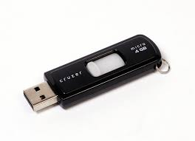
Saving Files on Lab Computers
Computers in this lab will not purposely erase any files you save. Some labs and any devices you borrow from the library utilize a thaw drive.
You may want to purchase a USB thumb drive to save files you work on OR save to a cloud account (such as DropBox or Google Drive).

Slide 11
TRY IT
Let’s create a folder on desktop/stick/cloud.
Let’s download some files.

Slide 12
2 Special File Types

Slide 13


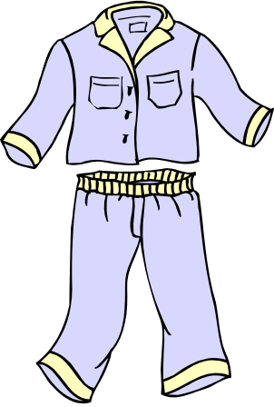



What are Zip Files?
To go on a trip, how do you prepare your clothes?

Slide 14
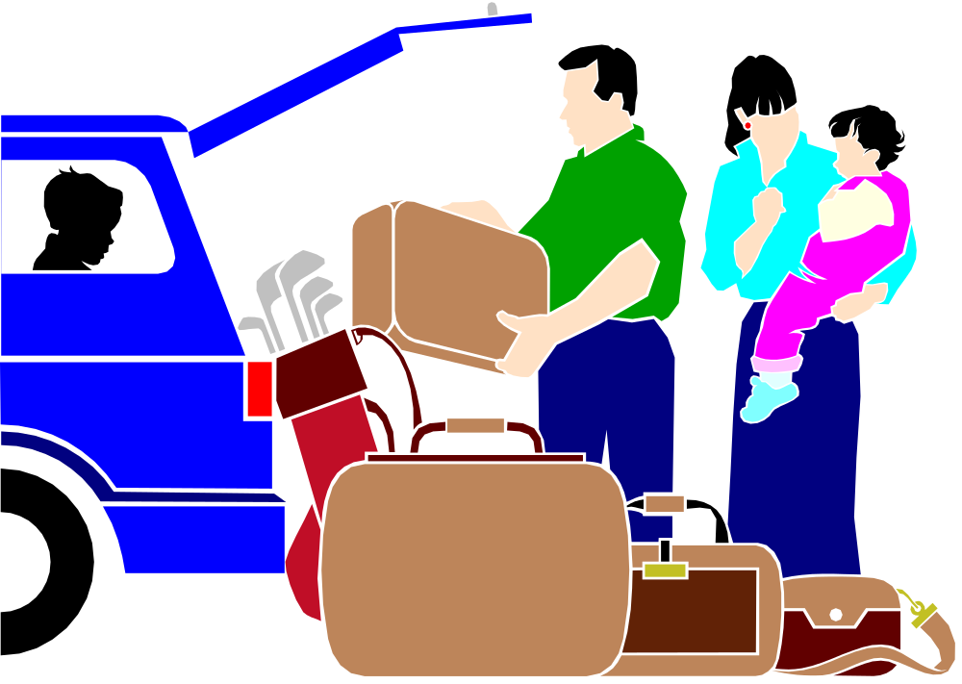
What are Zip Files?
To go on a trip, how do you prepare your clothes?
A suitcase is a single, compact container that holds much material.

Slide 15
What are Zip Files?
zip
filename.zip
document.docx
photo.gif
photo.jpg
document.docx
spreadsheet.xlsx
powerpoint.pptx
document.docx 57 Kb
photo.gif 96
photo.jpg 256
document.docx 92
spreadsheet.xlsx 396
powerpoint.pptx 2359
Total Size: 3,256 Kb
Total Size: 1,456 Kb
Over 3 Mb.
Only 1½ Mb!

Slide 16
To Unzip a File
Double-click the downloaded zip archive.
Select all of the files you wish to unpack from the zipped archive file (hold control or shift).
Extract the files to a location you can locate.
  Alternatively, you can also double-click on a single file to unpack it and view it.
Close the program.

Slide 17
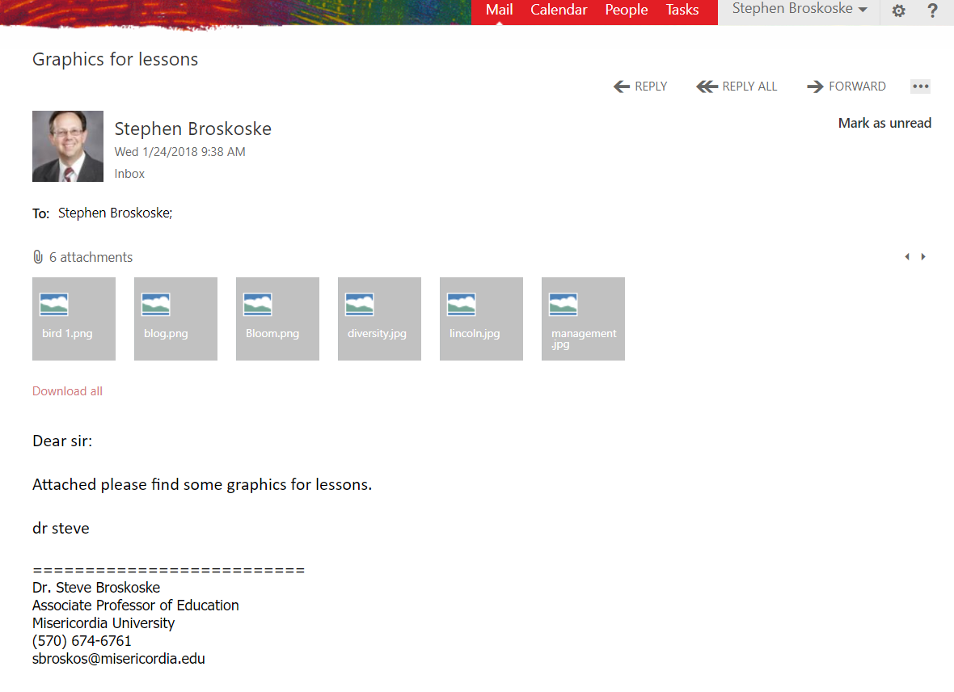
Downloading Email
Attachments as a Zip
Select download all to open attachments as a zip.

Slide 18

To Create a Zipped Archive
Select 1 or more files (hold shift or control key while selecting to add more to the selection).
Right-click over the files and select: send to--compressed file.
Rename the zip archive file if desired.

Slide 19
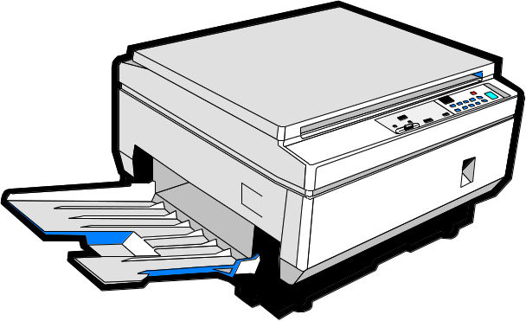
Working with PDF Files
PDF file is a perfect copy of original.
PDF’s are accepted by the government as official forms.
Read using free Adobe Acrobat
reader.
Using PDF’s, you can read,
copy, and print material.

Slide 20
Working with PDF Files
You cannot change the contents of a PDF file.
  Exception: Some PDF’s are designed to allow a user to complete a form and print it out, but you cannot save the contents of what you type.
You can sometimes copy and paste text material from a PDF, but you may lose the formatting (e.g., tables, columns, etc.).

Slide 21

Why Create a PDF?
Why would you create a PDF vs. saving as a Word document?
  Ensure that a document will appear and print exactly as the original.
  Not allow anyone to change the contents of a document and re-save it.

Slide 22
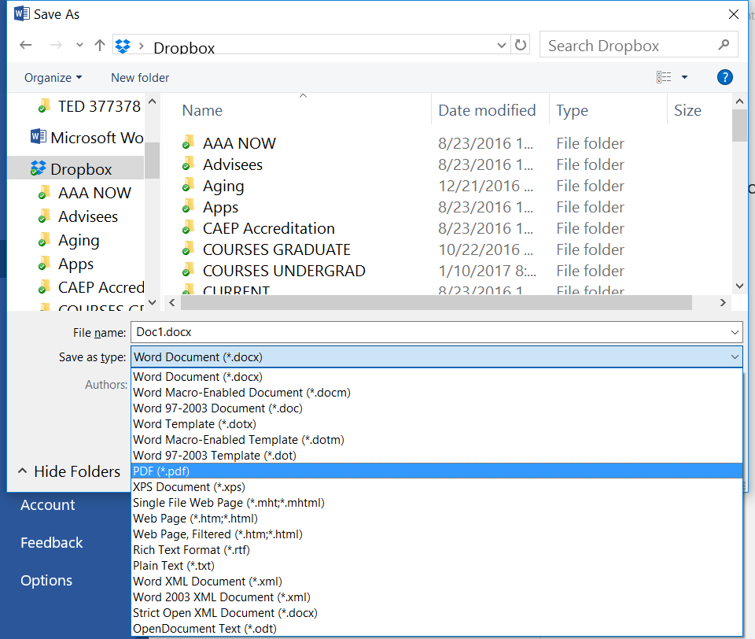
How to Create a PDF File
Using Word, select save as and select PDF as the save file type.

