Slide 1

Exploring the Powerful
Features of PowerPoint
PowerPoint
is great!
TED 121 Educational Technology
Dr. Steve Broskoske

Slide 2

PowerPoint Is…
Presentation software
is an effective and popular way to present information to students.

Slide 3
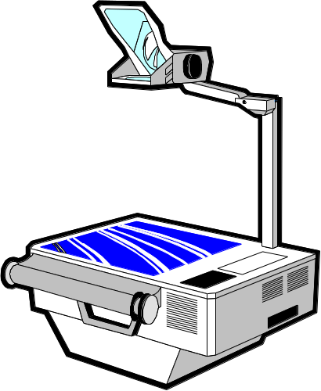

Popularity of PowerPoint
Most teachers use PowerPoint (or similar product) or whiteboard software (Activ or SmartBoard software) to present to their classes.
While many teachers rely on
bullets…
Need to make presentations
go beyond the old overhead projector.
There is so much more PowerPoint can offer…

Slide 4
Other Presentation Software
Prezi
Slideshare
Google Slides

Slide 5
Educational benefits?
Hold learner attention.
Provide multisensory instruction.
Provide clear, meaningful examples.
Address multiple learning styles.
Plus many other teaching/learning benefits!
Let’s explore some of the benefits to teaching/learning…

Slide 6
Build a Slide
Place all information on a slide.
Reveal (build) the slide contents as you are ready.
Pace the lesson.
Ask a question:
  What other technology does this resemble?
Answer: The overhead projector.

Slide 7
Illustrating Your Point
<A HREF = “http://www.misericordia.edu”> Misericordia </A>
Opening Anchor followed by HREF=
“Hot text” to appear on page.
Closing Anchor
URL (Web address) in quotation marks

Slide 8
Illustrating Your Point
Add animation and sounds to effectively demonstrate how to solve a math problem.
5
1
6 4
- 4 6
1
8

Slide 9

Tricks with Graphics and Text
You can insert a text box over a graphic to produce some nice effects. Here, it looks like this teacher is writing on the blackboard.

Slide 10
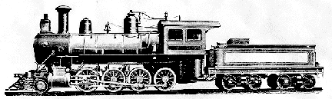
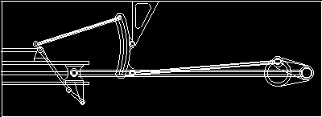
You can add animations and shapes for illustration. Look how the animation is more explanatory than a static image!
cylinder

Slide 11
Illustrate through Artistic Effect
Easily use drawing tools and background painting to create effects that illustrate a point or invoke a sensory experience.
The Process of Making Steel
Steel is forged in very hot ovens. It is heated to several hundred degrees Fahrenheit! Take the hottest summer day you have ever known, and multiply by 10!

Slide 12



Add Attention-getting Devices
Add devices to draw attention to, highlight, or illustrate important concepts, OR add pure attention-getters.
Point to important information.
Highlight salient points or words.
Call attention to items.
Remember!
Focus attention through effects.
Add pure attention-getters.

Slide 13

Creating hot spots using invisible buttons
Click on a hot spot on the microscope graphic to learn more about parts of a microscope.

Slide 14
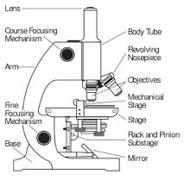
Microscopes
The objective refers to the lenses that can be used to view the slide placed on the stage.

Slide 15
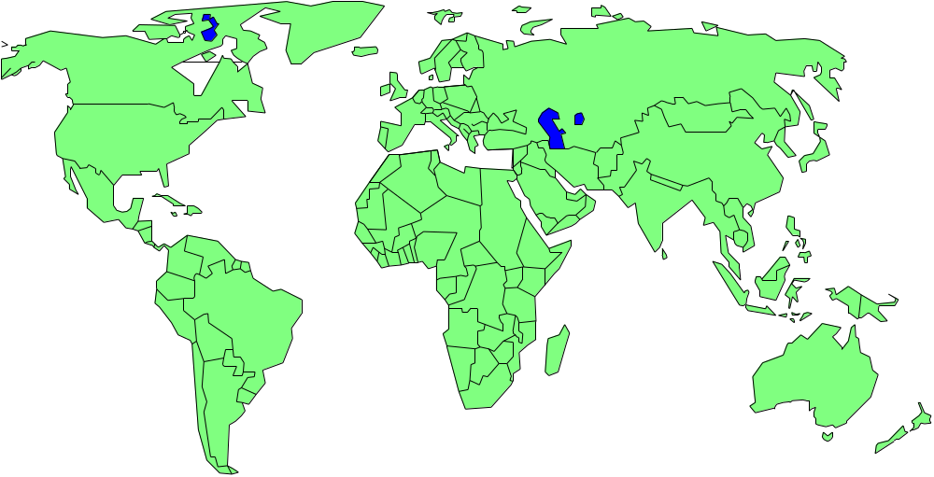
Write/Draw on a Slide
You can use the electronic pen to draw or write on a slide during a presentation.

Slide 16
Record Lecture Notes
In the editing mode, record notes for instructor use during a presentation.
Will not be seen by students.
Print out with a picture of slide to use when presenting.
Notes:
In this area of the screen, a teacher can type out notes to be used when giving the presentation. The students will never see the notes. The instructor can print a slide with notes underneath, one piece of paper per slide. See the sample lecture notes below:
To enter editing mode, hit the ESC button.
Can drag border between windows to make notes area larger.
Can edit in this area like a word processor.

Slide 17
Print Handouts
Print handouts from slides.
  Eliminate need for students to copy everything.
  Allow students to focus on you.
  Allows students to take home the teacher’s notes.
Choose from the following formats:
  2, 4, 6, 9 slides on a piece of paper
  3 slides (with lines to take notes)

Slide 18

Hyperlink to Web Sites
Using hypertext or action buttons, create active links to Web sites. All the work is done in advance to eliminate technology concerns during the presentation.
Misericordia Home Page
PA Department of Education

Slide 19
Run Other PC Applications
Use action buttons to open documents (in Word), spreadsheets (in Excel), and databases (in Access). Run any software application on the computer. Again, this eliminates concerns about technology during the presentation.
Open Microsoft Word

Slide 20

Link to a Video

Slide 21

Embed a Video

Slide 22

Add Video
You can type a script to use as cue cards.
Easily add video into a presentation.
Finally, you can export a PP presentation as a video file.

Slide 23
Finishing Touches
Finally, you can “fancy up” your presentation by adding transitions between slides.
For example, watch closely as you advance to the next slide…

Slide 24
Finishing Touches
What do you think of this slide transition? Pretty cool?

Slide 25
HOPE YOU ENJOYED THIS POWERPOINT PRESENTATION.
Written and Directed by
Dr. Steve Broskoske
Inspired by the entire TED faculty.
Enjoy PowerPoint!!!!!!!!
THE END
Click the mouse one more time to end the presentation.

