Slide 1

Why Should I Improve My PowerPoint Backgrounds?
Dr. Steve Broskoske
Misericordia University

Slide 2

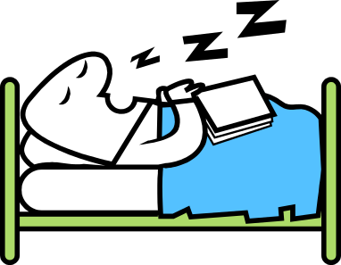


How PowerPoint
Is Typically Used
Many people “miss the boat” with PowerPoint.

Slide 3
How PowerPoint
Is Typically Used
How to Gain and Hold Attention with PowerPoint

Slide 4
Use as Overhead Replacement
Display text.
Display static graphics.
Use exactly as an overhead projector.

Slide 5
More Advanced Replacement
Place all information on a slide.
Reveal (build) the slide contents as you are ready.
Pace the lesson.

Slide 6
Never Hold Learner Attention
Use standard themes (called design templates in Office 2003): everything looks the same.

Slide 7
Miss Teaching Opportunities
Does not gain/hold learner attention.
Miss opportunities to illustrate concepts more clearly.
Miss opportunities for interactivity.

Slide 8
How Textbook-supplied PowerPoint Typically Looks
Why Should I Improve My PowerPoint Backgrounds?

Slide 9
How Textbook-supplied PowerPoint Typically Looks
Some clues that spyware is on your PC: (according to the Federal Trade Commission)
a barrage of pop-up ads
a hijacked browser (takes you to sites other than those you type into the address box)
a sudden or repeated change in your computer's Internet home page
new and unexpected toolbars
new and unexpected icons on the system tray at the bottom of your computer screen
keys that don't work (for example, the "Tab" key that might not work when you try to move to the next field in a Web form)
random error messages
sluggish or downright slow performance when opening programs or saving files
To guard against spyware, experts at the FTC and technologists suggest:
Update Windows and Web browser software.
Download free software only from sites you know and trust.
Be careful with peer-to-peer file-sharing programs. Know the risks (FTC's P2P File Sharing Alert).
Don't install any software without knowing exactly what it is.
Ensure your browser security setting is high enough to detect unauthorized downloads.
Don't click on any links within pop-up windows. (If you do, you may install spyware on your computer. Instead, close pop-up windows by clicking on the "X" icon in the title bar.)
Don't click on links in spam that claim to offer anti-spyware software. Some software offered in spam actually installs spyware.
Switch on the Windows firewall program or install a another similar product.

Slide 10
How Textbook-supplied PowerPoint Typically Looks
Material is “dumped” onto slides, overloading them and students.
All information is text-based and static.
Backgrounds are plain white.
  Can you make presentation accessible but not boring?

Slide 11
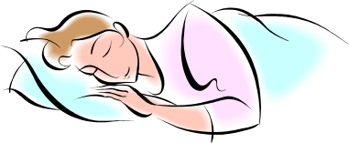
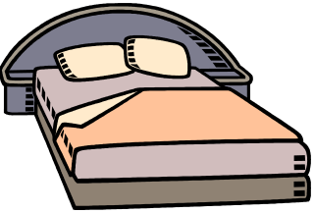
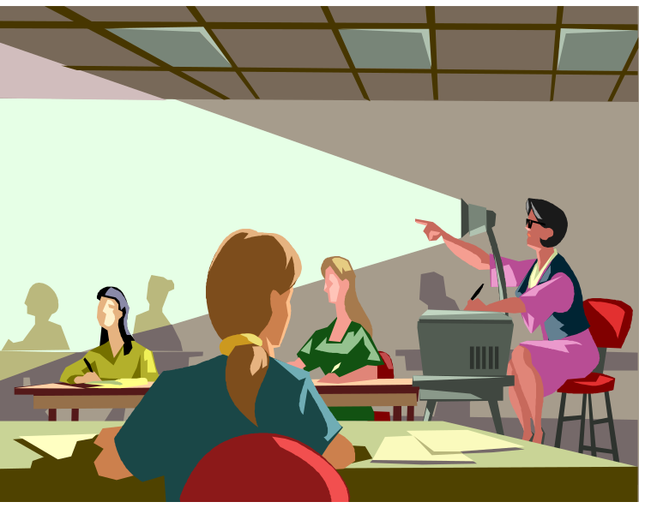
Result: Boring

Slide 12

Let’s Improve Our PowerPoint to Excite Our Students!
PowerPoint could be used to immerse students in an effective, interactive multimedia teaching/ learning environment.

