Slide 1

Creating More
Effective Backgrounds
Hands-on Approach
to Creating More Effective Backgrounds
Dr. Steve Broskoske
Misericordia University

Slide 2



Reasons to Use
Creative Backgrounds
Support content.
  Illustrate content.
  Create a sensory experience.
Support organization of presentation.
More Effective Learning

Slide 3
A Word about Themes
MS Office Help states:
  Document themes are shared across Office programs so that all of your Office documents can have the same, uniform look.
This feature makes designing the screen “easy” (dumbs it down).
Everything looks the same. Translation: boring!

Slide 4
A Word about Themes
While you don’t want to create a different background on every slide (that’s overkill), having the same background (theme) on every slide is B-O-R-I-N-G!
Didn’t we say that PP has the power to hold learner attention? It also has the ability to lose attention and bore an audience, depending how skillfully you use it.

Slide 5
Choosing a Solid Color
How to Do It
Select design tab.
Under the background group, press the little arrow to open the format background dialog box.
Select solid fill and choose colors.

Slide 6
Any Color to Indicate a Theme
Using a Solid Color

Slide 7
Counting Money
Using a Solid Color

Slide 8
Using a Color Gradient
How to Do It
Select design tab -- background group, open the format background dialog box.
Select gradient fill.
Select preset color OR make your own.

Slide 9
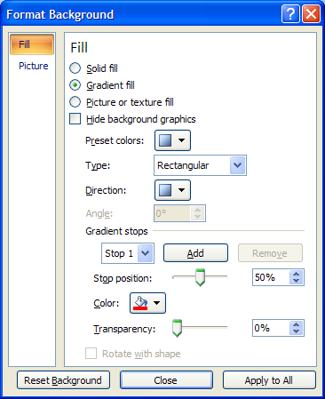
Using a Color Gradient
How to Do It
Pick colors (stops).
Slide stop position
slider.

Slide 10
Any Color to Indicate a Theme
Using a Color Gradient

Slide 11
Exploring the Hot Sun
Using a Color Gradient

Slide 12
Trick: Duplicating Slides
Trick
How to Do It
If you create a background you want to reuse, you can duplicate a slide and then edit it.
On the left-hand slide pane, right-click a slide, and select duplicate slide. Now you can edit the new slide.
Alternately, you can select another slide(s) and press control-Y to repeat the action.

Slide 13
A Pond
Using a Color Gradient

Slide 14
A Beautiful Blue Sky
Using a Color Gradient

Slide 15
A Rainbow
Using a Color Gradient

Slide 16
Using a Texture
How to Do It
Select design tab -- background group, open the format background dialog box.
Select texture fill.
Select texture from list.

Slide 17
Any Background to Indicate a Theme
Using a Texture

Slide 18
Prehistoric Times
Using a Texture

Slide 19
Making Text Boxes Readable
UDL Alert!
How to Do It
Double-click a text box border (be out of the box) to open drawing tools--format.
From the shape styles group, use the following tools as needed:
  Shape fill.
  Shape outline.
  Shape effects.

Slide 20
How an Historical Figure Died
Using a Texture

Slide 21
Background Washout Graphics
How to Do It
Select insert tab -- illustrations group – Clip Art OR picture.
As in Word:
  Resize picture as needed.
  Under picture tools--format, in the adjust group select recolor and washout.
  Right-click graphic and select send to back.

Slide 22
Learning About Computers
Using Background Graphics

Slide 23

Learning about a City/Country
Using Background Graphics

Slide 24
Tricks with Graphics and Text Boxes
How to Do It
Select the insert tab -- Clip Art OR picture from the illustrations group.
From the insert tab, select text box from the text group.
Position and format text box to achieve desired effect.

Slide 25
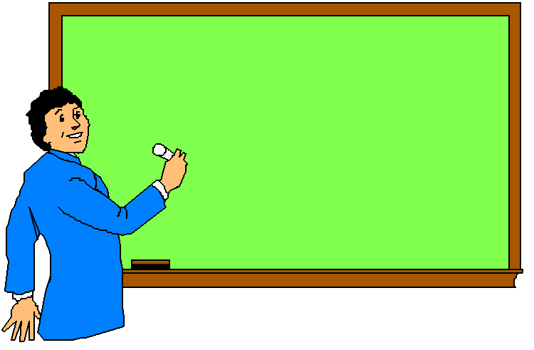
See What the Teacher Writes
Tricks with Graphics and Text Boxes

Slide 26

You Can Write in This Book
Tricks with Graphics and Text Boxes

Slide 27
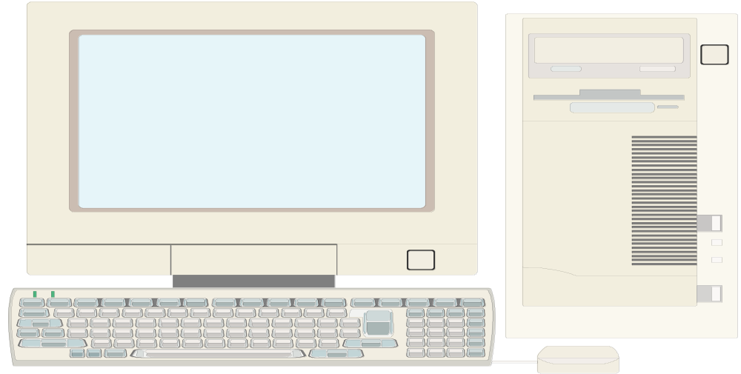
Write on the Computer Screen
Tricks with Graphics and Text Boxes

Slide 28
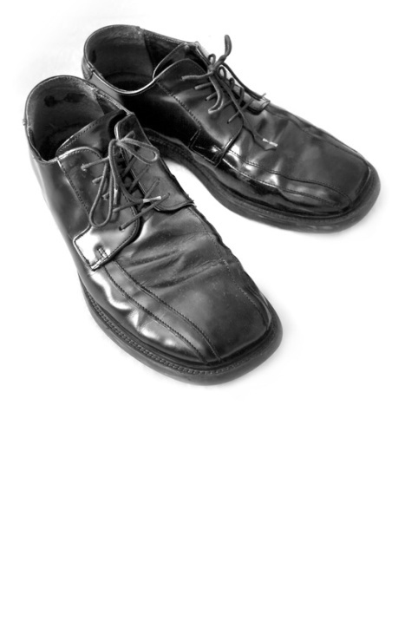

Reminder: Transparent Color
Tricks with Graphics and Text Boxes

Slide 29

Reminder: Compressing Images
Tricks with Graphics and Text Boxes

