Slide 1

Animating Graphics and Text Boxes
Hands-on Approach to
Animating Elements on a Slide
by Dr. Steve Broskoske

Slide 2
Animate Any Object on a Slide
Set up: From the animations tab, select animation pane from the advanced animations group.
Click to select an object.
Press add animation.
Specify:
  Entrance, emphasis, and/or exit.
  OR Motion path.
Specify a sound by selecting effects from the drop-down arrow in a play-listed item.

Slide 3

Animating a Graphic
Specify entrance, emphasis, and exit as desired. Select on click, with previous, or after previous to specify what will trigger the play-listed items to play.

Slide 4

Adding Sound to an Animation
Select the drop-down arrow for a play listed item, and select effect options to add a sound.

Slide 5

Animating Using a Custom Path
Select custom path. Double-click when done.

Slide 6
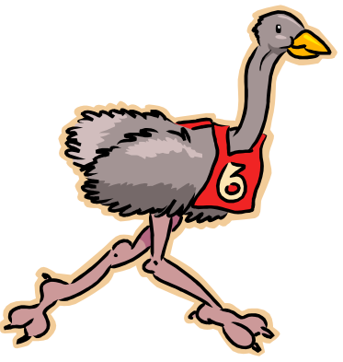
Animating Using a Custom Path
Trick
Consider dragging graphic off-screen before drawing path.

Slide 7
Animating Text
Select entire text box (not just the text) and specify animation entrance. Notice how all of the bullets get the same action.
Animating text is fun and easy.
Just remember to highlight the text box by clicking on a border of the box.
Then specify the entrance animation.
Then work with the bullets as one whole unit OR as individual play-listed items.

Slide 8
Animating Text
Specify an animation entrance. Then, expand the expander box. Now you can treat each bullet separately. Don’t exceed good taste!
Interactivity.
Such as flying bullets!
This allows the speaker to capture and focus audience attention.
And pace the presentation.

Slide 9
Advanced Animating Text
TRY IT: Some students with special needs may have trouble focusing. When you bring in a bullet, you could select effect options – after animation – [select a color] to “gray out” the bullet.
Fly in your first bullet.
When you fly in your second bullet, also change the color of your first bullet.
Remember to use “with previous” to minimize clicks.
Now focus is even easier for students.

Slide 10
Advanced Animating Text
TRY IT: Some students with special needs may have trouble focusing. When you bring in a bullet, you could select effect options – after animation – [select a color] to “gray out” the bullet.
Fly in your first bullet.
When you fly in your second bullet, also change the color of your first bullet.
Remember to use “with previous” to minimize clicks.
Now focus is even easier for students.

Slide 11



Reordering Animation Order
Animate the graphics. Then, use the re-order buttons below the play list to determine the order of play.

Slide 12

Review: Animation
Animate every element on this screen, even text boxes. Then change the order of animation. Title should enter first.
Butterflies are fun to watch!
Butterflies come in many different colors.
Butterflies live the first half of their lives crawling on the ground before they earn their wings.
Butterflies love to fly around.

Slide 13
Advanced Order of Animation
Animate so that an advantage appears, followed by a disadvantage. Do not animate the headings “advantages/disadvantages.”
Advantages
Advantage 1
Advantage 2
Advantage 3
Disadvantages
Disadvantage 1
Disadvantage 2
Disadvantage 3

Slide 14
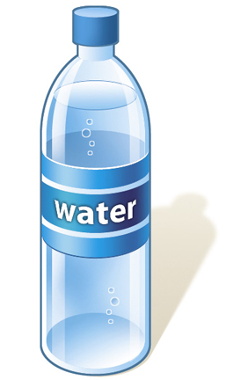

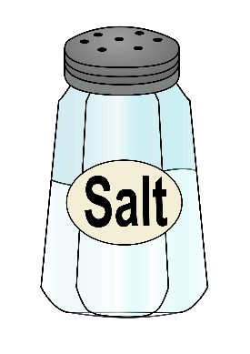
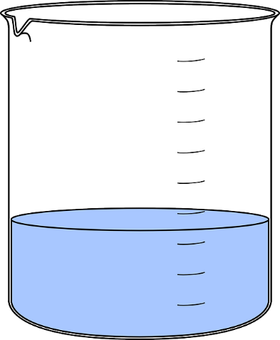
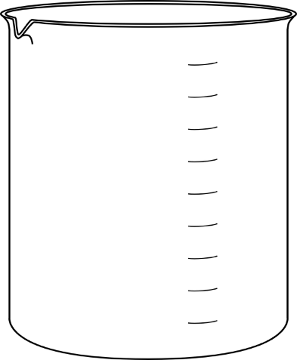
How to Make Saline Solution
Demo
Add 1 cup of water of distilled water into a container.
Add ½ teaspoon of salt.
Ingredients you will need:

Slide 15
How to Make Saline Solution
Try It!
Add 1 cup of water of distilled water into a container.
Add ½ teaspoon of salt.
Ingredients you will need:

Slide 16
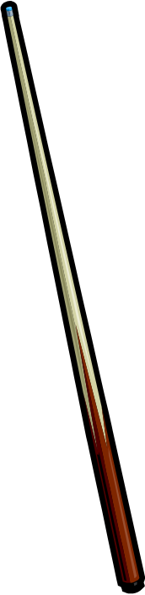
Advanced Timing with Animation
Select the drop-down arrow for a play listed item, and select show advanced timeline. Now, drag the timing bar(s) to properly adjust the timing of animation. (Ensure subsequent play listed items are set to “after previous” to enable the timing bar to be adjusted.)

Slide 17


Advanced Timing with Animation
Use the advanced timeline to make the football player kick the ball. Use the cropping tool to hide football. Draw a goal post. Add grass to field.

Slide 18
Creating and Animating
Callouts

Slide 19
Creating Callouts
From the insert tab, select shapes from the illustrations group. Then, animate them to point to something specific on a slide.
Point to this.
Point to this.
Point to this.

Slide 20
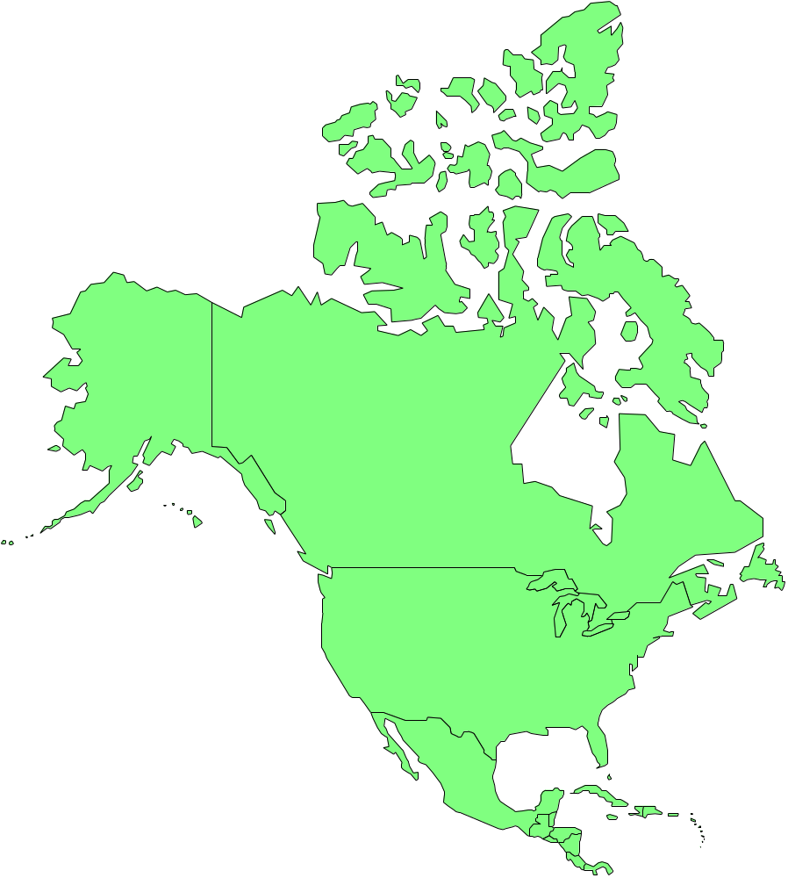
Creating Callouts

Slide 21
Using Drawing Tools as Callouts
From the insert tab, select shapes from the illustrations group. Use rectangles and ovals to call attention to words on the slide. After animating, right-click and select send to back.
The young man walked down the street.

Slide 22
Using Drawing Tools as Callouts
Additionally, add block arrows as callouts to provide additional information to various words below.
The eager student entered the classroom early.

Slide 23
Reminder: Don’t Overdo!
Correct this slide.
Animating text is fun and easy.
Just remember to highlight the text box by clicking on a border of the box.
Then specify the entrance animation.
Then work with the bullets as one whole unit OR as individual play-listed items.

Slide 24



Dinosaurs Disappeared
An asteroid collision with Earth caused the extinction of the dinosaurs about 65 million years ago.
Correct this slide.

Slide 25

Reminder: Ensure Text is Readable (UDL)
Correct this slide.
Animating text is fun and easy.
Just remember to highlight the text box by clicking on a border of the box.
Then specify the entrance animation.
Then work with the bullets as one whole unit OR as individual play-listed items.

Slide 26
Review
Animate an object by specifying entrance, emphasis, and exit, or custom path.
Add sound by selecting effects from a play-listed item’s drop-down menu.
Change animation order by using re-order buttons.
Create call-outs to point to items on a slide by using drawing tools or autoshapes.

