Slide 1



Virtual Experiences in the Classroom: Augmented Reality
TED 121 Educational Technology
Dr. Steve Broskoske

Slide 2
Goals
To introduce you to augmented reality: what it is and how it functions.
To explore a number of mobile software applications (apps) for various grade levels that “bring content to life” and allow pupils to explore content in a hands-on and visual way.

Slide 3
Introduction to
Augmented Reality

Slide 4
What Is Augmented Reality?
Augmented reality (AR): Interaction of overlaid audio, graphics, text, and other virtual elements on a real-world environment displayed in real-time (Green, Green, & Brown, 2017).
Augmented reality involves superimposing a computer-generated image on a user’s view of the real world (Dictionary.com).

Slide 5
What Is Augmented Reality?
The AR objects are either scanned into digitizing software or created through computer-assisted design (CAD) software.
The augmented object, situated within an image of the real world, has the capacity to appear more real to the user when compared with virtual reality, in which the user is immersed in a completely computer-generated environment.
Further, the user can manipulate and explore the object in an interactive environment.

Slide 6
Markers vs. No Markers
Augmented reality can involve either the use of markers to place AR objects or can involve no markers.
  Markers: Some type of object over which the AR artifact is digitally mapped. The marker can be a QR code, a diagram of some content, or an object (such as a Merge Cube).
  Markerless: An AR artifact is placed in an open space or on an existing objects (such as a table).

Slide 7
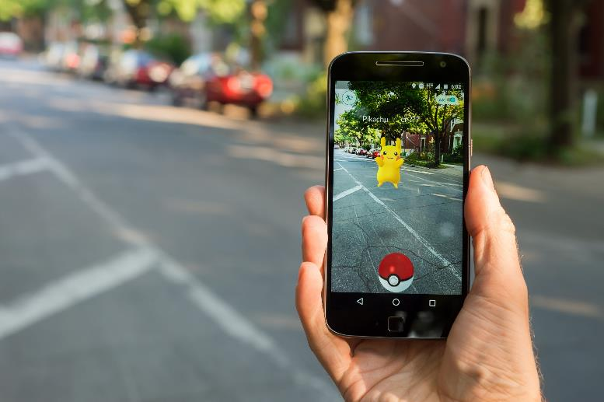

What Is Augmented Reality?
While AR existed in theory and in rudimentary forms for a number of years, AR captured public attention when the electronic game, Pokemon Go, was released in the summer of 2016.
(Green, Green, & Brown, 2017)

Slide 8

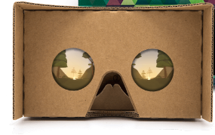
How Does AR Compare to VR?
Virtual reality involves immersing a learner within a completely computer-generated simulation of a 3-D environment. Many times the learner uses a VR viewer (e.g., Occulus or Google Cardboard).

Slide 9
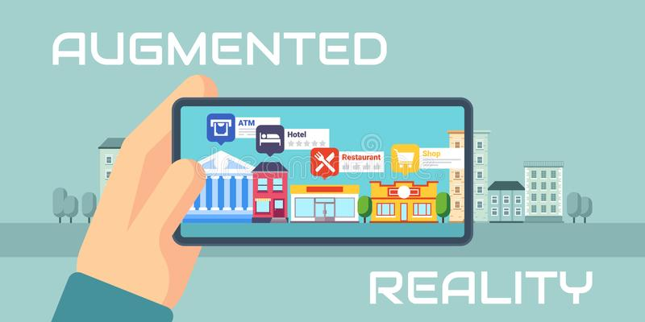
How Does AR Compare to VR?
Augmented reality involves learners viewing the real world through a mobile device and placing a computer-generated 3-D image into the real world. Usually viewed through a smart mobile device.

Slide 10

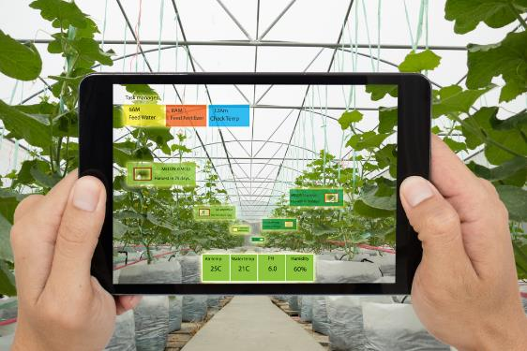
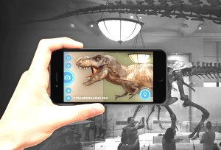
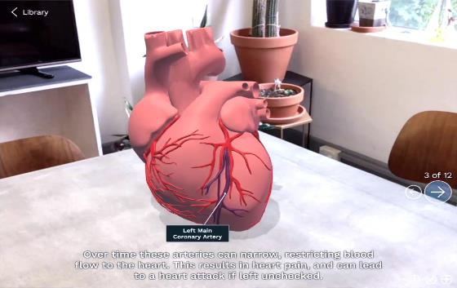
Potential Uses of AR in K-12

Slide 11
Can AR Benefit the Classroom?
According to one study (Hsin-Hun, Yang, Chen, & Wernhuar, 2017), the real-world objects presented in augmented reality can:
  Reduce the mental load of learners.
  Increase the sense of immediacy due to the appearance of peers and other real-world objects.
  Enhance learner motivation.

Slide 12
Can AR Benefit the Classroom?
Several researchers have also suggested that AR holds much potential to positively impact the classroom
  Klopfer & Sheldon, 2010
  Santos, Taketomi, Yamamoto, Rodrigo, Sandor, & Kato, 2016

Slide 13
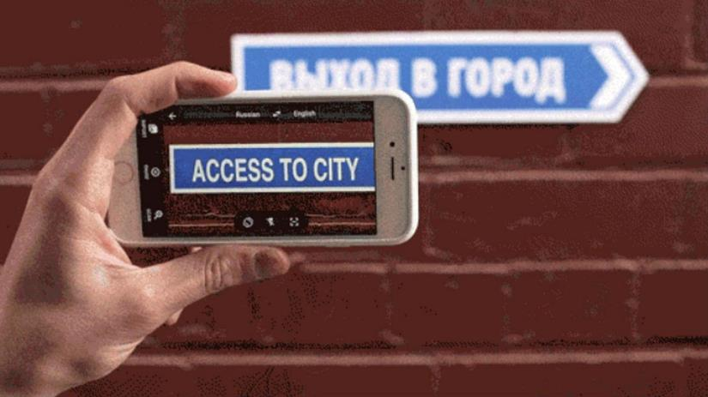
AR Outside of the Classroom
Google Translate: Going far beyond traditional translation apps, this app live replaces existing text with text translated into another language.

Slide 14



AR Outside of the Classroom
HP Reveal: Once called “Aurasma,” this tool brings to life everyday, ordinary objects by mapping AR content over the objects.
Notes:
https://youtu.be/mm-RGrG4qLA?t=323

Slide 15
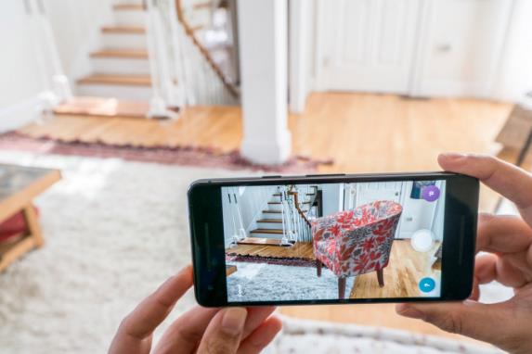
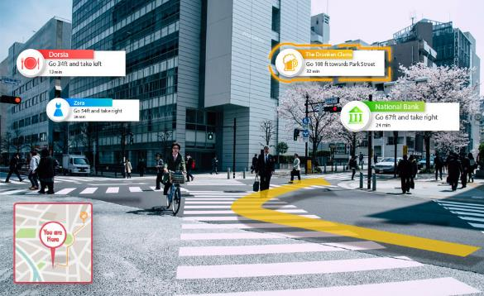
AR Outside of the Classroom
Mapping software can provide helpful information about surroundings.
Wayfair now allows consumers to shop for furniture by placing AR objects in their rooms.

Slide 16
AR Demonstration

Slide 17
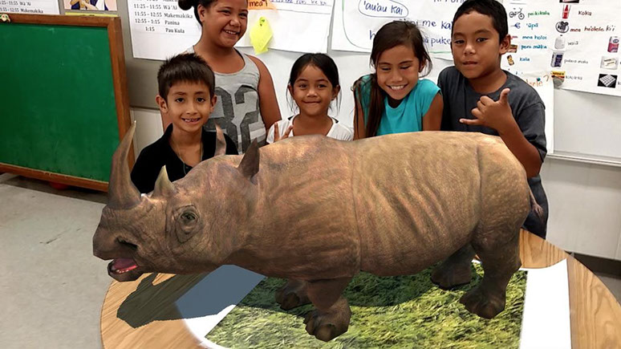
Zookazam
Zookazam: This app allows younger learners to explore over 50 animals in AR. Cost: $0.99

Slide 18
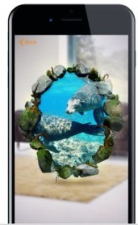
Hologo
Hologo: With Hologo journeys, walk through a portal into a new land, such as into Rome to view the Colloseum or underwater.

Slide 19
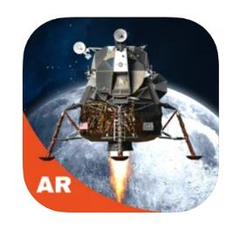

Apollo’s Moon Shot AR
Place yourself in the middle of the moon mission, launch a Saturn V rocket, sit inside the Lunar Command Module of Apollo 11, and step through a portal to explore the lunar landscape

Slide 20
Centers
In groups, we will visit 3 centers:
  AR apps for younger children.
  Merge Cube apps.
  AR apps for older children.

Slide 21
AR for Younger Children

Slide 22
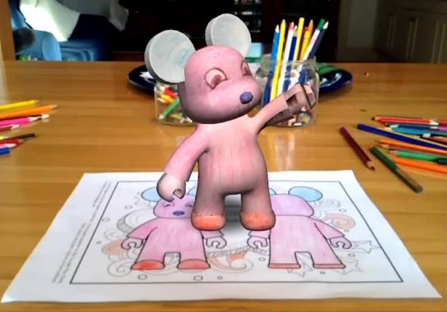
Quiver AR
Quiver AR: This app prompts early childhood learners to color provided coloring sheets, and then bring them to life as AR objects.

Slide 23

GeoGebra VR
GeoGebra AR: Provides shape activities for younger children. Also, older students can type in an equation and the tool displays a real-world display of a mathematical equation.

Slide 24
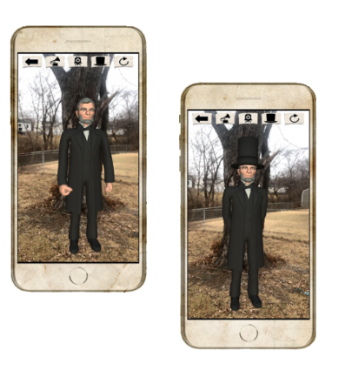
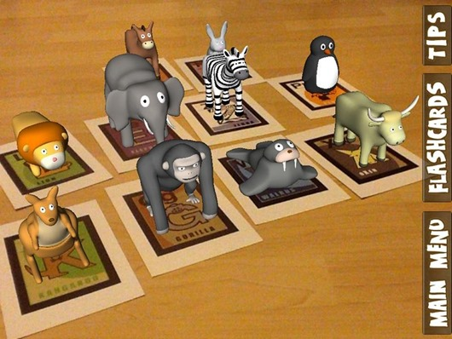
AR Flashcards
AR Flashcards: This app allows young students to explore a number of different areas of content: shapes, colors, alphabet, animals, space, President Lincoln.
AR Flashcards

Slide 25
Merge Cube

Slide 26
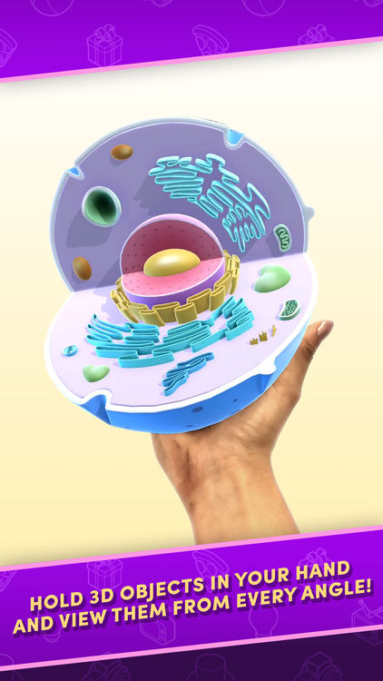

Merge Cube
Merge Cube: Using various apps, a student can digitally map an artifact onto a Merge Cube marker, effectively turning the cube into the artifact, allowing it to be manipulated and studied directly.

Slide 27
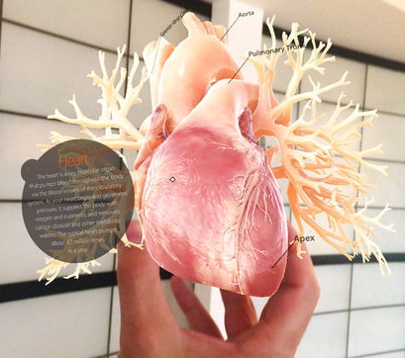
Anatomy AR+
Anatomy AR+: This app digitally maps various organs and systems of the human body onto the Merge Cube. Cost: $0.99

Slide 28
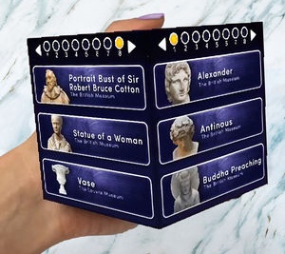
Museum Viewer
Museum Viewer: This app digitally maps 20 different museum artifacts onto the Merge Cube so students can explore and learn more about the items.

Slide 29
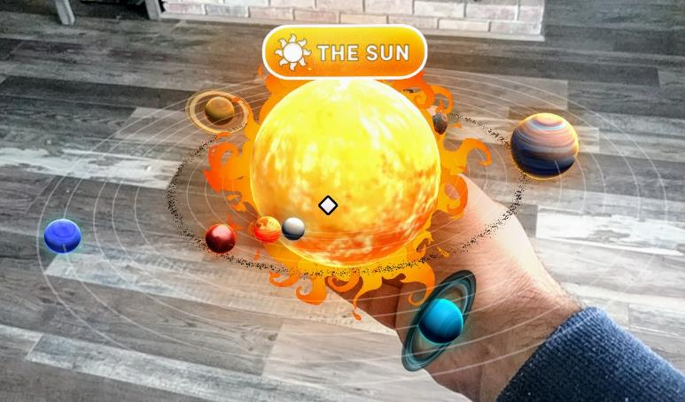
Galactic Explorer
Galactic Explorer: This app digitally maps our solar system onto the Merge Cube so students can explore and manipulate.

Slide 30
AR for Older Students

Slide 31
Google Expeditions
Google Expeditions was a great augmented reality teaching tool that has recently been discontinued. It allows teachers to produce AR full-size objects and explore them.

Slide 32
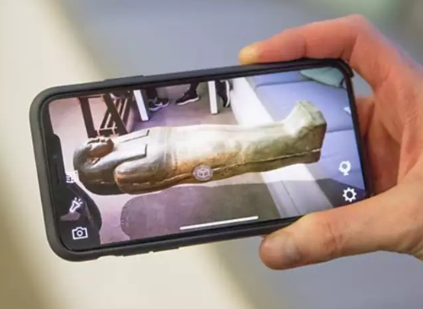
Civilisations AR
Civilisations AR: Based on the popular BBC TV show, this app allows users to explore various artifacts, place them in the current view, manipulate, and explore them.

Slide 33
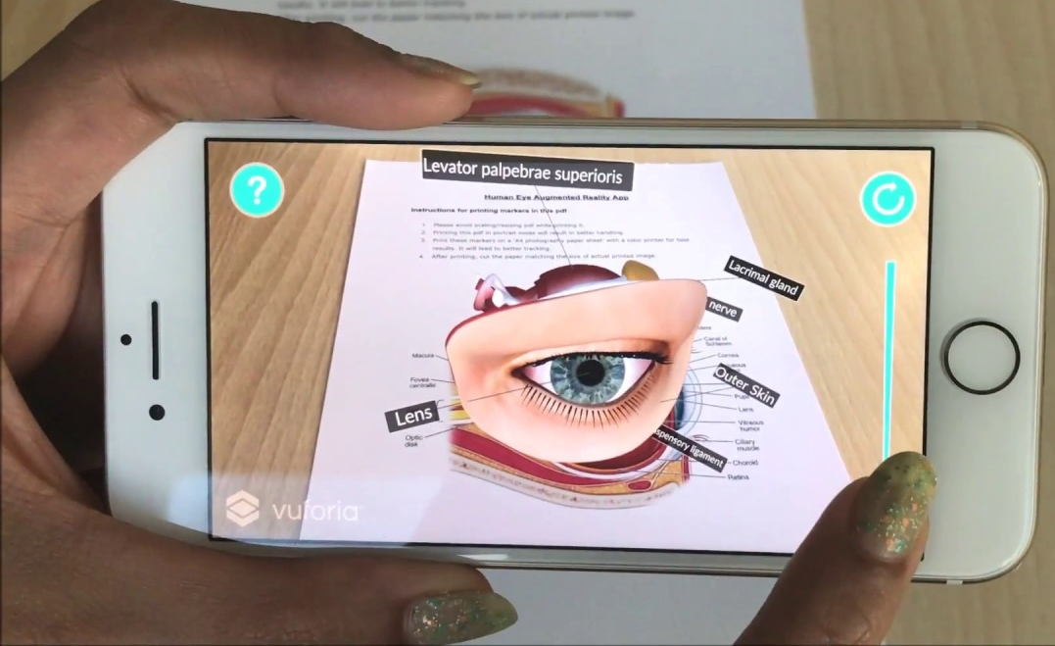
Human Eye Augmented Reality
Human Eye Augmented Reality: Print out the marker (color diagram of eye), point the device at the marker, and explore the eye in 3-D. Peel away layers to explore more in depth.

Slide 34
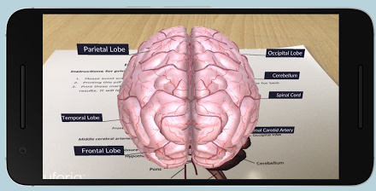
Human Brain
Augmented Reality
Human Brain Augmented Reality: Print out the marker (color diagram of eye), point the device at the marker, and explore the brain in 3-D.

Slide 35
Online Discussion
To process information from today’s class, let’s use a discussion board. Record your reactions and thoughts about augmented reality. I have provided the following questions to spark our conversation. You do not have to answer every individual question.

Slide 36
Online Discussion
What are your reactions to augmented reality?
Could you use AR apps in your teaching? How?
How do you predict your students would enjoy using AR apps?
Did any apps in particular interest you? How might you use them to support teaching/learning?

