Slide 1

Introduction to Universal Design for Learning (UDL)
Dr. Steve Broskoske
Misericordia University

Slide 2
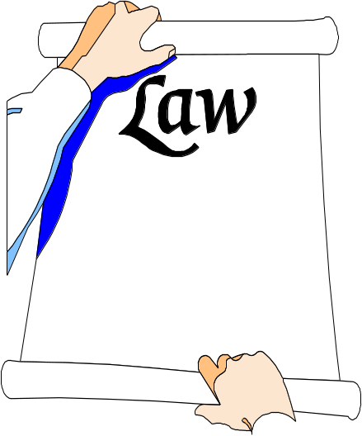
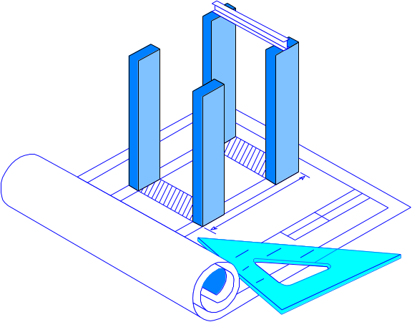
Where did Universal Design Come From?
Individuals with Disabilities Act (IDEA)
Rehabilitation Act of 1973, Section 504
Architectural practice of Universal Design.
Architecture

Slide 3
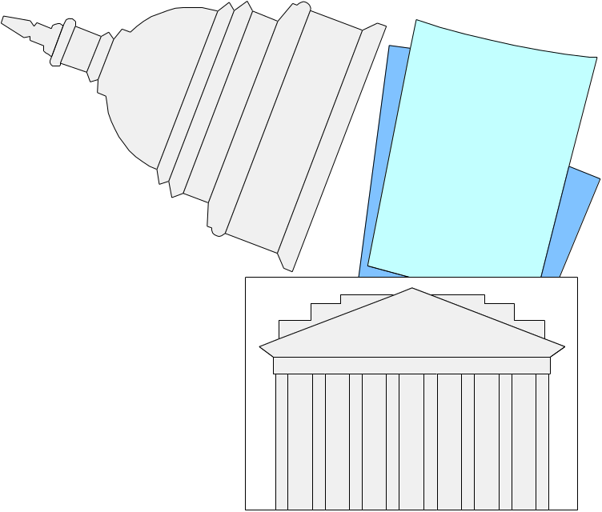

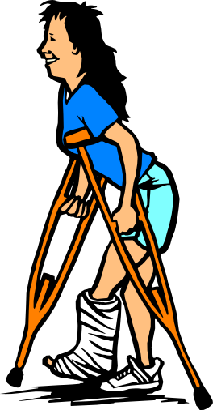
Universal Design
Universal Design has it's basis in Section 504 of the Rehabilitation Act which mandated that public buildings be accessible to all.
LAW

Slide 4
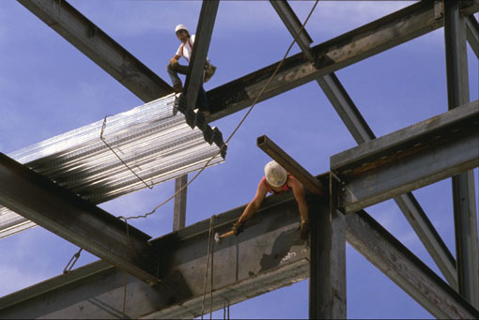
“Universal design does not focus on the very tall or the very short, the person who uses a wheelchair or the person whose hands are affected by arthritis, the person who is 7.5 years old
or 75 years old. It does, however, embrace each of these people as possible users of a space (or product), and eliminates bias against them…consumers have a right to expect their unique needs will be met by design.”
Mary Jo Peterson, CKD, CBD, CAPS
Kitchen and bath designer

Slide 5
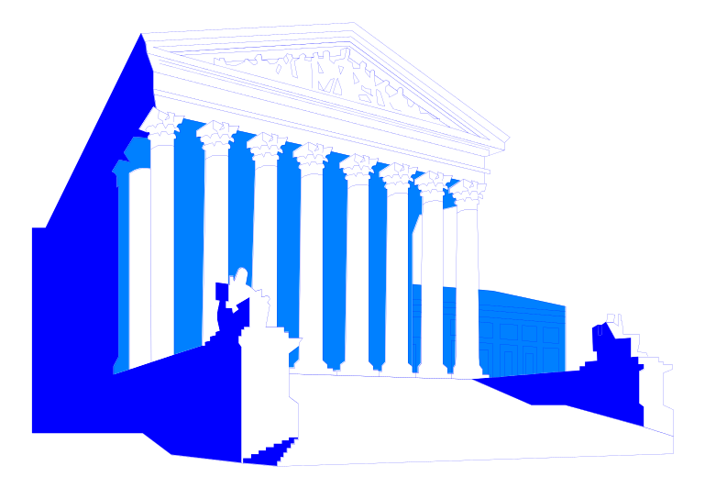


Universal Design
Don’t retrofit or “fix” the building to accommodate people with special needs.
Construct the building to meet the needs of all users of a space.
Universal design will become a way of life, and benefit all people.
ramp

Slide 6


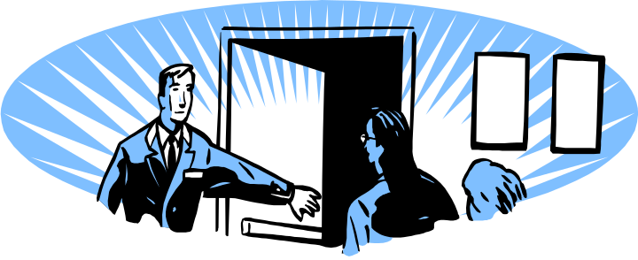
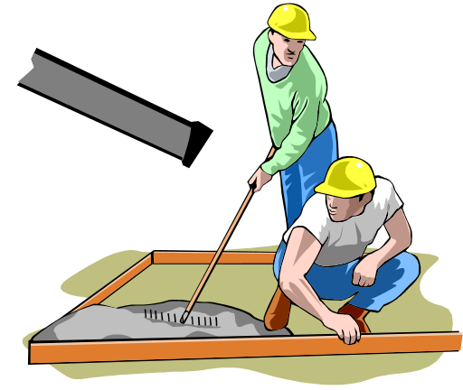
Universal Design
Text messaging on cell phones
Closed
captions
Automatic opening doors
Curb cuts in sidewalks

Slide 7

Universal Design in Education
According to CAST:
  Universal Design for Learning (UDL) is a framework to improve and optimize teaching and learning for all people based on scientific insights into how humans learn.
CAST is a nonprofit education research and development organization that created the Universal Design for Learning framework and UDL Guidelines.

Slide 8
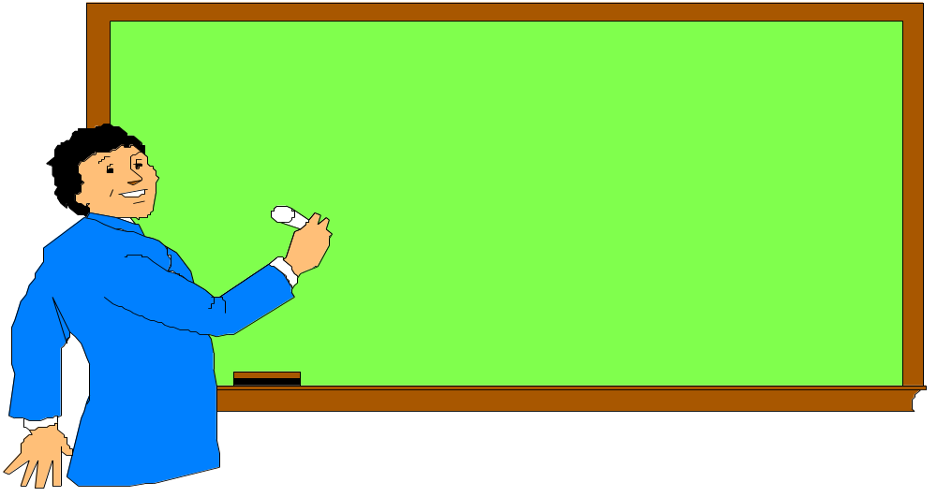
Universal Design in Education
Universal Design for Learning (UDL):
  Physical access to school buildings.
  Access to the curriculum: teaching, learning, and assessment.

Slide 9

What does “universal” mean?
The “universal” in universal design does not imply one optimal solution for everyone. Rather, it reflects an awareness of the unique nature of each learner and the need to accommodate differences, creating learning experiences that suit the learner and maximize his or her ability to progress.
(CAST website)

Slide 10
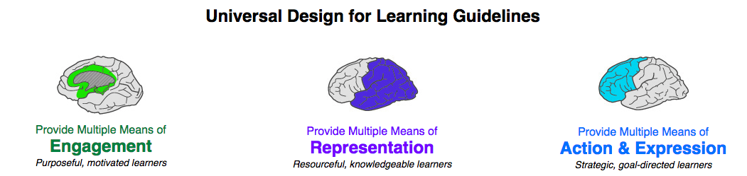
What Does
Universal Design Entail?
According to CAST, Universal Design involves:
This Photo by CAST.org is licensed under CC BY

Slide 11
UDL Paradigm Shift
Pre-UDL
Students with disabilities are considered in a separate category.
UDL
Students with disabilities fall along a continuum of learner differences within the classroom.

Slide 12
UDL Paradigm Shift
Pre-UDL
Learners with disabilities are viewed as having a “problem” that needs to be fixed.
UDL
All students learn differently. Teachers “fix” teaching to accommodate learner differences.

Slide 13
UDL Paradigm Shift
Pre-UDL
Teacher adjusts instruction for students with disabilities.
UDL
Teacher designs the curriculum in advance to accommodate all learners.

Slide 14
UDL Paradigm Shift
Pre-UDL
The major curricular vehicle is a textbook.
UDL
Curriculum materials are varied and diverse to accommodate various learning styles.

Slide 15
Who benefits from UDL?
Learning differences.
Cultural differences.
Language differences.
Physical differences.
Sensory differences.
Cognitive differences.
Students with IEP’s.
Everyone!

Slide 16
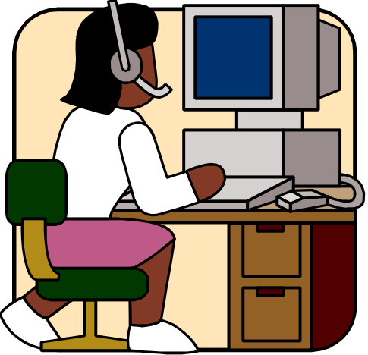
Technology and UDL
Digital multimedia learning tools:
  Making UDL a reachable goal.
  Making attainment of UDL within reach of individual educators and students.

Slide 17
On the basic level, how can I design my materials to be accessible to ALL learners?
Utilize readable fonts and font sizes.
Use plenty of white space.
Provide sufficient visual contrast between text and backgrounds.
Minimize distractions:
  Background sounds and effects.
  Animated graphics.
  Visual crowding.

Slide 18
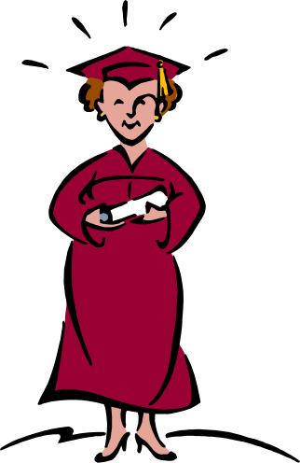
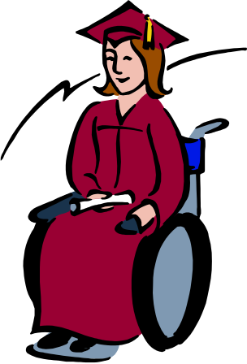
As We Learn About
Technology in Modules 4 & 5…
We will consider how to apply the principles of UDL in the educational materials we produce to benefit all learners.

