Slide 1

Introduction to Scratch Coding
Dr. Steve Broskoske
TED 121
Educational Technology
Misericordia University

Slide 2
Introduction to Scratch
STEM: Focus on science, technology, engineering, and mathematics.
STEAM: Focus on science, technology, engineering, art, and mathematics.
One part of this focus in education is programming/coding/robotics and object-oriented programming.

Slide 3
Introduction to Scratch
Scratch is a free programming environment that runs in a Web browser. Designed by the MIT Media Lab’s Lifelong Kindergarten Group.
Scratch users (“Scratchers”) can create programs by snapping together code blocks in the Scratch editor (like Legos).
Designed for 8- to 16-year-olds, but can appeal to all ages.

Slide 4
Introduction to Scratch
No software to install.
Completely free — no ads or in-app purchases.
Can use online or download a copy of the offline editor software.
Use the mouse to drag and drop code blocks — little typing is needed.

Slide 5
Scripting in Scratch
The most basic object in Scratch is the sprite. Sprites appear on the Stage, and their code blocks control their behavior.
The editor automatically starts with a cat sprite, but you can change/add sprites.
Program a sprite by adding code blocks to the Scripts Area in the middle of the screen.
In Scratch, a stack of code blocks is called a script.

Slide 6
Exploring Scratch
Navigate to Scratch:
https://scratch.mit.edu/
Let’s explore the interface.
Scratch online

Slide 7
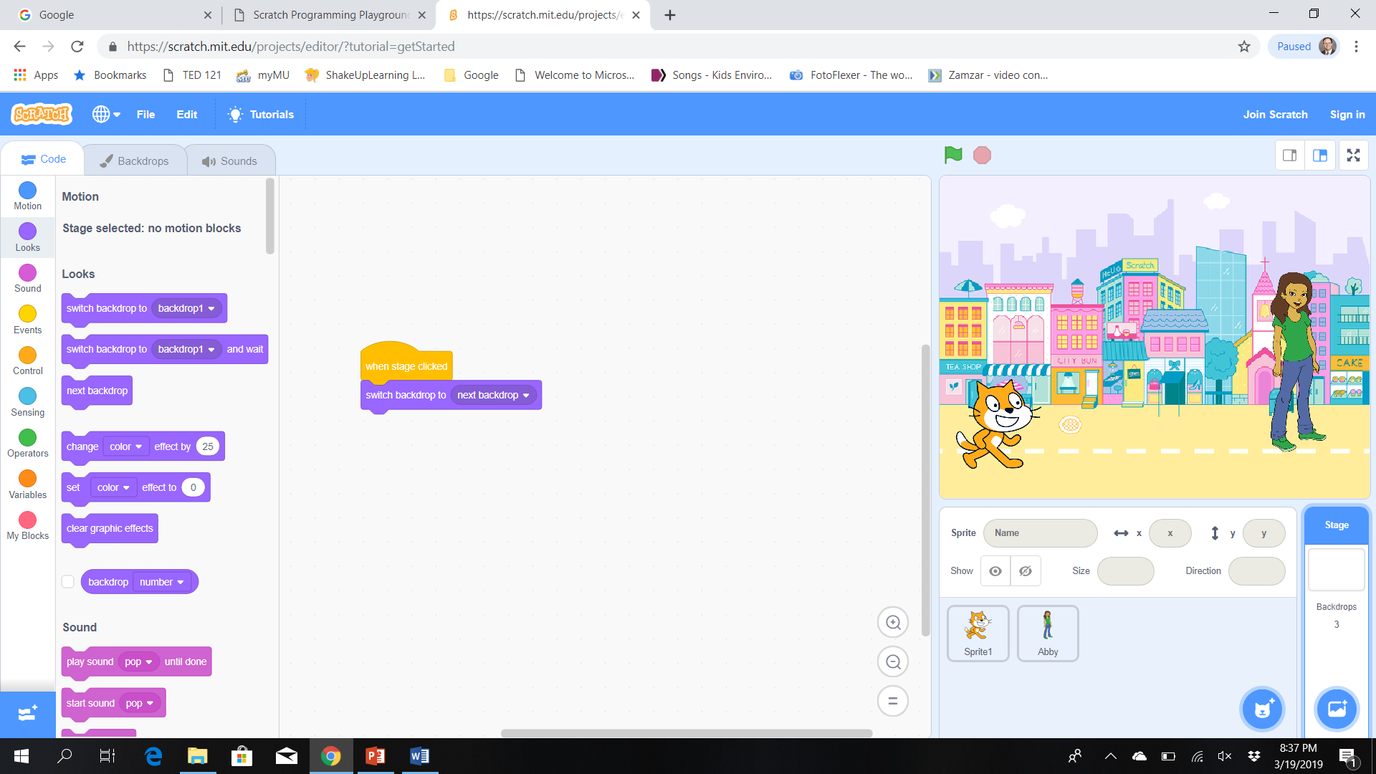
Exploring Scratch
Categories of coding blocks.
Stage.
Coding blocks.
Coding area.

Slide 8
Categories of Code Blocks
Motion.
Looks.
Events.
Control.
Sound.
Sensing.
Operators
Variables.
More blocks. (Click extensions in lower left.)
Let’s focus on these blocks today.

Slide 9
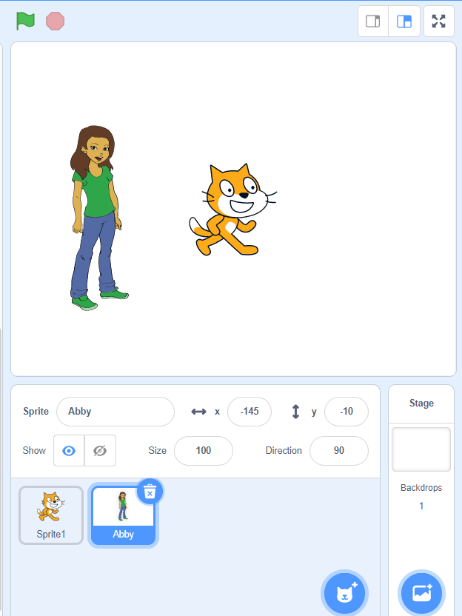
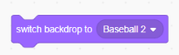
Add a Sprite / Change Backdrop
1) Add a backdrop.
2) Drag this coding block and click to run.
Add a sprite.

Slide 10
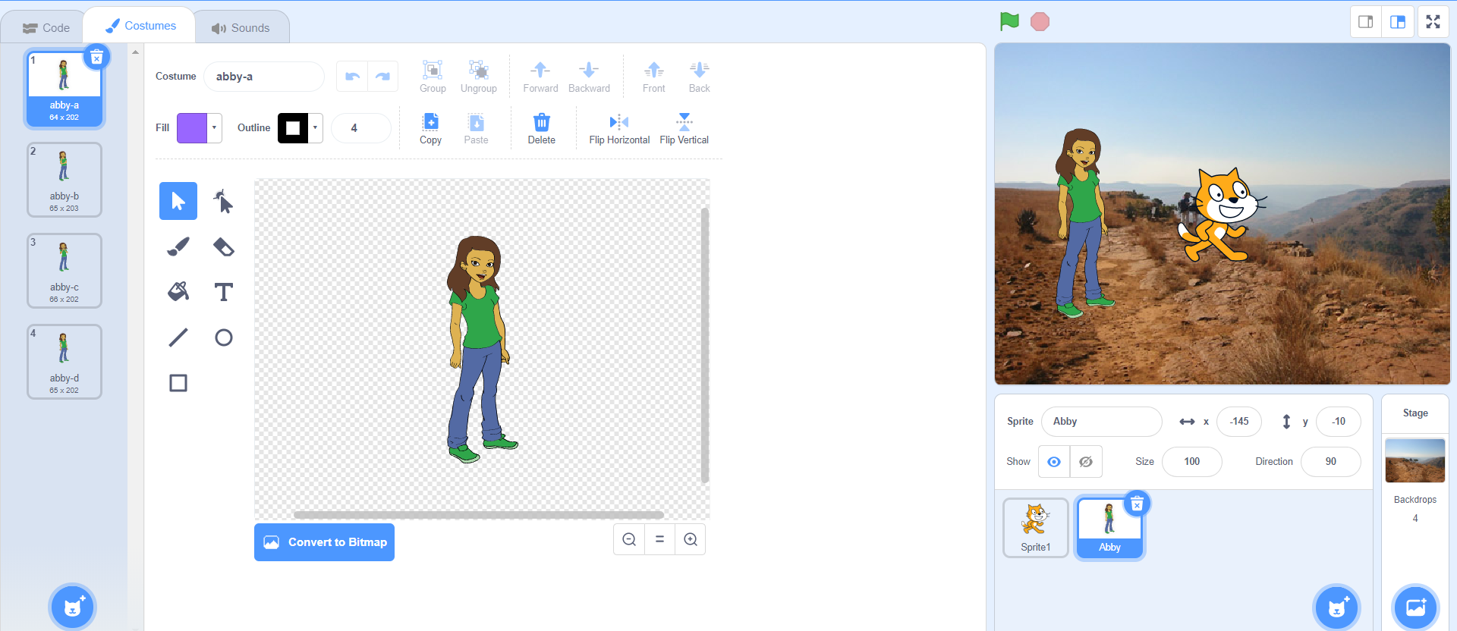
Edit Costumes
2) Use tools to edit costumes.
1) Click a sprite or a backdrop to select.

Slide 11
Coding Hints
Drag a coding block to the coding window. Drag a block to the left to erase it.
Right-click the character in the upper right-hand corner of the scripting window.
  Undo an action.
  Clean up blocks.
Everything is “live.” To change a backdrop on the stage, select the backdrop and click on the “switch the backdrop to…” control to make it work.

Slide 12
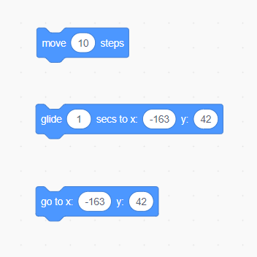
Moving a Sprite: Add a Motion
Move (like walk).
Glide to a position.
Move quickly to a position.

Slide 13
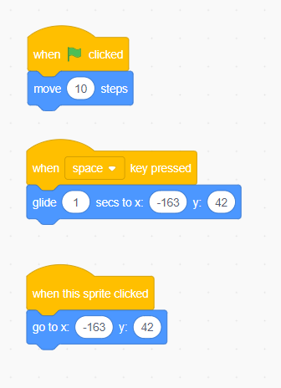
Moving a Sprite: Add an Event
Click flag.
Press a key.
Click a sprite.

Slide 14
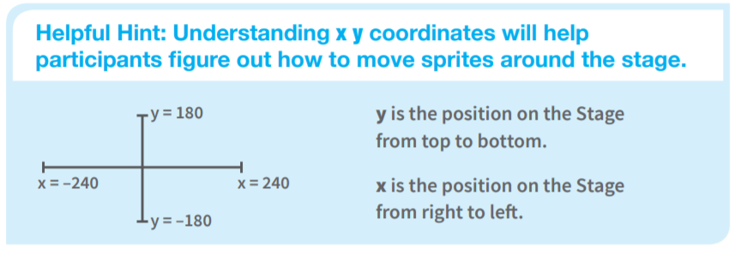
Understanding Movement
Hint: You can drag a sprite to a location on the stage and view the coordinates.

Slide 15
Moving a Sprite
Challenge: Make a sprite move up/down/right/left when the corresponding arrow key is pressed.
Use the “when X is pressed” and “change x by” blocks.

Slide 16
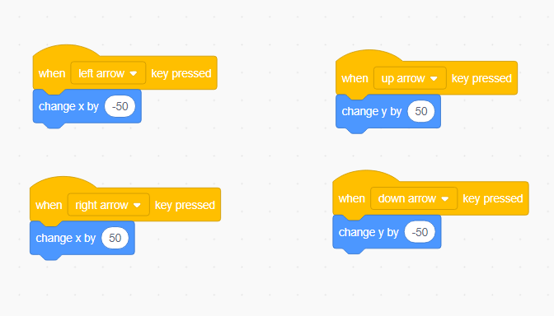
Moving a Sprite
Challenge: Make a sprite move up/down/right/left when the corresponding arrow key is presed.

Slide 17
Moving a Sprite
Now add an additional sprite and animate it.
  Remember to click on the appropriate sprite before coding.
  The sprite should be showing in the upper right portion of the coding window.

Slide 18
Moving a Sprite: Advanced
Challenge: Now let’s animate a sprite using these advanced coding blocks.
  When a key is pressed, make a sprite move to the mouse pointer.
  When a key is pressed, make a sprite move to the other sprite.

Slide 19
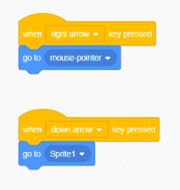
Moving a Sprite: Advanced
Challenge: Now let’s animate a sprite using these advanced coding blocks.

Slide 20
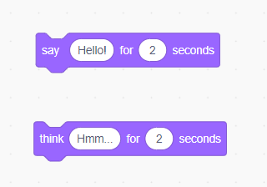
Sprite Actions: Changing Looks
Say something.
Think something.
Try adding an event to trigger the looks to occur.

Slide 21
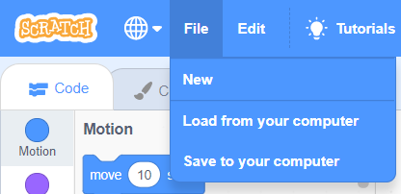
Saving Your Work
You can save and load Scratch programs to/from your computer (or Cloud account).
You can also create a login to save your work online.

Slide 22
Code Using Tutorials
Try It
Navigate to the following site and experiment with Scratch coding:
  https://scratch.mit.edu/ideas
For each activity presented, you can:
  Try the Tutorial.
  Download a set of Coding Cards.
  View the Educator Guide.
Scratch Tutorials

Slide 23
Next Class
Intermediate coding with Scratch.
  Operators.
  Variables.

