Slide 1

Intermediate Scratch Coding
Dr. Steve Broskoske
TED 121
Educational Technology
Misericordia University

Slide 2
Exploring Scratch
Navigate to Scratch:
https://scratch.mit.edu/
Scratch online

Slide 3
Categories of Code Blocks
Motion.
Looks.
Events.
Control.
More blocks. (Click extensions in
lower left.)
Sound.
Sensing.
Operators.
Variables.
Let’s focus on these blocks today.

Slide 4
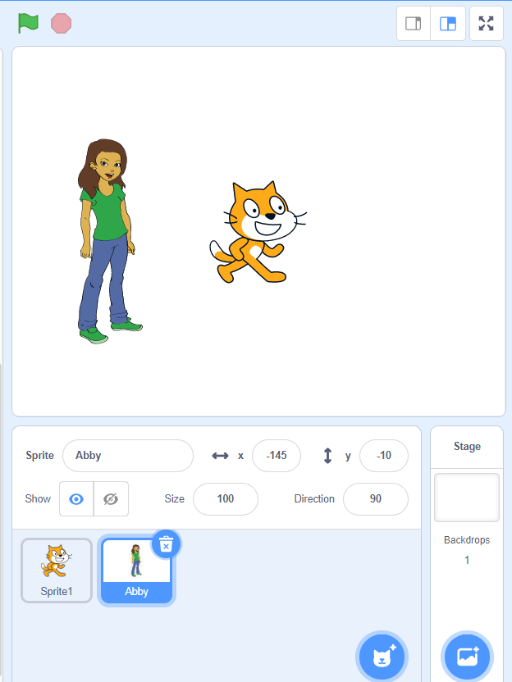
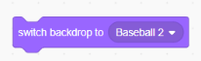
Add a Sprite
Change Backdrop
Review
1) Add a backdrop.
2) Drag this coding block and click to run.
Add a sprite.

Slide 5
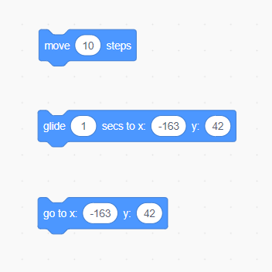
Moving a Sprite: Add Motion
Review
Move (like walk).
Glide to a position.
Move quickly to a position.

Slide 6
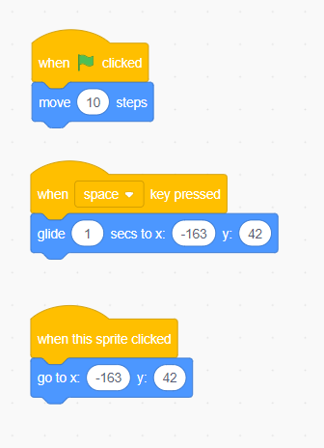
Moving a Sprite: Add Event
Review
Click flag.
Press a key.
Click a sprite.

Slide 7
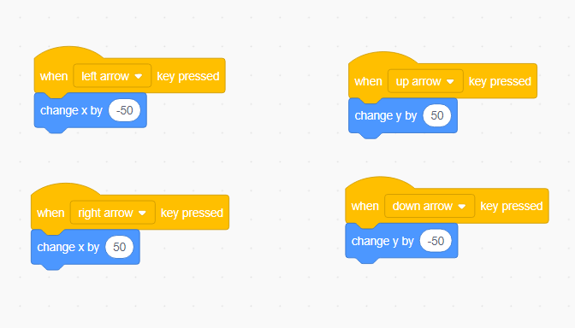
Moving a Sprite
Review
Make a sprite move up/down/right/left when the corresponding arrow key is pressed.

Slide 8
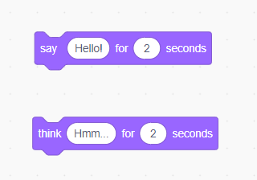
Sprite Actions: Changing Looks
Review
Say something.
Think something.
Try adding an event to trigger the looks to occur.

Slide 9
Intermediate Scratch

Slide 10
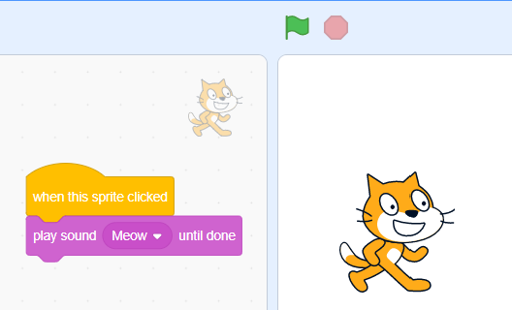
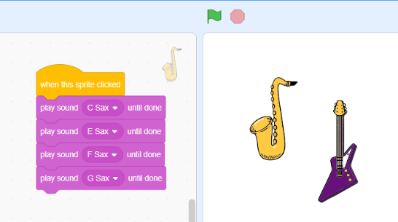
Have a Sprite Play a Sound

Slide 11
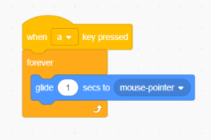
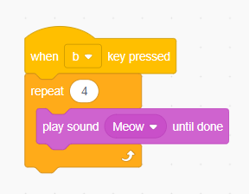
Introduction to Looping
Looping means having code repeat under specific conditions (such as “forever” or for a set number of times).

Slide 12
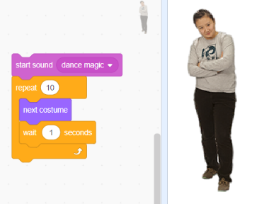
Use a Loop to Make a
Sprite Dance to Music
Start sound.
Create a loop to function 10 times.
“Next costume” switches dance positions.
Use to slow down motion.

Slide 13
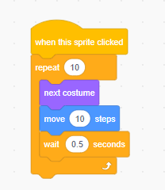
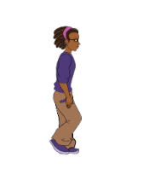
Use a Loop to Animate a Sprite
Insert a new sprite: Avery walking.
Let’s use a loop, changing costumes, and motion to make this sprite walk.

Slide 14
TRY IT
Change costumes.
  Select a sprite that has several costumes (different movements).
  Make the sprite move around the screen and change costume (movement/position).
Use a loop.
  Select a sprite that has several costumes.
  Use a loop to cause the sprite to change costumes (movement/position) automatically.

Slide 15
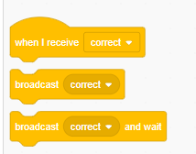
Broadcast Messages
You can use these coding blocks to:
  Send a broadcast message.
  Trigger a sprite to do something when a broadcast message is received.

Slide 16
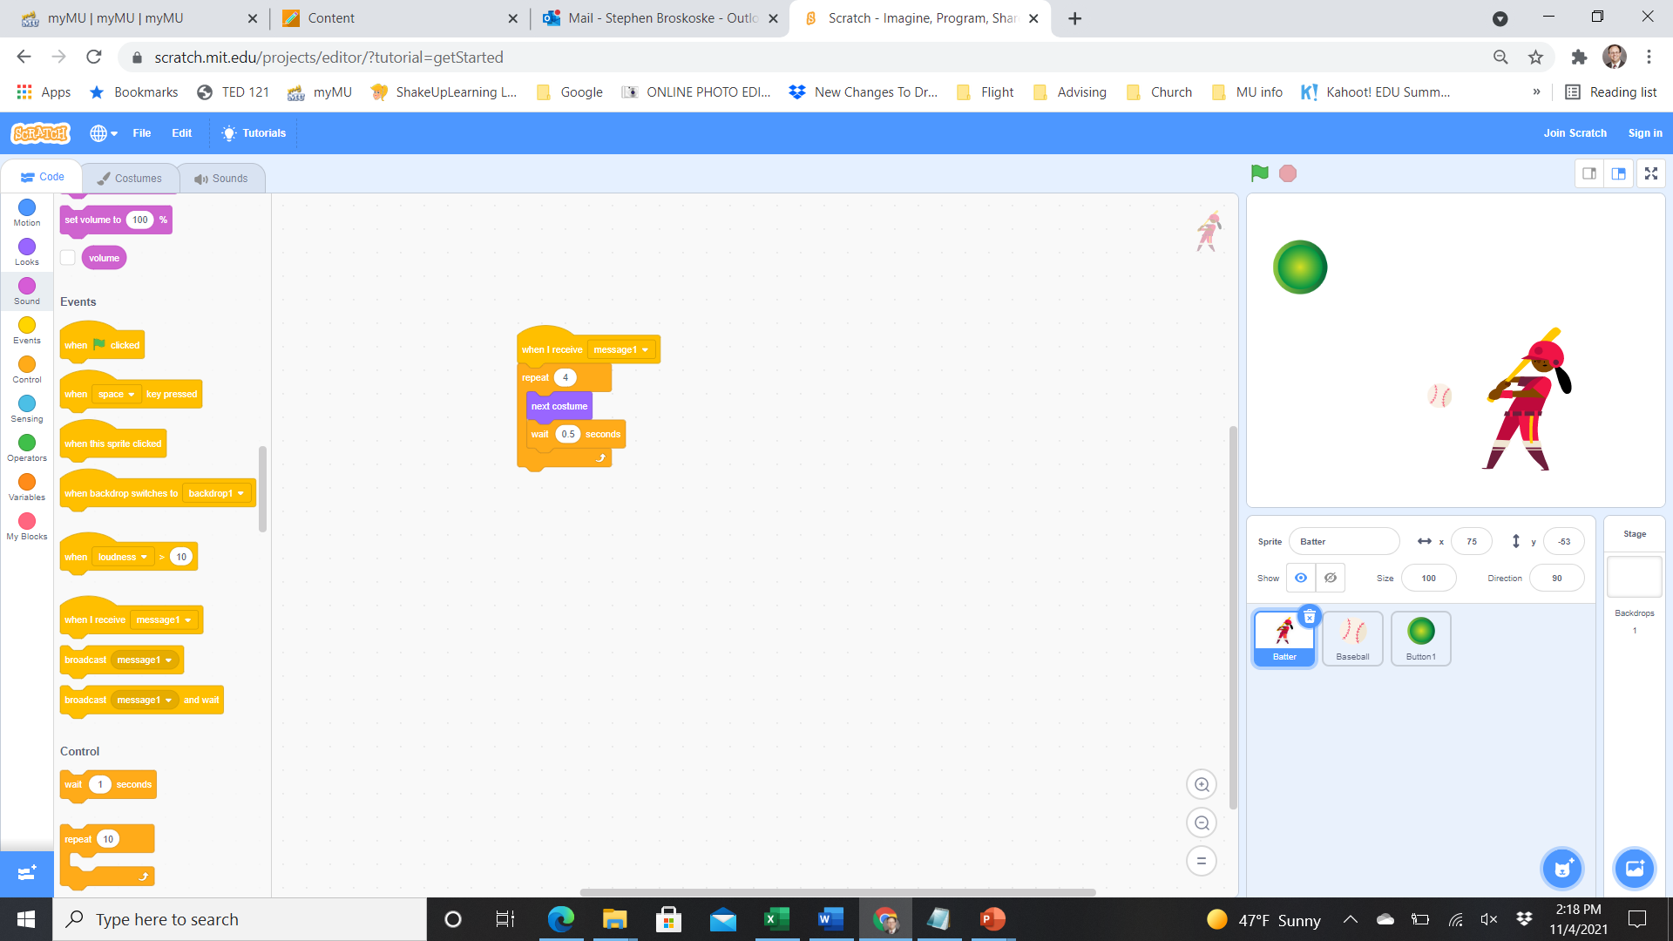
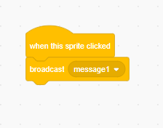
Send a Broadcast Message
Let’s send a broadcast message to trigger some event to start.
Batter
Button

Slide 17
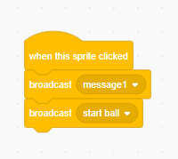
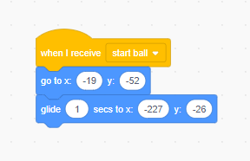
Broadcast Message:
Make Ball Fly
Let’s send a broadcast message to trigger some event to start.
Button
Ball
Add to trigger
ball to move.
Add to move ball
back to initial position.

Slide 18
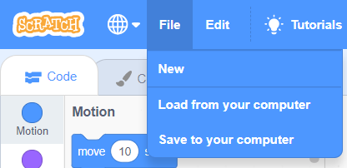
Saving Your Work
You can save and load Scratch programs to/from your computer (or Cloud account).
You can also create a login to save your work online.

Slide 19
Code Using Tutorials
Try It
Navigate to the following site and experiment with Scratch coding:
  https://scratch.mit.edu/ideas
For each activity presented, you can:
  Try the Tutorial.
  Download a set of Coding Cards.
  View the Educator Guide.
Scratch Tutorials

Slide 20
Next Class
Practice Scratch programming and have time to create a program (complete an assignment).

