Slide 1

Review and Advanced Scratch Coding
Dr. Steve Broskoske
TED 121
Educational Technology
Misericordia University

Slide 2
Exploring Scratch
Navigate to Scratch:
https://scratch.mit.edu/
Scratch online

Slide 3
Review of Scratch Coding

Slide 4
Categories of Code Blocks
Motion.
Looks.
Events.
Control.
Sound.
Sensing.
Operators
Variables.
More blocks. (Click extensions in lower left.)

Slide 5
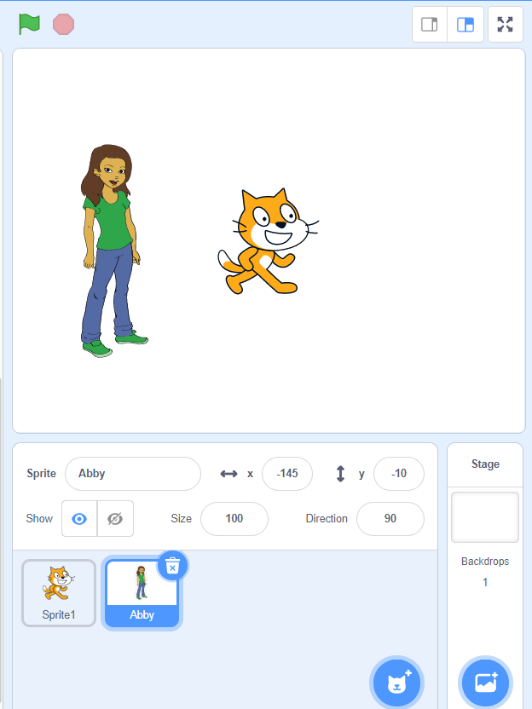
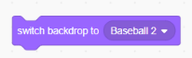
Add a Sprite / Change Backdrop
1) Add a backdrop.
2) Drag this coding block and click to run.
Add a sprite.

Slide 6
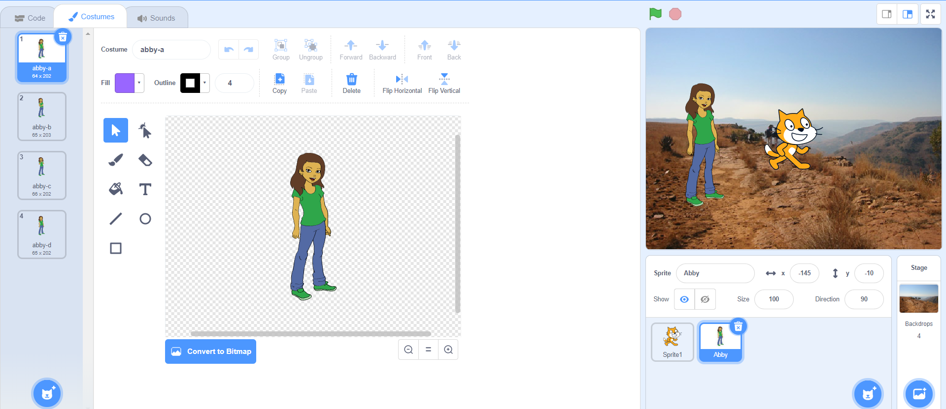
Edit Costumes
2) Use tools to edit costumes.
1) Click a sprite or a backdrop to select.

Slide 7
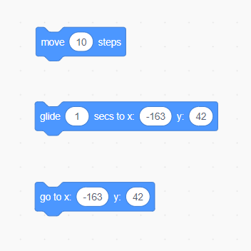
Moving a Sprite: Add a Motion
Move (like walk).
Glide to a position.
Move quickly to a position.

Slide 8
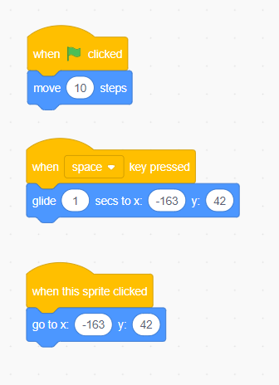
Moving a Sprite: Add an Event
Click flag.
Press a key.
Click a sprite.

Slide 9
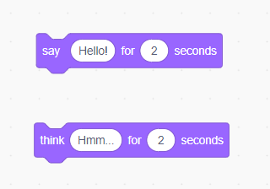
Sprite Actions: Changing Looks
Say something.
Think something.
Try adding an event to trigger the looks to occur.

Slide 10
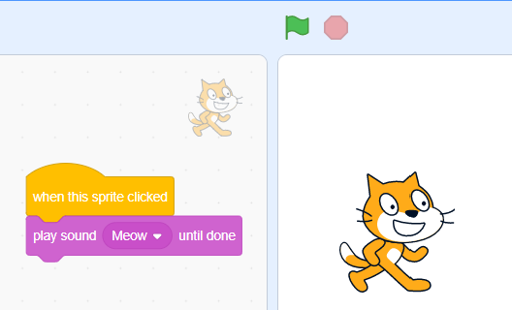
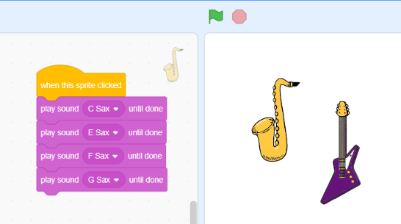
Have a Sprite Play a Sound

Slide 11
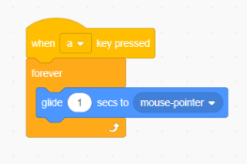
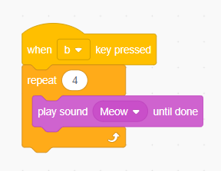
Introduction to Looping
Looping means having code repeat under specific conditions (such as “forever” or for a set number of times).

Slide 12
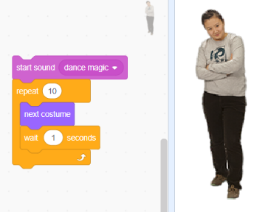
Use a Loop to Make a
Sprite Dance to Music
Start sound.
Create a loop to function 10 times.
“Next costume” switches dance positions.
Use to slow down motion.

Slide 13
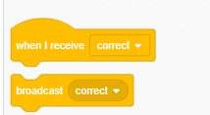
Broadcast Messages
You can use these coding blocks to:
  Send a broadcast message.
  Trigger a sprite to do something when a broadcast message is received.

Slide 14
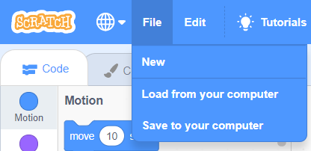
Saving Your Work
You can save and load Scratch programs to/from your computer (or Cloud account).
You can also create a login to save your work online.

Slide 15
Advanced Scratch:
Variables and Operators

Slide 16
Variables
Variable: A container that holds some value, much like x and y are popular variables in Algebra.
In Scratch, variables are represented with elongated circular blocks.
Variables can be used as counters, timers, and memories (like on a calculator).

Slide 17
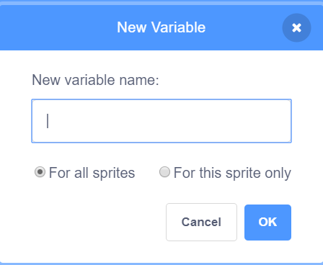
Variables
Make a “global” variable here.
Make a “local” variable here.

Slide 18
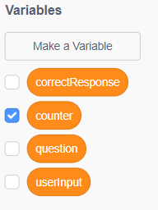
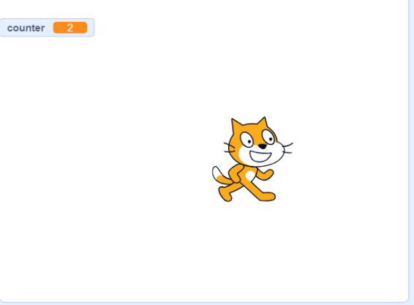
Coding Hints
The variables you create will be shown in the variable area in the left pane. You can click the checkbox by any variable to see the contents of the variable as the script plays.

Slide 19
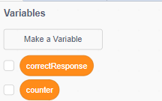
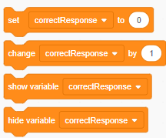
Make Some Variables
Challenge: Let’s create some variables and try changing their value in a script.

Slide 20
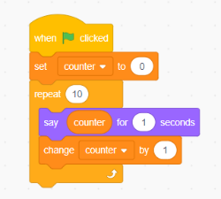
Make a Sprite Count with a Variable
Challenge: Make a sprite count up from 1 to 10. Create a variable and use the repeat loop control block.
Use this block to change the variable (increment the counter) in the loop.

Slide 21
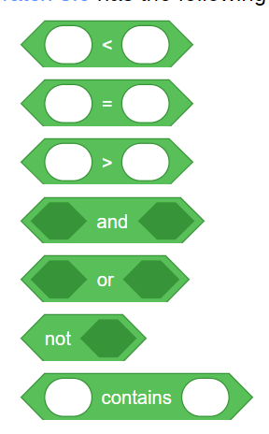
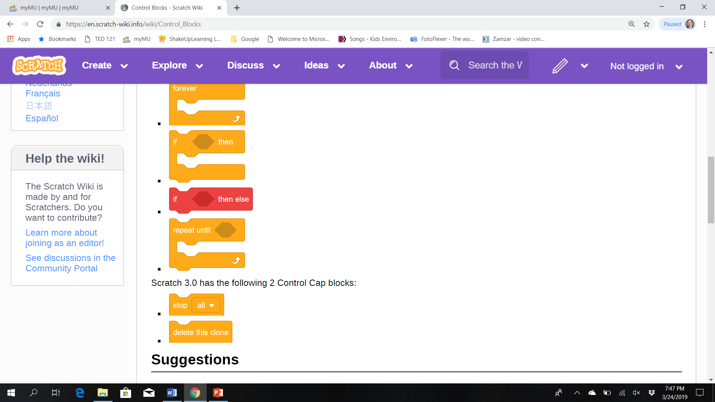
Operators
Operators: Green blocks in Scratch that allow a user to perform various operations through handling of strings (text) and numeric information.
Combine with control blocks to allow more control.

Slide 22
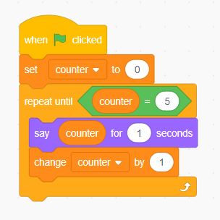

Make a Sprite Count with an Operator and Variable
Challenge: Make a sprite count up from 1 to a value you determine, using an operator and a variable.
Drag variable name into the = operator.

Slide 23
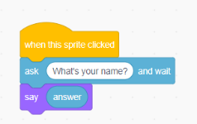
Ask a Question
Use the “ask…and wait” to ask the user a question. Stores the user’s answer in the variable “answer.”
Operator “ask…and wait.”
Sound “say.”
Variable “answer.”

Slide 24
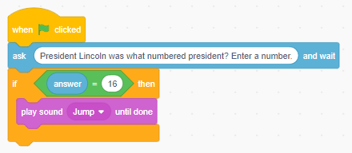
Ask a Question and
Give Feedback
Challenge: Ask a question using ask and wait combined with if—then.

Slide 25
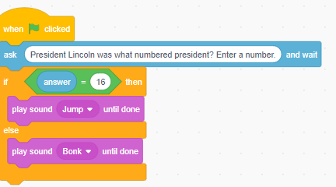
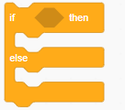
ADVANCED: Ask a Question and Give Feedback
Ask a question using ask and wait combined with if—then—else to provide more functionality.
Use if—then—else to provide options.

Slide 26
TRY IT
Ask a question and store the user’s response in the variable “answer.”
If the user got the answer correct, have a sprite react (either “say” they got it correct, or move, or make a sound).

Slide 27
Going Further with Scratch
You can do so much more with Scratch!
Click the “add extension” button in the lower left to explore additional capabilities that Scratch coders can add to their work!

Slide 28
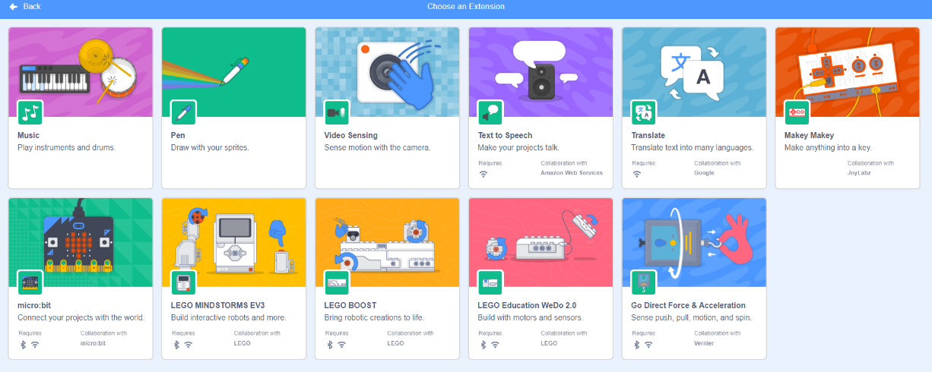
Extensions Available

Slide 29
Practice with Scratch and Assignment

Slide 30
Coding Practice Exercises
Challenges:
  Make a sprite display all of its motions (costumes) using a loop.
  Make a sprite move across the screen. Change the backdrop at least once as the sprite moves, allowing the sprite to move through 2 different scenes.
  Add several sprites, each of which can be clicked to allow the user to make music.
  Ask the user a question. Then, have a sprite say/think what they have typed.

Slide 31
Scratch Assignment 2
Create a Scratch application that will:
  Allow the user to play a game.
  Teach something.
  Tell a brief story.
  Allow the user to practice a skill.

Slide 32
Scratch Assignment 2
Demonstrate use of at least the following elements:
  Add at least 2 sprites.
  Use at least 2 backdrops.
  Have a sprite change costumes (motions).
  Move a sprite.
  Have a sprite play a sound.
  Use a loop to cause a sprite to perform an action several times.

Slide 33
Code Using Tutorials for Inspiration
Navigate to the following site to view tutorials to inspire your project:
  https://scratch.mit.edu/ideas
Scratch Tutorials

