Slide 1
Finalizing the APA-Formatted Research Paper
TED 121 Educational Technology
Dr. Steve Broskoske
Misericordia University

Slide 2
Paper Guidelines
8 pages total:
  Title page.
  Abstract page.
  5 pages in body.
  Reference page (bibliography).
Divided into sections (according to outline).
Use at least 5 professionally-respected sources.
  At least 3 sources must be from Ebsco Host.

Slide 3
Paper Guidelines
Topic should be about technology (ideally, technology as used in education).
Follow APA publication guidelines.

Slide 4
Paper Requirement
You must submit a proposed topic, outline, and 5 sources in advance. Otherwise, Dr. Steve will not accept your paper! (This is due to the possibilities of online plagiarism.)

Slide 5
Type Headings into Paper
(Points from Outline)
Using Dr. Steve’s Word APA Template, type the headings from your outline into the paper.
Introduction
What is Distance Learning?
Advantages and Disadvantages of Distance Learning
Conclusion

Slide 6
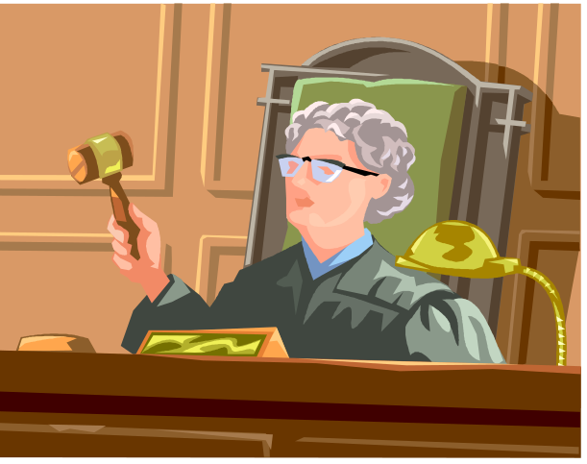
Writing a Research Paper Is Like Being a Lawyer in a Court Case
REMEMBER
Frame your topic as a court case to be proved.
  Does Assistive Technology Benefit Students with Special Needs in the Classroom?
  vs. Assistive Technology

Slide 7
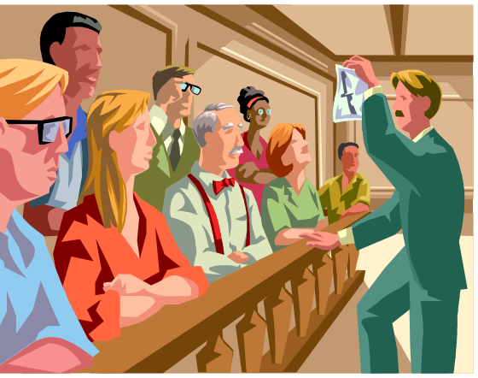
Make Your Case
REMEMBER
As you write the paper, present “evidence” to substantiate your points and prove your case.
  Broskoske and Rogan (2014) argue that…
  Research (McCann, 2013) suggests that…
  Tomascik (2015) states that…

Slide 8
Cite Evidence
REMEMBER
Remember that, as you type the paper, you cite evidence from articles you have read.
  Do not indicate your own opinions or feelings!
  Back up any claims that you make by citing research evidence.

Slide 9
Formulate an Argument (Case)
REMEMBER
For example, after reading several articles, I determined that there are 5 advantages (reasons) DL benefits education.
I determined these 5 reasons by taking specific points/statements out of various articles that I believe prove my case.
Notice that I did not report on an article, nor take all of one author’s points and list them as my argument. I built my own argument.

Slide 10
How to Cite Evidence in Paper
Method 1:
Authors’ last names
are listed, using &
before the final name.
Then list year.
REMEMBER
List author name(s) and year of publication.
Method 2:
Place authors’ last
names in a sentence.
Then list year in
parentheses.
One way that educational technology can enhance learning (Broskoske & McCann, 2014) is…
OR
According to Broskoske and McCann (2014), one way that educational technology can enhance learning is…

Slide 11
Text Citations
REMEMBER
Text citation for 3 or more authors.
  1st citation:
  Subsequent citations:
One way that educational technology can enhance learning (Broskoske, Rogan, Kruger, & McCann, 2012) is…
Another way that educational technology can enhance learning (Broskoske et al., 2012) is…

Slide 12
Finishing Touches on the Paper

Slide 13
Create an Introduction
Create an introduction section of the paper to do the following:
  Introduce the topic of the paper.
  Describe the general outline to be used in the paper.

Slide 14
Pattern for the Introduction
“[Topic name] is an important topic in education today. [Topic name] refers to…”
  You do not have to use these exact words. But make some introductory comments.
  Use another sentence or two to briefly introduce the topic, what it means, and its importance to education.
“In this paper, the author will examine…”
  List the main points covered in the paper, usually the headings used in the paper.

Slide 15
Example of Introduction
Introduction
Introduce
topic &
importance
to education.
Distance learning is an important technology in education today. Distance learning actually refers to a host of various technologies that allow teachers and students to be involved in instruction while not in a classroom at the same time. If employed well, distance learning can enhance the classroom…
In this paper, the author will begin by examining the technologies used in distance learning, the advantages and disadvantages of using distance learning in the classroom, and some positive practices used in classrooms today.
Present
outline
of paper.

Slide 16
Create a Conclusion
Start the conclusion of the paper by restating the topic, and by reviewing the main points covered in the paper (usually the headings used in the paper).
For example, you might state: “This paper explored [topic name]. In the paper, the author examined [list the main points covered in the paper].”

Slide 17
Create a Conclusion
Then, answer:
  Did you “prove” your court case?
Optionally, answer questions like:
  Based on what you researched and wrote, what will happen in the future?
  What is the future of this technology?
  Will it significantly impact education? Will its influence in education be positive or negative?

Slide 18
Example of Conclusion
Conclusion
Begin by
summarizing
paper.
This paper explored distance learning and its use in K-12 classrooms. In the paper, the author examined the technologies used in distance learning, the advantages and disadvantages of using distance learning in the classroom, and some of the positive practices used in classrooms today.
Go on to
describe if
you proved
your case.

Slide 19
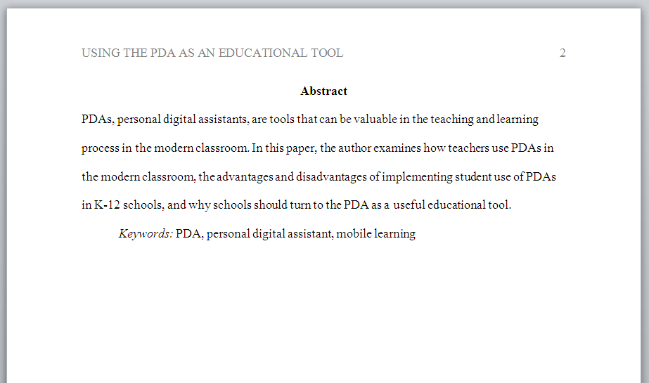
Create an Abstract
Create a one paragraph summary.
Create several search keywords.

Slide 20
Re-read Paper:
Ensure You Have Sound Paragraphs
Advantages and Disadvantages of Distance Learning
Distance learning technologies allow a teacher to bring a guest speaker into class for little or no cost (Broskoske, 2004).
There are many advantages to using distance learning. For example, Broskoske (2004) states that these technologies allow a teacher to bring a guest speaker into class for little or no cost. These technologies do not have to cost much. It depends on which tools you choose to use (Smith, 2002).
Distance learning technologies do not have to cost much. It depends which tools you choose to use (Smith, 2002).
Notice the use of a good introductory sentence.
Notice how the choppy notes are crafted to
form a good, flowing paragraph.

Slide 21
Research More If Needed
Are there any "holes" in your case? Is any topic “skimpy” with evidence?
If yes, then gather additional resources.
Looks sufficient.
Introduction
What is Distance Learning?
Advantages and Disadvantages
Looks sufficient.
Needs more!

Slide 22

Learn by Example
Help with APA
Dr. Steve’s
Help with APA Page

Slide 23
Paper Submission
Submit your paper electronically through Blackboard.
Dr. Steve will return the paper with comments as to how you can improve your writing.

Slide 24

First Paper Submission Is a Draft
Remember that the first paper submission is a draft.
Dr. Steve will return the paper with comments as to how you can improve.
Improve the paper based on the instructions provided, and resubmit the paper.

Slide 25

Much success!

