Slide 1

How to Write the Paper
OR How the Paper Will Write Itself
TED 121 Educational Technology
Dr. Steve Broskoske
Misericordia University

Slide 2
Paper Requirement
You must submit a proposed topic, outline, and 5 sources in advance. Otherwise, Dr. Steve will not accept your paper! (This is due to the possibilities of online plagiarism.)

Slide 3
Creating Citations in Text

Slide 4
Citing Works
When you refer to someone else's ideas or words, you must cite them in 2 places:
  Text of paper.
  Reference section (bibliography) at the end of the paper.

Slide 5
Citing Works (cont’d)
To avoid plagiarism, you must give credit in a paper whenever you:
  Use another person's idea, opinion, or theory.
  Refer to statistics, graphs, drawings, etc. that are not common knowledge.
  Quote or paraphrase another person's spoken or written words.
Remember that you do not have to cite any author for anything that is common knowledge (such as facts).

Slide 6
Text Citations
Method 1:
Authors’ last names
are listed, using &
before the final name.
Then list year.
List author name(s) and year of publication.
Method 2:
Place authors’ last
names in a sentence.
Then list year in
parentheses.
One way that educational technology can enhance learning (Broskoske & McCann, 2020) is…
OR
According to Broskoske and McCann (2020), one way that educational technology can enhance learning is…

Slide 7
Text Citations
Special Case
If you cite the same work in the same paragraph, just list the authors’ names (and no year).
Another technology that can revolutionize the classroom if it is used well is the Smart Board (Broskoske & McCann, 2020). One way the Smart Board… Another aspect of the Smart Board is the way in which a teacher can convert written words to typed text (Broskoske & McCann).

Slide 8
Text Citations
Special Case
Text citation for 3 or more authors.
  Article contains more than 2 authors, but we don’t list all of the authors.
  APA calls for only showing the first author’s name, followed by et al.
(Broskoske, Rogan, Tomascik, Brague, & McCann, 2018)
Another aspect of the Smart Board is the way in which a teacher can convert written words to typed text (Broskoske et al., 2018).

Slide 9
Text Citations
Special Case
Multiple citations for same idea.
One way that educational technology can enhance learning (Broskoske & McCann, 2007; Rogan, Kruger, & Tomascik, 2006) is…
2 separate citations,
separated by a ; (semicolon)

Slide 10
Text Citations
Special Case
One article refers to another article/study.
Rogan and Vitale’s study about Assistive Technology (as cited in Broskoske & McCann, 2013) indicates that…

Slide 11
Which of the following are correct?
TRY IT
APA is reported to be fun and helpful (Broskoske & Banya, 2011).
APA is reported to be fun and helpful (Broskoske and Banya).
According to Broskoske and Banya (2011), APA is reported to be fun and helpful.

Slide 12
Which of the following are correct?
TRY IT
Ed. tech. can increase student learning (Broskoske, S., McCann, P., Vitale, M., & Rogan, J., 2009).
Ed. tech. can increase student learning (Broskoske, McCann, Vitale, and Rogan, 2009).
Ed. tech. can increase student learning (Broskoske, et al., 2009)

Slide 13
How to Write the Paper
Dr. Steve’s Method of
Writing a Research Paper

Slide 14
Read Articles and Take Notes
Read the articles you have gathered, and take notes in your own words.
Do not directly quote authors.
Exceptions:
  An author has presented an official definition.
  An author has stated something so powerfully that you want to directly quote him/her.

Slide 15
Take Notes in Your Own Words
As you take notes on each article, state everything in your own words, and write in the present tense.
Fishbein (2003) states that...
Fishbein (2003) contends that...
According to Fishbein (2003), …
NOT Fishbein (2003) said...
NOT Fishbein (2003) stated, “the purpose of technology is to…”

Slide 16
Type Your Notes into Word
Continuous learning is an American innovation which is considered "unimaginable" in Japan or in Germany
There are two ways to increase the productivity of knowledge workers. In knowledge work, ask "What should you be doing?" rather than how. Second, make sure that people can concentrate on results rather than spending time performing nonessential tasks
(Drucker & Schwartz, 1993).
Use copy and paste to
place a APA-formatted
citation in your notes.
(Drucker & Schwartz, 1993).

Slide 17
Type Your Own Ideas as You Go
It appears that an organization must build in organized abandonment into an organizational system. It cannot successfully innovate unless it systematically abandons (Dr. Steve).
Jot down your thoughts, ideas,
and insights as you work. You can use these
to better prepare your argument/case.

Slide 18
Type Headings into Paper
(Points from Outline)
Using Dr. Steve’s Word APA Template, type the headings from your outline into the paper.
Don’t place “introduction” as a heading. It will be understood (APA 7th Edition).
Introduction
What is Distance Learning?
Advantages of Distance Learning in the Classroom
Disadvantages of Distance Learning in the Classroom
Conclusion

Slide 19
Copy and Paste Notes Under Appropriate Headings
What is Distance Learning?
Advantages of Distance Learning
Disadvantages of Distance Learning
Conclusion
Distance learning technologies allow a teacher to bring a guest speaker into class for little or no cost (Broskoske, 2014).

Slide 20
Craft the Wording into
Understandable Paragraphs
Advantages of Distance Learning
There are many advantages to using distance learning. One advantage is that these technologies allow a teacher to bring a guest speaker into class for little or no cost. This means…
A second advantage is that these technologies do not have to cost much. It depends on which tools you choose to use (Smith, 2002).
Distance learning technologies allow a teacher to bring a guest speaker into class for little or no cost (Broskoske, 2004).
Distance learning technologies do not have to cost much. It depends which tools you choose to use (Smith, 2002).
Notice the use of a good introductory sentence. Notice
how the choppy notes are crafted to form good, flowing paragraphs.

Slide 21
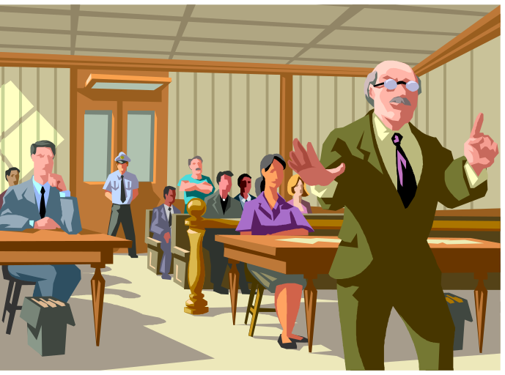
Remember to “Prove” Your Case
As I write, I must remember that…
  I am trying to prove that DL benefits students in the classroom.
  I must build a case/argument that will prove my point and win the court case.
In my paper about DL, the “advantages to education” section is the most important part of proving my case.

Slide 22
Formulate an Argument (Case)
Ask: How can I prove my case? What evidence exists to help me prove the case?
Locate: Search for evidence from articles.
Process: Don’t just copy information from articles. Read several articles and draw individual points out of these articles to formulate your own personal argument.

Slide 23
Formulate an Argument (Case)
For example, after reading several articles, I determined that there are 5 advantages (reasons) DL benefits education.
I determined these 5 reasons by taking specific points/statements out of various articles that I believe prove my case.
Notice that I did not report on an article, nor take all of one author’s points and list them as my argument. I built my own argument.

Slide 24
Organize Your Thoughts
Into Paragraphs
Advantages of Distance Learning
There are many advantages to using distance learning in the classroom. One advantage is xxxxx (Broskoske & McCann, 2007). This means…
A second advantage is xxxxx (Rogan, 2008). When teachers employ distance learning…
Banya (2009) indicates that another advantage of distance learning is xxxxx.

Slide 25
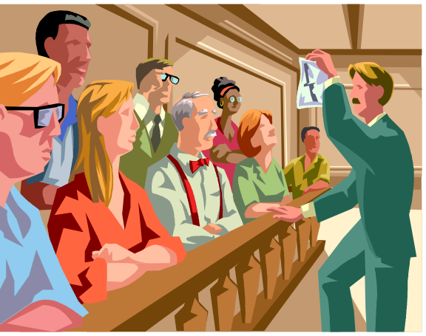
Cite Evidence
As you type the paper, cite evidence from articles you have read (Broskoske, 2022).
As a general rule of thumb, every paragraph should have at least one article cited (except for the introduction and conclusion sections).

Slide 26
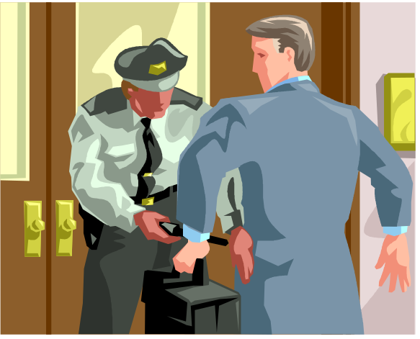
Cite Evidence
You must back up any points or claims that you make by citing research evidence (Broskoske, 2021).
Do not indicate your own opinions or feelings if you cannot find evidence in an article to back up those statements!

Slide 27
Cite Evidence
GOOD
Broskoske and Rogan (2007) argue that…
Research (McCann, 2009) suggests that…
Tomascik (2006) states that…
NOT GOOD
In my experience, PowerPoint…
I have found that…
It is my belief that…
I have heard that…
These claims are not valid unless you can back them up with evidence!

Slide 28
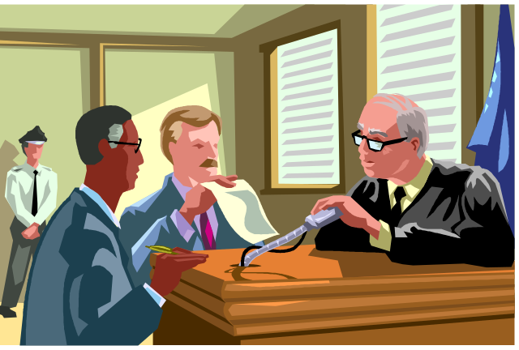
Adding Your Own Ideas
If you want to include your own ideas, add a discussion section to your paper.
In a discussion section you can discuss the evidence already presented and add your own personal input without citations.

Slide 29
Research More If Needed
Are there any "holes" in your case? Is any topic “skimpy” with evidence?
If yes, then gather additional resources.
Looks sufficient.
What Is Distance Learning?
Technologies Used in Distance Learning
Advantages and Disadvantages
Looks sufficient.
Needs more!

Slide 30
Using Dr. Steve’s APA Template

Slide 31
Using Dr. Steve’s APA Template
If you download Dr. Steve’s Word APA Template, the majority of formatting will be handled for you,
If you don’t use this resource, you must ensure that you have followed all of the APA formatting conventions

Slide 32
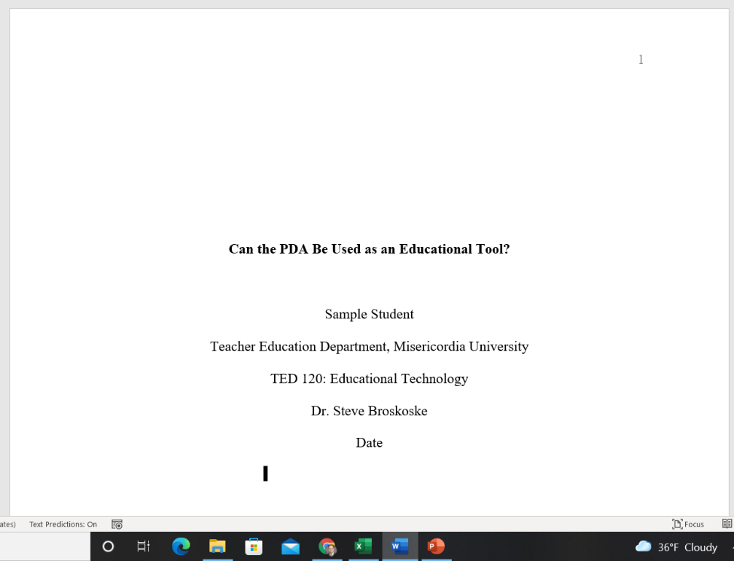
APA: Title Page
Title page is page number 1. Put in
header of document.
Title of Paper
Your Name
Dept. & University
Class
Teacher
Date

Slide 33
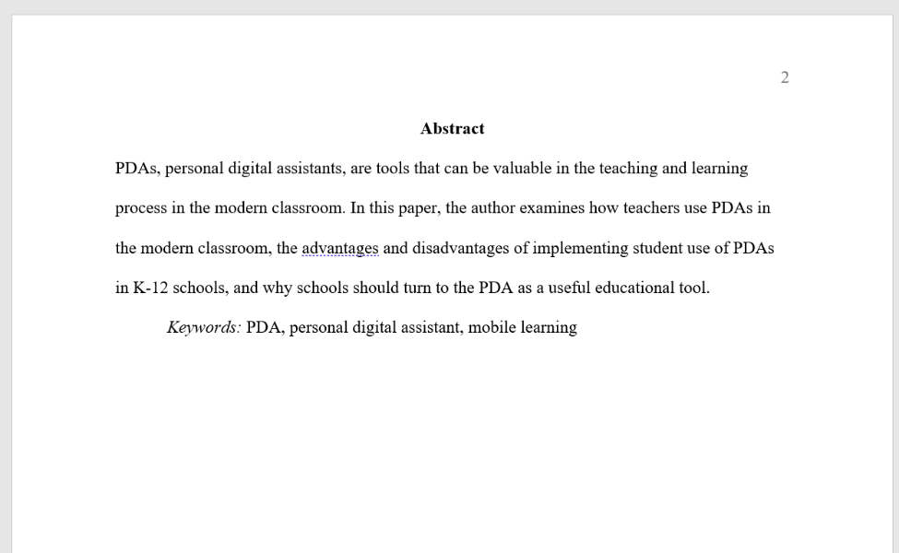
APA: Abstract
Paragraph that briefly describes paper. Write this after you have written the paper.
List keywords for search purposes.

Slide 34
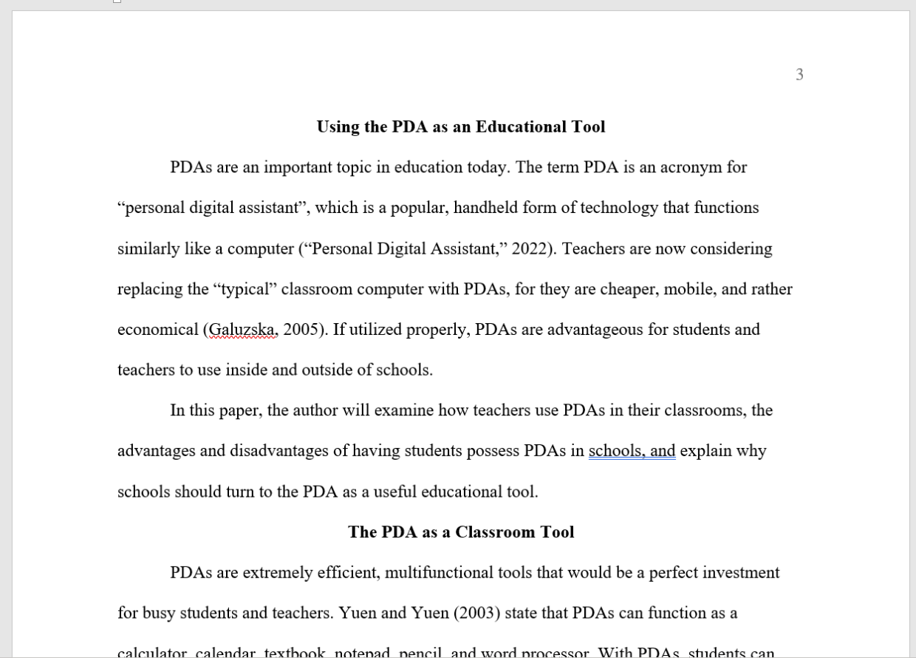
APA: Body of Paper
Title replaces “Introduction.”
Citations.
Section heading
(from outline).

Slide 35
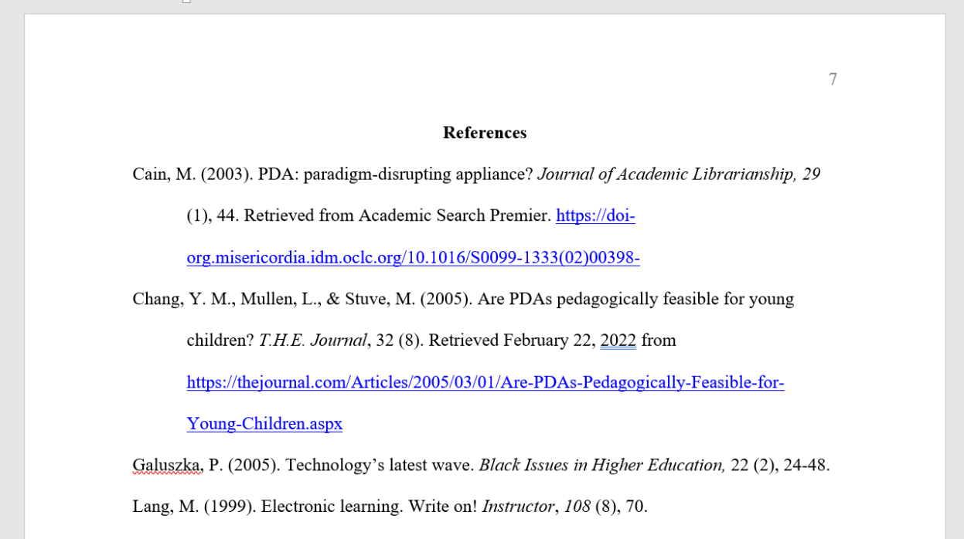
APA: References (Bibliography)
References alphabetized and written in APA format.

Slide 36
Let’s Try It
Help with APA

