Slide 1

Developing an Outline for the Course Research Paper
TED 121 Educational Technology
Dr. Steve Broskoske
Misericordia University

Slide 2
Our Research Paper
5 pages, plus title, abstract, and reference pages
Divided into sections (according to outline).
Use at least 5 professionally-respected sources.
  At least 3 sources must be from Ebsco Host.
Follow APA publication guidelines.

Slide 3
Writing a Research Paper
Being a Lawyer Defending a Case
Review

Slide 4

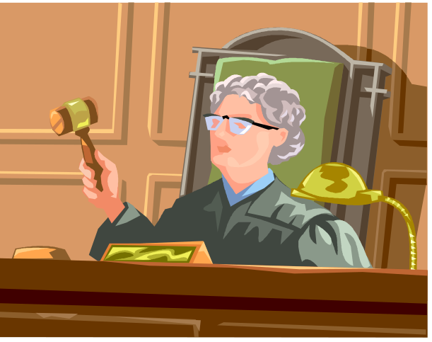
Writing a Research Paper Is Like Being a Lawyer in a Court Case
Frame the case.
Search out evidence.
Present the evidence.
Make a closing argument.
Define your topic.
Perform research.
Write the paper.
Draw a conclusion.

Slide 5
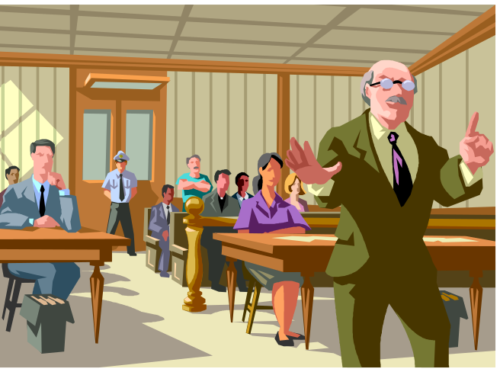
Frame Your Court Case
(Define Your Topic)
Step 1
Too general:
  Distance Learning
  Assistive Technology
  PowerPoint
Can be defended:
  Is Distance Learning Effective in Teaching/Learning?
  Is it Beneficial to Use AT in the Classroom?
  Can Teachers Improve Learning with PowerPoint?
Frame your topic as a question
to be defended in a court case.

Slide 6
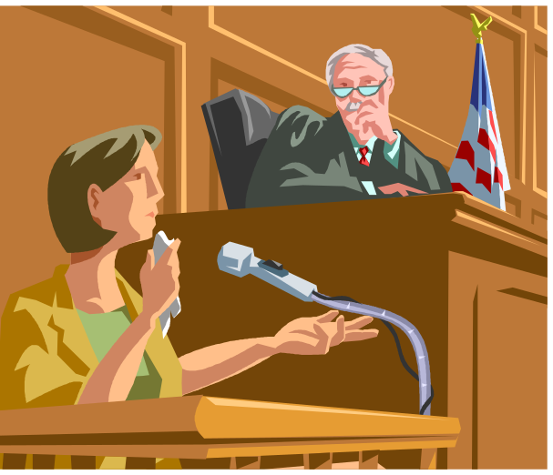
Search Out Evidence
(Research Sources)
Step 2
Search for articles that will “prove” your case.
  Perform searches on your topic:
    Ebsco Host
    MU library
    Online journals
If you find articles to the contrary, be responsible and report on those too.

Slide 7

Suggestion:
Research More than 5 Sources
Selecting more than 5 resources is a good idea. Then you have more to write about.
Don’t go too far, though. 20 sources is way too much!
I wish I had researched more sources. I don’t have much to write about.

Slide 8
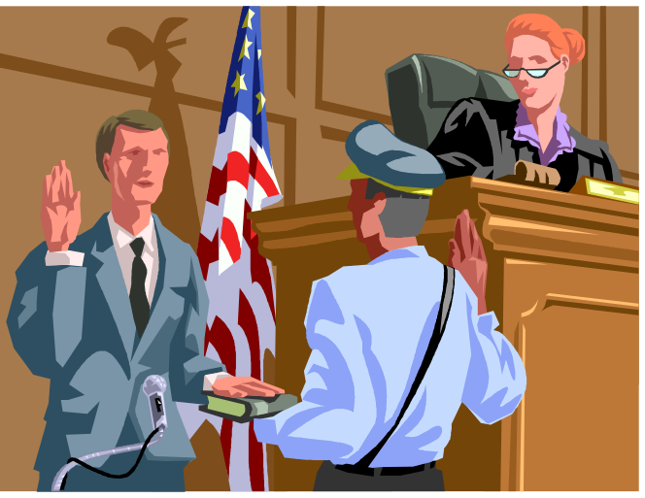
CAUTION: Use Only
Professionally Respected Material
Make sure that the material you plan to use is valid, respected, and scholarly.
Use Ebsco Host!
If you use Websites, be sure to verify that they will be professionally respected (evaluate the authors and publishers).

Slide 9
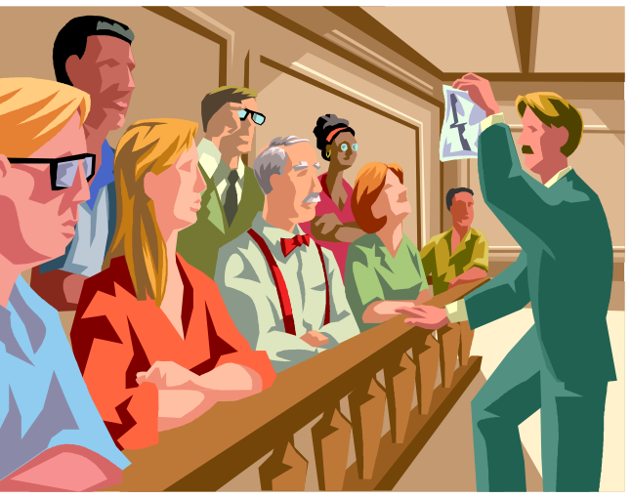
Present the Evidence
Step 3
You present evidence by talking about and citing resources in the text of the paper.
  Broskoske and Banya (2004) argue that…
  Research (McCann, 2003) suggests that…
  Tomascik (2002) states that…
Use articles as a lawyer would use evidence to prove a case in court.

Slide 10
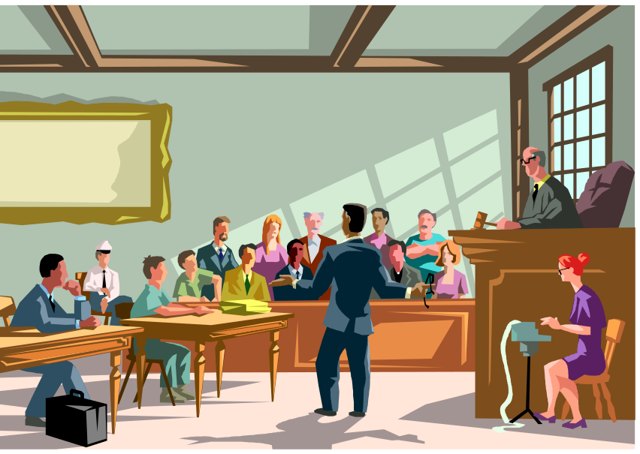
Draw a Closing Argument
Step 4
Begin by briefly reviewing the entire case.
Based on all of the evidence you presented, draw a conclusion.
  Did you prove your court case?
  What are the implications for the future?

Slide 11
How to Develop an Outline

Slide 12
Logging into Ebsco Host
Review
Select a database to search, such as Academic Search Complete.
As you enter Ebsco Host, log into your account to access your personal folder.
Be sure to select the following checkboxes:
  Misericordia-owned
  full text
  OPTIONAL: peer reviewed

Slide 13
Defining Keywords as Part of a Search Strategy
Review
  When performing research, formulate a search strategy by analyzing a topic to identify alternative keywords/concepts.
  For example, when searching for iPad’s in the classroom:
    iPad / tablet / handheld devices / mobile devices
    AND classroom / teaching/ education
  Remember you can click on an article and view suggested keywords for searching in Ebsco Host.

Slide 14
Search at Google Scholar
Navigate to: Scholar.google.com
Search for academic articles using Google’s search tools.
If you cannot locate the full text of an article, search for the information you have found on Ebsco Host.
If you log into your Google account, you can save articles for later reading.

Slide 15
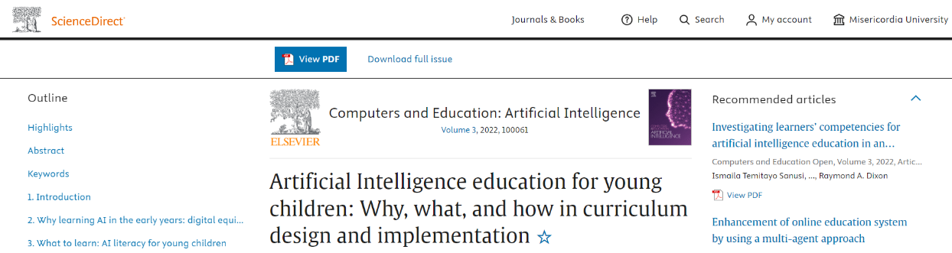
Search at Google Scholar
In some cases you might be able to get more free access to articles based on Misericordia subscriptions.

Slide 16
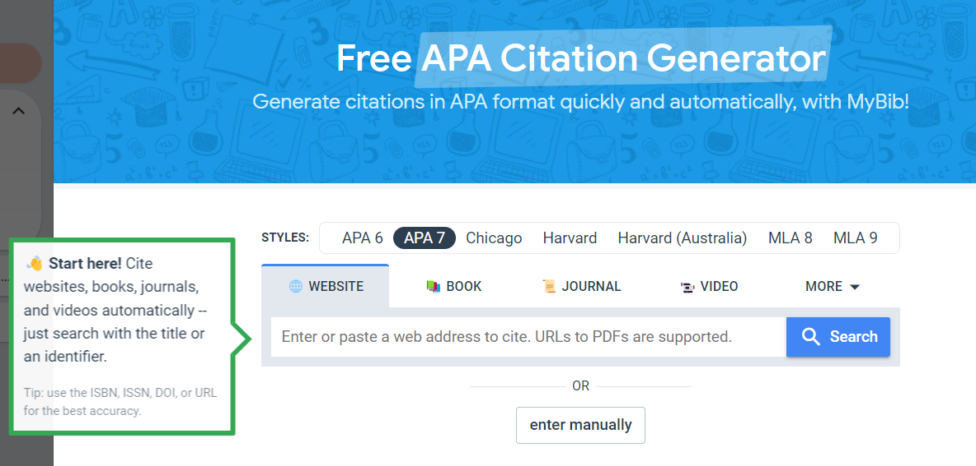
Search for an
APA Citation Generator
www.mybib.com/tools/apa-citation-generator
Notes:
https://www.mybib.com/tools/apa-citation-generator

Slide 17
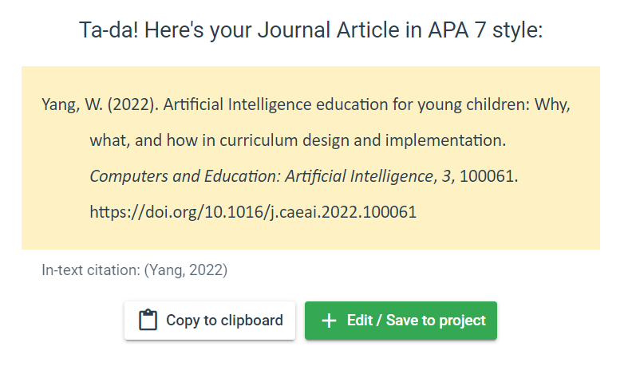
APA Citation Generator

Slide 18
Developing an Outline
Now that you have identified keywords, begin searching.
First search: Search to put potential articles in your Ebsco folder.
  Read the abstract of an article. (Don’t need to read the entire article at this time.)
  If an article appears that you might be able to use it, stuff it into your Ebsco folder.

Slide 19
Developing an Outline
Second search: Search through your Ebsco folder.
  Re-read the abstracts of articles in your Ebsco folder.
  If an article appears that you can use it, keep it in your folder. If unusable, delete it.
    Sometimes you need to click into the full text of the article to decide if the article is usable for your research area.

Slide 20

Alter Your Topic If Needed
What happens if you do not have enough articles to allow you to write a good paper?
  Select another topic. OR
  Alter your topic.
    Instead of “iPad’s to improve math”
    iPads’s to Improve Math and Science
    Instead of “cell phones in the classroom”
    Cell Phones and Promethean Boards

Slide 21
Develop an Outline
Identify themes you find in the articles you research.
Place the articles in categories, based on their themes.
Use these categories to develop your paper outline.

Slide 22
Identify Themes
When researching distance learning, I found articles talking about the following things:
  Definitions and descriptions of what DL is.
  Advantages of using DL in the classroom
  Disadvantages of using DL in the classroom
  Examples of good and poor practices of DL in the classroom.

Slide 23
Draw Up the Outline
Introduction
  Introduce the topic of the paper, the case that you will attempt to make, and introduce the topics (the outline) that will be covered.
What is Distance Learning?
  Define and introduce the topic.
Advantages of Distance Learning
Disadvantages of Distance Learning
Positive Practices in Distance Learning
Conclusion
  Briefly summarize the entire paper.
  Review the purpose of the paper,
  and its main points. Draw a conclusion.
These sections titles were determined after reading articles.

Slide 24
What is APA?

Slide 25
What Is APA?
At Misericordia University, the faculty require that all papers, posters, and other research activities should be formatted according to APA publication standards. But what does APA mean?

Slide 26

What Is APA?
APA refers to the American Psychological Association.
What does an association of psychologists have to do with MU and TED?

Slide 27
What Is APA?
Now in the 7th edition.
APA publishes The Publication Manual of the American Psychological Association.
  200-page book.
  Many educational researchers use APA format for preparing papers for publication.
  Many colleges have adopted these publication guidelines for all academic papers prepared within their college.

Slide 28
Main Points of APA Manual
How to prepare a printed manuscript.
  Designing title page, using fonts, listing name and affiliation, numbering pages, setting margins and spacing, and much more.
How to cite the work of others.
  How to cite the work or ideas of others, and thus avoid plagiarism.
  Plagiarism refers to using someone else's original work or ideas within your own printed (or online) work and claiming (or giving the impression) that those ideas are your own original work.

Slide 29
Where Can I Learn About APA?
Publication Manual of the APA
  Purchase book in college bookstore.
APA Style Home Page
  www.apastyle.org
Dr. Steve’s Help with APA Web Page

Slide 30
Dr. Steve’s “Help with APA”
Publication Manual
of the
American
Psychological
Association
Dr. Steve’s
Help with APA
Almost 200-page
book.
Several Web pages.

Slide 31
Citing Works
When you refer to someone else's ideas or words, you must cite them in 2 places:
  Text of paper.
  Reference section (bibliography) at the end of the paper.

Slide 32
Citing Works (cont’d)
To avoid plagiarism, you must give credit in a paper whenever you:
  Use another person's idea, opinion, or theory.
  Refer to facts, statistics, graphs, drawings, etc. that are not common knowledge.
  Quote another person's actual spoken or written words.
  Paraphrase another person's spoken or written words.

Slide 33
How to List Sources in APA Format

Slide 34
Technology-enabled
APA Reference Formatting
The “cite” tool in Ebsco Host or RefWorks will help you format the references in APA format.
Let’s look at particulars of APA formatting so you can correct little problems when they go wrong when using these tools.

Slide 35
Journals in Print
Author, A. A. (year of publication). Title of the article. Journal name, volume, (issue), page numbers. DOI
Cumming, J. & Maxwell, G. (1999). Contextualising authentic assessment. Assessment in Education: Principles, Policy & Practice, 6 (2), 177-193.
Let’s get a close-up look…

Slide 36
Author’s last name, first initial.
Multiple authors separated by &.
Year of article in
parentheses,
followed by a period.
Article
title is
written
like a
sentence.
Cumming, J. & Maxwell, G. (1999). Contextualising authentic assessment. Assessment in Education: Principles, Policy & Practice, 6 (2), 177-193.
Journal title is written
with capital letters,
and is Italicized.
Page numbers
of the article.
Volume and
issue number.

Slide 37
Ebsco Host (Online Journals)
Author (year of publication). Title of article Journal Name, volume, (issue).
DOI
Holley, D. & Oliver, M. (2010). Student engagement and blended learning: Portraits of risk. Computers & Education, 54 (3), 693-700. doi:10.1016/j.compedu.2009.08.035
Add DOI identifier.

Slide 38
What is DOI?
Digital Object Identifier:
  Unique identifier for each publication (book or article from a periodical).
  New system that attempts to provide a standard system for positively identifying a document.
At the end of the reference, simply paste the DOI as found/presented.

Slide 39
What If No Author Is Listed?
Title of article. (year of publication). Journal Name, volume, (issue).
doi:
Contextualising authentic assessment. (1999). Assessment in Education: Principles, Policy & Practice, 6 (2).
doi:10.1016/j.compedu.2009.08.035
Move title to author position.

Slide 40
Using Ebsco Host’s Cite Tool
In Ebsco Host, click on the article title and select cite from the right-hand pane.
  Be aware that sometimes errors will be found when using this tool, especially capitalization.
In Word, highlight text and use shift-F3 to quickly change capitalization.
Let’s try formatting a reference section.

Slide 41
Web Page: Author
Author (year of publication). Title of page. Retrieved (date) from (URL).
Broskoske, S. L. (n.d.). Searching the Internet. Retrieved February 1, 2022 from http://users.misericordia.edu//ted121/2search.html
“n.d.” means no date listed.
Be careful if using a Web page. Make sure it is professionally respected material!

Slide 42
Web Page: Organization
Organization (date of publication). Title of page. URL
World Health Organization. (2018, May 24). The top 10 causes of death. https://www.who.int/news-room/fact-sheets/detail/the-top-10-causes-of-death
Be careful if using a Web page. Make sure it is professionally respected material!

Slide 43
Wikipedia
(or other online reference material)
Title of entry. (Year, month day). In Wikipedia. URL of archived page.
Geology. (2021, March 21). In Wikipedia. https://en.wikipedia.org/w/index.php?title=Geology&oldid=1014011568
Since the Wikipedia articles are likely to change over time, include the URL of archived page of the website: Access the archived version by clicking “View History” and choosing the date/time stamp of the version you use for reference.

Slide 44
Help Doing References?
You can find help in the following places:
  In Ebsco Host, click on the title of an article and select the “cite” tool.
  Search for an APA Citation Generator tool.
  APAStyle.org
  Visit Dr. Steve’s Help with APA Page online.
APA Style.org
Help with APA

Slide 45
Module 3 Assignment
Submit the following on BlackBoard:
  Topic (framed as a court case).
  Proposed outline of paper.
  5 sources you might use, written in APA format.
    At least 3 sources (if not all) must be from Ebsco Host or Google Scholar.

Slide 46
Course Paper
You must submit a proposed topic, outline, and 5 sources in advance of submitting the course paper. Otherwise, Dr. Steve may not accept your paper! (This is due to the possibilities of online plagiarism.)

Slide 47

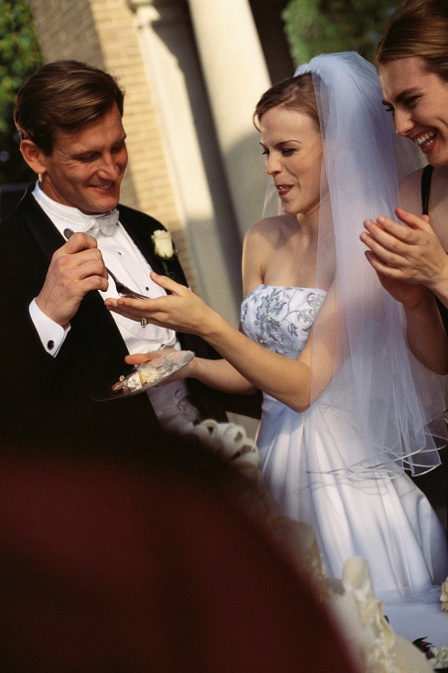
HINT: Select a Topic Soon!
Pick any technology-related topic.
Do some preliminary research to ensure sufficient information exists to pursue this topic.
Then, define your topic as a court case.
Pick a topic soon!
Don’t wait for God to inspire you!
Don’t wait to select the perfect topic you’re not going to marry this topic!

