Slide 1

Introduction to the Course Paper and Choosing a Topic
TED 121 Educational Technology
Dr. Steve Broskoske
Misericordia University

Slide 2
Overview of the Paper

Slide 3
Our Research Paper
5 pages, plus title, abstract, and reference pages
Divided into sections (according to outline).
Use at least 5 professionally-respected sources.
Follow APA publication guidelines.

Slide 4
Paper Requirements
5 Pages in Body
Title Page
+
+
Reference Page/
Bibliography
5 pages
Abstract

Slide 5
Paper Requirements
Divided Into Sections
Introduction
  Introduce the topic of the paper, the case that you will attempt to make, and introduce the topics (the outline) that will be covered.
What is Distance Learning?
  Define and introduce the topic.
Advantages of Distance Learning
Disadvantages of Distance Learning
Conclusion
  Briefly summarize the entire paper.
  Review the purpose of the paper,
  and its main points. Draw a conclusion.
These section titles were determined after briefly reviewing articles.

Slide 6
Paper Requirements
Use at Least 5 Sources
Use at least 5 sources (articles).
At least 3 (if not all) should be retrieved from Ebsco Host.
Hint: The more sources you find, the easier it is to write the paper.

Slide 7
Paper Requirements
Follow APA Publication Guidelines
Publication Manual
of the
American
Psychological
Association
→ We will describe APA in class.

Slide 8
Paper Requirements
Following APA with Sources
In text of paper:
  There are ten ways that educational technology can enhance learning (Broskoske & McCann, 2018).
On the reference page:
  Author, A. & Author B. (year of publication). Title Journal name, volume, (issue). doi:

Slide 9
Paper Requirements
Dr. Steve’s Helpful APA Utilities
Dr. Steve’s
Web Page
Dr. Steve’s
APA Word
Template
Help with APA

Slide 10
Writing a Research Paper
Is Like
Being a Lawyer Defending a Case

Slide 11
Dr. Steve’s Research
Can Help You!
Published in journals:
Cited on other Websites:
College Teaching (journal)
The Teaching Professor
National American University Library
Eastern Illinois Writing Project
(Summer Institute 2021)
Blogs

Slide 12

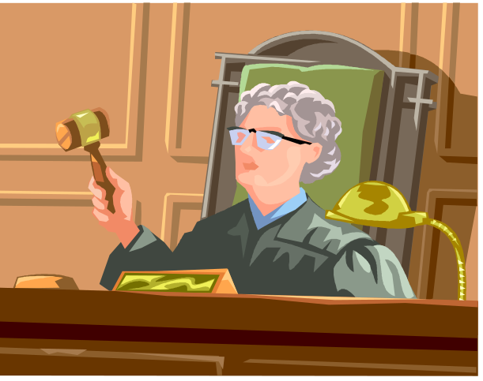
Writing a Research Paper Is Like Being a Lawyer in a Court Case
Frame the case.
Search out evidence.
Present the evidence.
Make a closing argument.
Define your topic.
Perform research.
Write the paper.
Draw a conclusion.

Slide 13
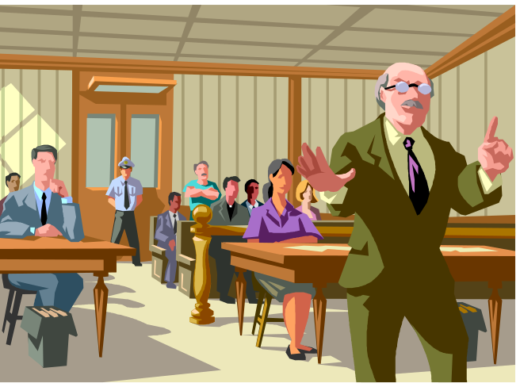
Frame Your Court Case
(Define Your Topic)
Step 1
Too general:
  Distance Learning
  Assistive Technology
  PowerPoint
Can be defended:
  Is Distance Learning Effective in Teaching/Learning?
  Is it Beneficial to Use AT in the Classroom?
  Can Teachers Improve Learning with PowerPoint?
Frame your topic as a question
to be defended in a court case.

Slide 14
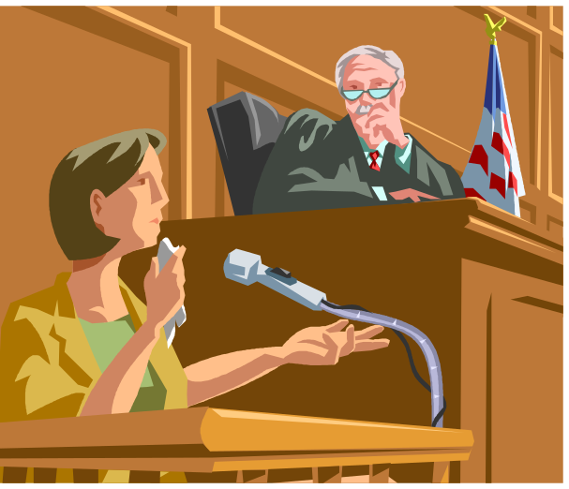
Search Out Evidence
(Research Sources)
Step 2
Search for articles that will “prove” your case.
  Perform searches on your topic:
    Ebsco Host
    MU library
    Online journals
If you find articles to the contrary, be responsible and report on those too.

Slide 15

Suggestion:
Research More than 5 Sources
Selecting more than 5 resources is a good idea. Then you have more to write about.
Don’t go too far, though. 20 sources is way too much!
I wish I had researched more sources. I don’t have much to write about.

Slide 16
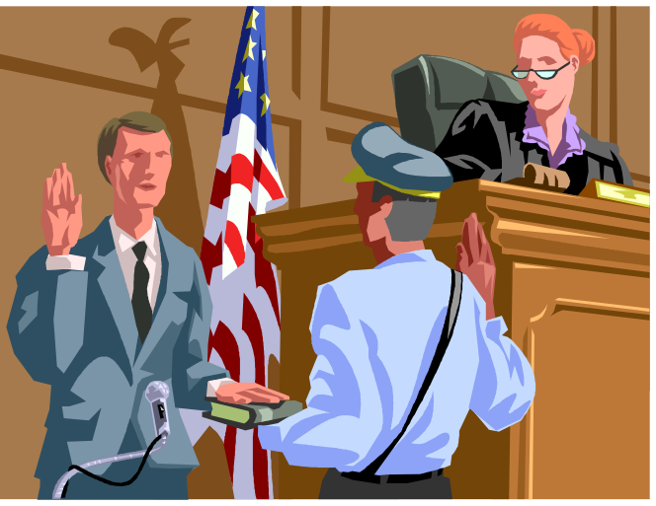
CAUTION: Use Only
Professionally Respected Material
Make sure that the material you plan to use is valid, respected, and scholarly.
Use Ebsco Host!
If you use Websites, be sure to verify that they will be professionally respected (evaluate the authors and publishers).

Slide 17

Present the Evidence
Step 3
You present evidence by talking about and citing resources in the text of the paper.
  Broskoske and Banya (2017) argue that…
  Research (McCann, 2015) suggests that…
  Tomascik (2022) states that…
Use articles as a lawyer would use evidence to prove a case in court.

Slide 18
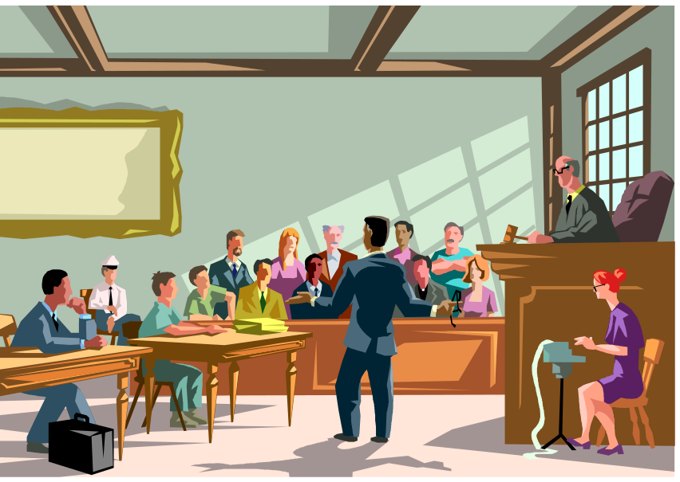
Draw a Closing Argument
Step 4
Begin by briefly reviewing the entire case.
Based on all of the evidence you presented, draw a conclusion.
  Did you prove your court case?
  What are the implications for the future?

Slide 19

How to Choose a Topic

Slide 20

Choose a General Topic Area
Start by choosing a general topic area.
  Pick an area you have interest in.
  Review the “hot topics” from mod 1.
  Pick a technology you would like to learn more about.

Slide 21
Focus the Topic
Then survey professional literature on Ebsco Host to help you focus your topic. Determine:
  Are people researching this topic?
  What are others saying about this topic?
  Based on what I am reading, what specific topic can I focus on?
  What type of “court case” (something to prove) can I develop in this topic area?

Slide 22
Your Paper Should Be About…
Educational Technology
Technology that Is/Could Be Used in Education
Any Technology
Your topic must with deal
with technology in some form.

Slide 23

Non-Acceptable General Topics
School Uniforms
Gardener’s Multiple Intelligences
School Voucher System
History of Education
These do not deal with technology.

Slide 24
Examples of
Acceptable Topic Areas
Using iPads (or any technology) in the classroom.
Apps to support special needs students.
Using artificial intelligence (AI) in teaching.
PowerPoint in the classroom.
Student response systems.
E-textbooks.
Using cell phones in the classroom.
Using technology in teaching.
Any of the “hot topics” from module 1.

Slide 25


Choosing a Topic
Don’t Wait for Inspiration
Pick a topic soon – don’t wait for God to inspire you with the perfect topic!

Slide 26
Formulating a Search Strategy

Slide 27

Enter Ebsco Host from Library Page
Open journal finder tab and click on advanced.
Select databases alphabetically or by subject.
Click on advanced search.
Most popular database for teachers is Academic Search Ultimate.

Slide 28
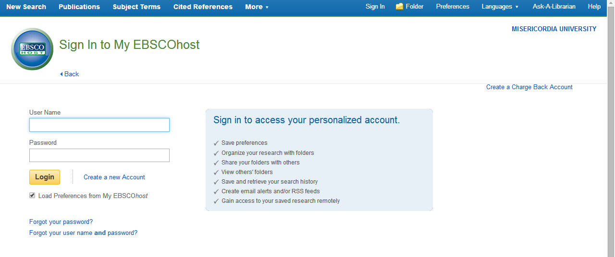
Create a Personal Folder
Create a user name and password to save your personal folder.

Slide 29
Search Strategy
As you enter Ebsco Host, log into your account to access your personal folder.
Select a database to search, such as Academic Search Complete.
Be sure to select the following checkboxes:
  Misericordia-owned
  full text
  OPTIONAL: peer reviewed

Slide 30
Search Strategy
Look for “scholarly” articles/journals:
  Cite other journal articles and/or books throughout the text of the article.
  Contain a bibliography.
  Attempt to provide unbiased, factual information to the reader.
  Some are “peer reviewed.”
  Ebsco Host and other library databases are good sources for scholarly articles.

Slide 31
Search Strategy
Peer reviewed:
  Usually higher quality scholarly articles.
  Authors submit a potential article to a journal for scrutiny and comments by a review panel (“graded”).
  Will not be published unless/until it meets the quality standards of the review panel.
  To search for these, check peer reviewed box in Ebsco Host.

Slide 32
Search Strategy: Establish Your Court Case (Thesis)
Topic area: PowerPoint
Possible court cases (theses):
  Can teachers improve learning with PowerPoint?
  Does PowerPoint have the capacity to hold learner attention?
  Does PowerPoint have a negative effect on the classroom?

Slide 33
Search Strategy: Establish Your Court Case (Thesis)
Topic area: iPads in the Classroom
Possible court cases (theses):
  Can teachers improve learning with iPads?
  Can iPads improve middle level math classes?
  Can the use of iPads in the classroom promote higher understanding of content?
  Can the use of iPads in the classroom prove too distracting for learners?

Slide 34
Search Strategy: Keywords
  When performing research, formulate a search strategy by analyzing a topic to identify alternative keywords/concepts.
  For example, when searching for iPads in the classroom:
    iPad
    tablet
    handheld devices
    mobile devices
    AND classroom / teaching / education

Slide 35
Search Strategy: Keywords
Let’s try it. Identify several keywords for the following topic areas:
  Assistive technology (Can assistive technology improve learning for students with special needs?)
  PowerPoint (Can PowerPoint improve teaching and learning in the classroom?)
  Distance learning (Can distance learning improve the classroom?)

Slide 36
Other Ebsco Host Tricks
Click an article title to explore more issues of that journal.
Click an author’s name to explore more articles written by that person.

Slide 37
In the Next Session We Will…
Start thinking about what topic you might select for your research paper.
Next time we will learn how to develop an outline that will guide how you write the course paper.
Outline

