Slide 1


Read/Write Web Revolution
Dr. Steve Broskoske
TED 121 Educational Technology
Misericordia University

Slide 2
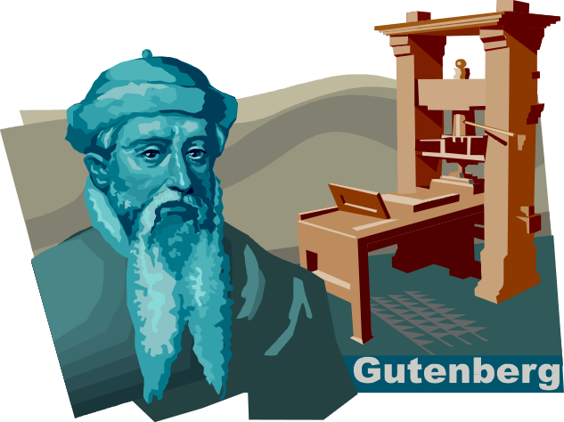

Read/Write Web Revolution
Mid 1400’s: Printing press.
Today: Read/write Web technologies (aka Web 2.0).

Slide 3
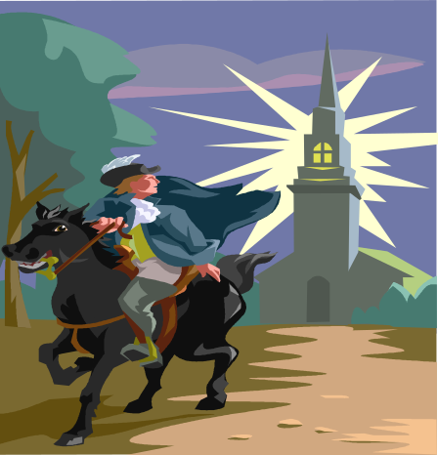


Read/Write Web Revolution
Tools:
  Blogs.
  Wiki.
  Social media sites.
Web 1.0
  Users consume content.
Web 2.0
  Users interact with and contribute content and help organize the Web.
Revolution

Slide 4
Read/Write Web Revolution
Amazon.com
  Sells products.
  Displays popular items.
  Ask for input/feedback from consumers.
  Provide customized choices based on buying habits.
Reflects Artificial Intelligence.
Users add value to the Web.

Slide 5
Read/Write Web Revolution
Users help construct knowledge (contribute) vs. being passive absorbers.
Content is constantly updated by everyone vs. occasionally by experts.
Through tags and other devices, users help to organize the material based on how people use the material.
Collaboration can motivate and excite.

Slide 6

New Literacies
Evaluating and editing content.
Use of publishing outlets.
Management of information.
Collaboration skills.

Slide 7
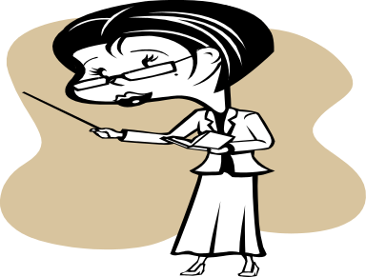
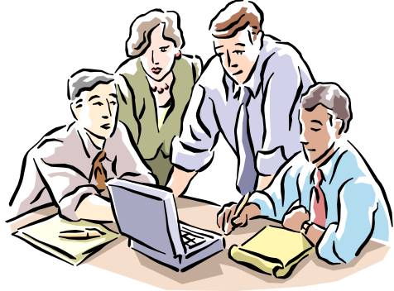

New Teacher
Deliverer of Content
Facilitator
Partner, as students generate content & construct their own knowledge
(Beldarrain, 2006)

Slide 8
Changing Environment
Information scarcity:
Memorizing of facts is important.
Controlling access to scarce resources gives power.
Teaching involves exposing students to information and info. sources.
Information abundance:
Memorizing of facts is unimportant.
Ability to locate and evaluate info. is important.
Ability to recognize patterns and make connections is important.
Education is changing from memorizing to locating and harnessing information.

Slide 9
Connectivism
Learning is no longer a personal activity performed in isolation within an information scarce environment.
Connectivism is a new educational theory that reflects this fact and the understanding that certain skills and tools will be required.
Revolution

Slide 10
Wiki/Shared Documents

Slide 11
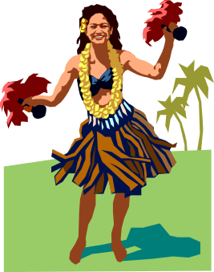
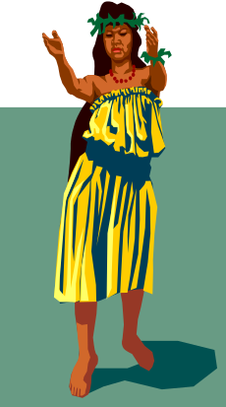
History: What Is Wiki?
Refers to a document that can be shared among several users.
Comes from the Hawaiian term, wiki wiki (meaning “quick”).
Wiki began as “quick” Web pages that readers of the Web page could edit (vs. author uploading).
Word later allowed multiple editors to be tracked.
Google Docs now allow multiple editors at the same time.
First Wiki was created in 1995.

Slide 12
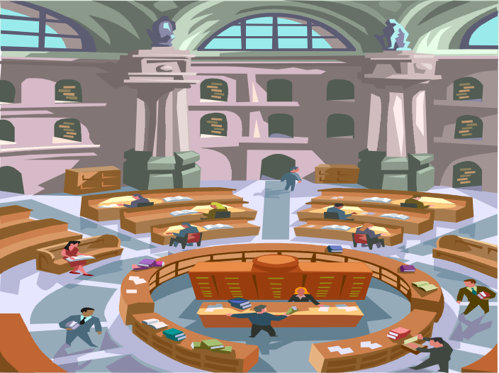
Changes in Communication and News
How many people don’t trust Wikipedia as a primary news/info. source?
Wikipedia (and the Web) is becoming the sum of all human knowledge and experience.

Slide 13
Reasons for Validity of Wikipedia
Everyone uses it.
Many editors.
Becoming a trusted source
Easy to track the editors and remove vandalism.
APA (as of version 6) recognizes the following sources: Newsgroup, online forum comment, electronic mailing list message, web log post, video file.

Slide 14

WikiMedia Foundation Products
WikiMedia Foundation offers many “sister projects” to Wikipedia:
  Commons
  WikiQuote
  WikiSpecies
  WikiNews
  WikiBooks
  Wikiversity
  Wiktionary
  WikiSource
WikiMedia Foundation Products
Notes:
http://en.wikipedia.org/wiki/Main_Page

Slide 15
Using Wiki in the Classroom
Students learn:
  Democratic process of knowledge construction.
  To negotiate meaning, relevance, wording, accuracy.
  To respect intellectual property, and the work and ideas of others.

Slide 16
Using Wiki in the Classroom
Benefits to students:
  Facilitates collaboration.
  Allows students to learn from the work of others (along with edits by the teacher).
  Enhances student motivation.
  Can provide more student control and independence in learning activity.
  Allows students to participate in a meaningful, real-life project (work could be made public).

Slide 17
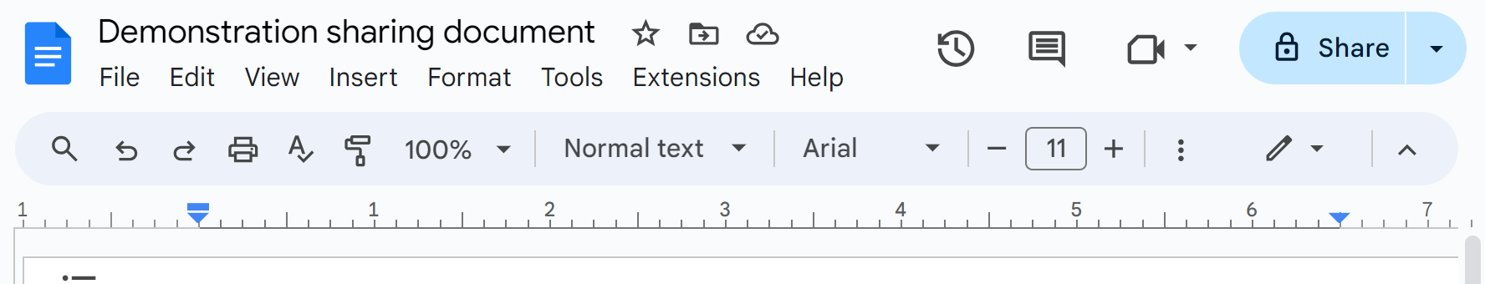
How to Share a Google Doc
Start by saving the Google Document (Google Doc, Slides, Sheets).

Slide 18
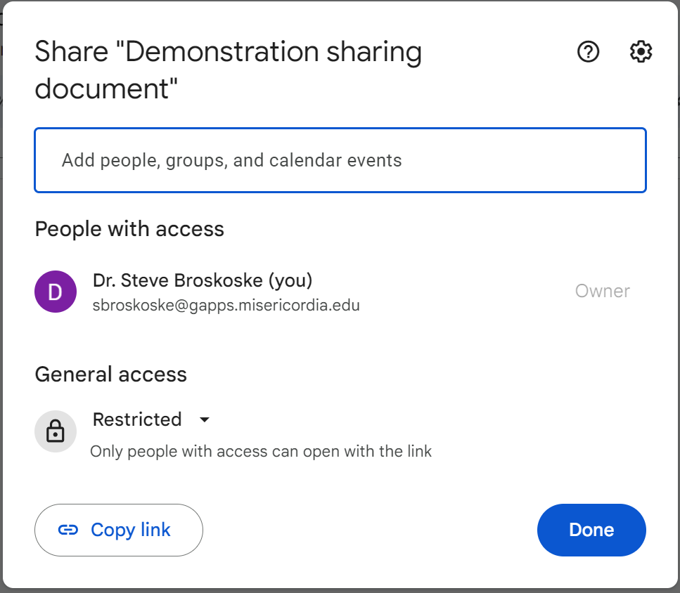
How to Share a Google Doc
Add individuals to keep document limited.
Open access wider by selecting this option.

Slide 19
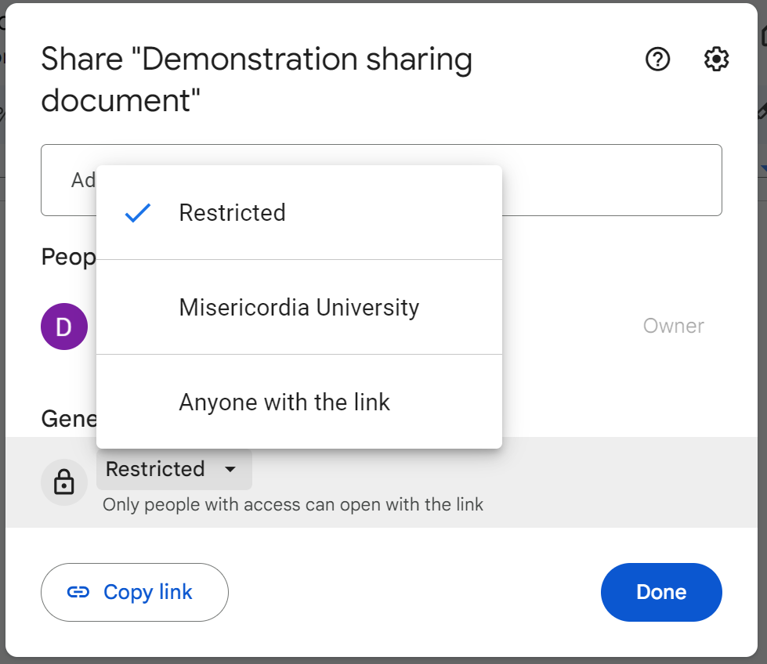
How to Share a Google Doc
Select “MU” to open to all people logged into MU.
Select “anyone with link” to allow access to anyone to whom you send the link.

Slide 20
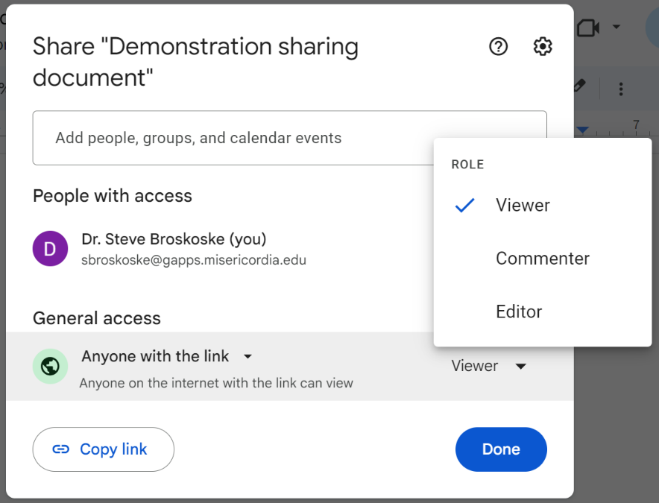
How to Share a Google Doc
Viewer means “read only.”
Commenter means make comments but no changes.
Editor means access to make changes.
Then copy and send link.

Slide 21
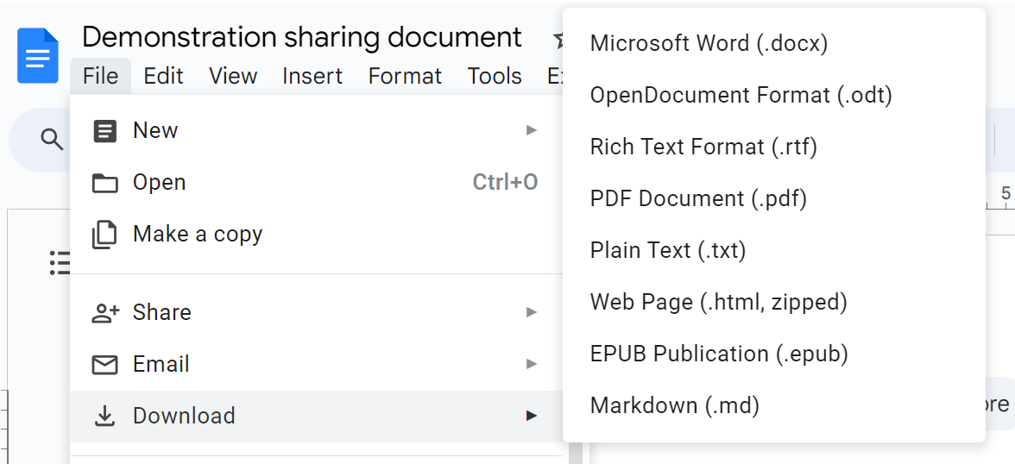
How to Share a Google Doc
To make accessible to the “world,” select download—MS Word (.docx).

Slide 22
Blog: First and Very Versatile Web 2.0 Tool

Slide 23
Blogs
blog: Shortened form of the word weblog. Blogs are Web-based journal pages which are added one at a time, with the most recent on top.
Blog posts normally allow readers (many times members) to comment on each post, opening the possibility for dialogue.

Slide 24
Ways to Use Blogs
Students can:
  Post material to show/document their progress on a project.
  Post material that they learn as they research a topic.
  Make comments about each other’s writing/work (peer reviews).
Promotes critical, analytical, and reflective thinking.

Slide 25
Ways to Use Blogs
Teachers can:
  Create an online book discussion.
  Have students reflect on progress of a project-based learning activity.
  Post examples of student work for parents.
  Build a class newsletter.
  Have students comment on news items or current issues.
(Richardson, 2009)

Slide 26
Teachers and Blogs
Writing
Assignment ends.
Monologue.
Thesis.
Written for teacher.
Blogs
Blog continues.
Conversation.
Synthesis.
Written for world.
Blogs allow a teacher to teach new writing skills, support Constructivist learning, support reflection, and support social interaction.

Slide 27
Review
Read/write Web 2.0 revolution!
Considered these technologies:
  Wiki.
  Blog.
We will be examining and experimenting with more interactive technologies that can be used in the classroom throughout the course.

